Slide 1
In the Cloud: Maps and Blogs
Kiyomi Fujii, Jim Elwood, Barron Orr
University of Arizona & Tsukuba University
Wireless 2010 Nagoya February 19, 2010
Notes:
Room E21 13:55-14:30

Slide 2
The Two Projects
(Or, What and How We Did Them)

Slide 3
Method: Participants
University JFL students in Arizona (n = 124)
University EFL students in Tsukuba (n = 36)

Slide 4
Method: Timing
Roughly one year (different academic calendars)
Data collected in Dec-Jan, 2009-2010 (at end of first term in Arizona, end of school year in Tsukuba)
Arizona: 1st-year students did map-making and making blogs (although did not progress to actual blogging)
Arizona: 3rd-years both map-making and blogging
Tsukuba: low-level 1st-years did map-making
Tsukuba: advanced 1st-years did blogging

Slide 5
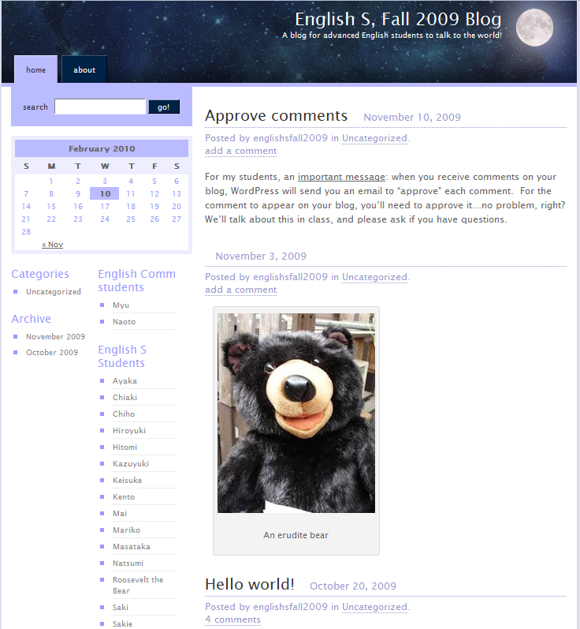
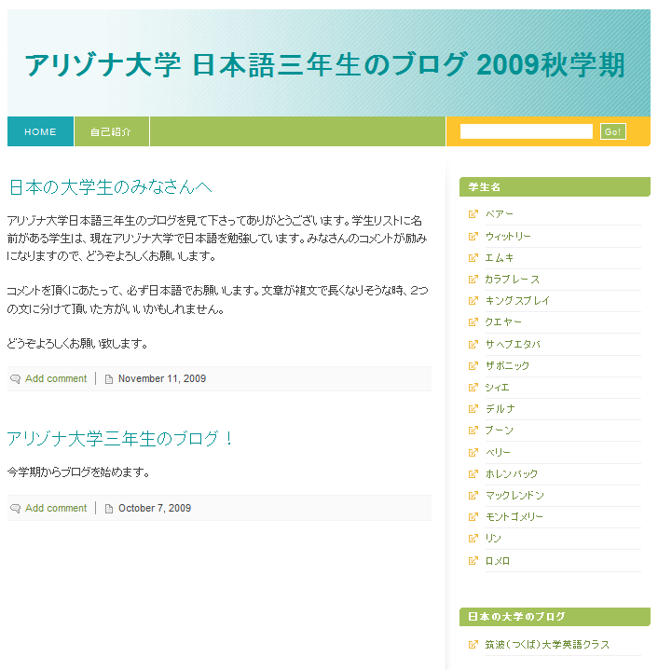
Method: Media of Communication
Simple delineation of languages
→ Japanese for Arizona-based projects
→ English for Tsukuba-based projects

Slide 6
The Map Project

Slide 7
Map-Making
Used Google Maps
Had to have “gmail” accounts
Students created a class map written in their L2 (thus, Arizona students wrote in Japanese, Tsukuba students wrote in English)
Extension of class material (forms)
Lesson(s) on word processing in Japanese

Slide 8
Map-Making
Introductions of …
University buildings, places (Arizona)
University and surrounding area (Tsukuba)
Primarily text and photos (more possibilities: videos, tours)
Notes:
Add examples here; each intro own map

Slide 9
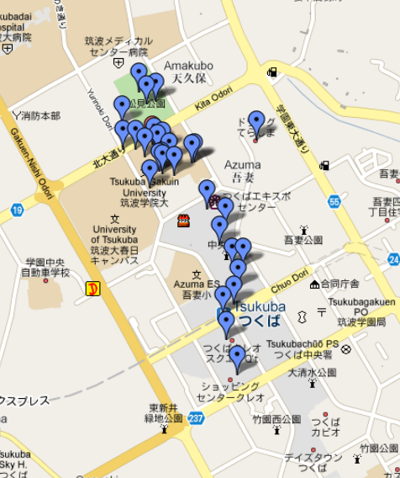
Map-Making
The Tsukuba map…
Students selected locations and added them to the map…
The pink rectangle shows the university, meaning about half the locations were outside campus.
For example…
Notes:
Add examples here; each intro own map

Slide 10
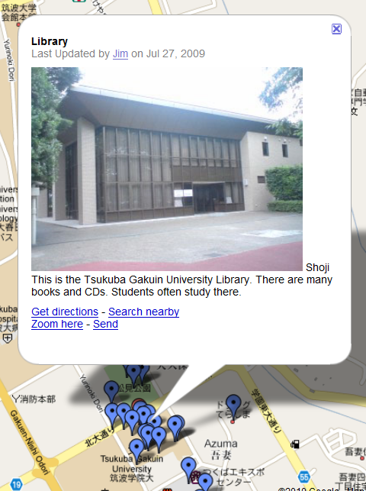
Map-Making
University things…
Notes:
Add examples here; each intro own map

Slide 11
Map-Making
Or … things outside the university (the local train station) ➔
Notes:
Add examples here; each intro own map

Slide 12
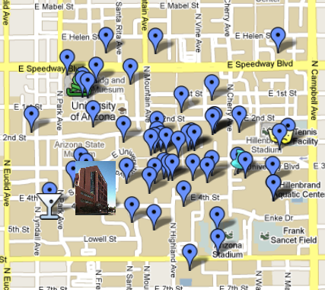
Map-Making
The Arizona map…
Students selected locations and added them to the map…
The pink circle shows one of the available icons…
Here’s what hiding there…
Notes:
Add examples here; each intro own map

Slide 13
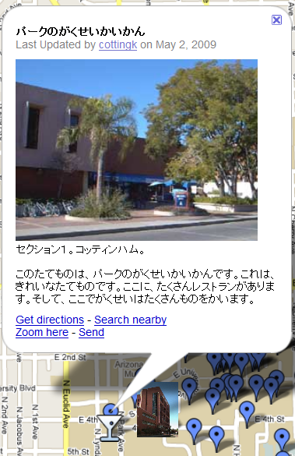
Map-Making
Wondering about that cocktail glass?
Notes:
Add examples here; each intro own map

Slide 14
Map-Making challenges…
That pesky Google account
Google Maps “confusing”, “complicated”
Typing difficult
Overlap (students choosing same thing)
Time-consuming
Notes:
Good to talk about problems (challenges) here instead of later in presentation?

Slide 15
The Blog Project

Slide 16
Blogging
Used WordPress
Can admin in English or Japanese
With guidance, students created personal blog
No correction by instructors ➔ student community

Slide 17
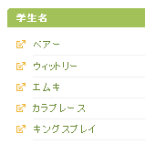
Blogging
Used WordPress
Can admin in English or Japanese
With guidance, students created personal blog
Linked to class blog home

Slide 18
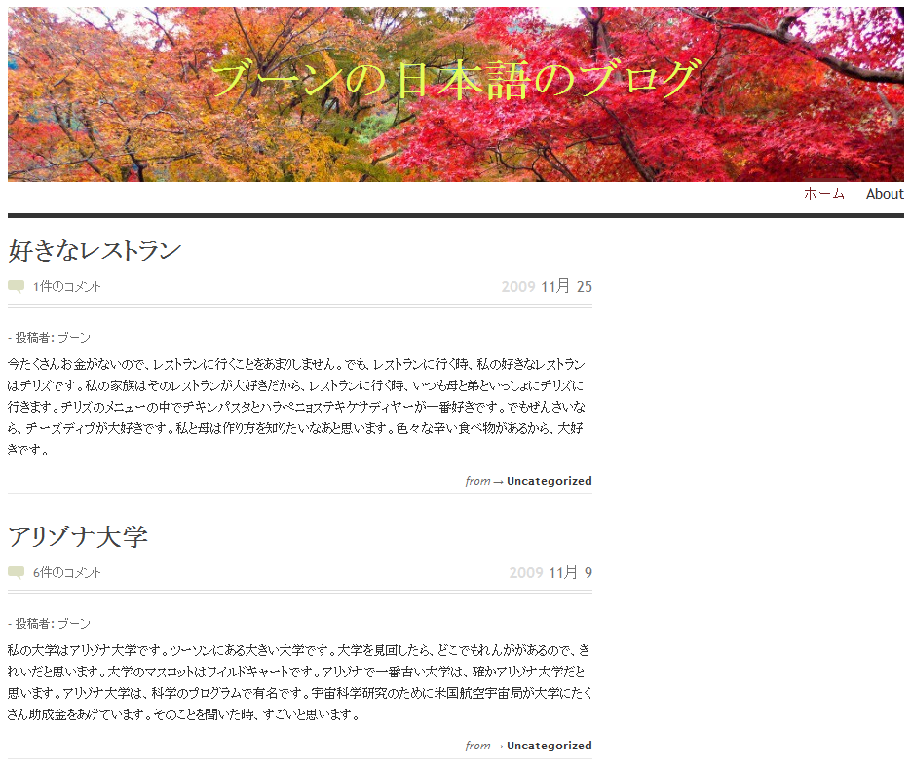
Blogging (Arizona)
For example, let’s look at Boone’s blog (in Arizona)…
In this screenshot, we see two topics…
My favorite restaurant
the University of Arizona

Slide 19
Blogging (Arizona)
Boone’s original post…
Comment from Sakie in Japan…
Boone’s reply to Sakie…
Comment from Mai in Japan
All in Japanese…

Slide 20
Blogging (sample of Tsukuba blog here?)
Used WordPress
Extension of class material (forms)
Tsukuba: Blog on self-selected research topic & anything else
Encouraged to comment on blogs on other side of Pacific

Slide 21
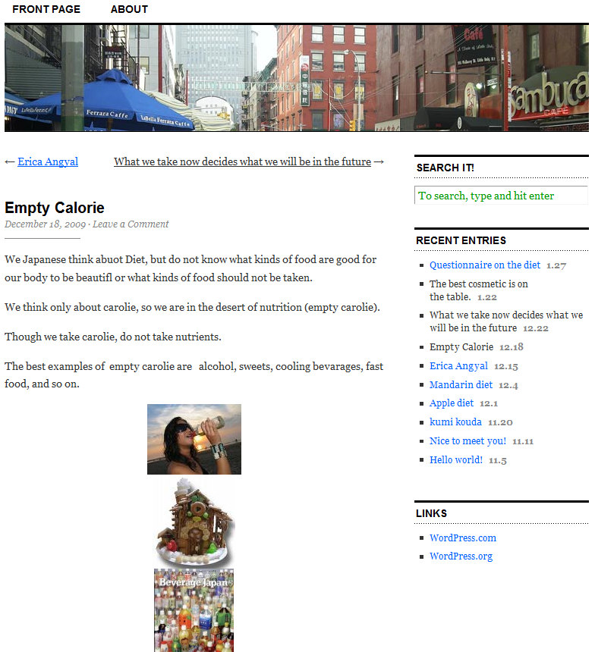
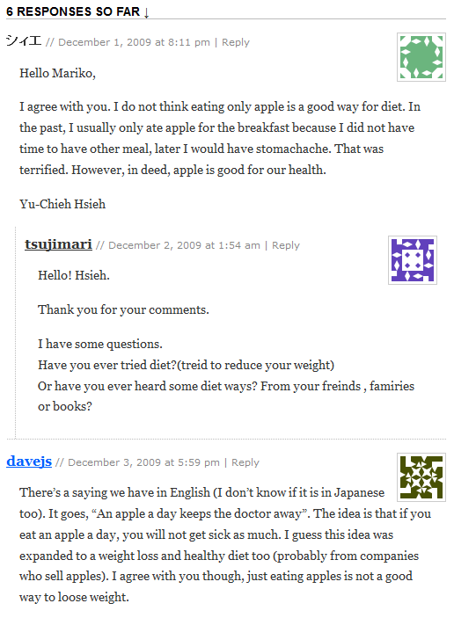
Blogging (Tsukuba)
Research project on healthy eating, diets
Total of 10 posts
Responses in English

Slide 22
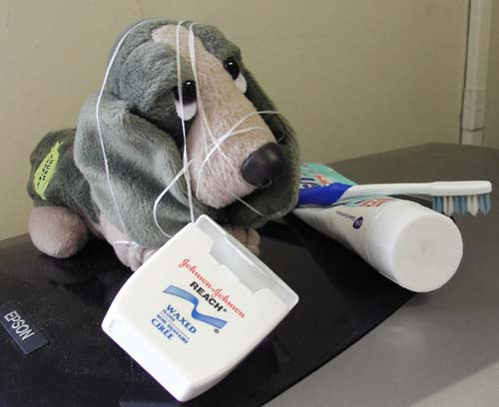
We’d be happy to entertain any questions at this time!
(sorry if we’ve tied you in knots)

Slide 23
References Cited
Benjamini, A., & Hochberg, A. (1995). Controlling the false discovery rate: A practical and powerful approach to multiple testing. Journal of the Royal Statistical Society. Series B (Methodological), 57, (1), 289-300.
Conner, M. L. (1997-2009). Introducing informal learning. Retrieved December 1, 2009, from http://marciaconner.com/intros/ informal.html#research
Falk, J. H., & Dierking, L. D. (2002). Lessons without limit: How free-choice learning is transforming education. Walnut Creek, CA: AltaMira Press).
Lafford, B. A. (2009). Toward an ecological CALL: Update to Garrett (1991). The Modern Language Journal, 93, Focus Issue, 673-696.
Levy, M. (2009). Technologies in use for second language learning. The Modern Language Journal, 93, Focus Issue, 769-782.
MacLean, G. R., & Elwood, J. A. (2009). Digital natives, learner perceptions and the use of ICT. In M. Thomas (Ed.), Handbook of research on Web 2.0 and second language learning (pp. 156-179). Hershey, PA: IGI.

