Slide 1
In the Cloud:
Maps and Blogs
Kiyomi Fujii, Jim Elwood, Barron Orr
University of Arizona & Tsukuba University
Wireless 2010 Nagoya February 19, 2010
Notes:
Room E21 13:55-14:30

Slide 2
The Reaction(s):
Student Perceptions
The Results (or, What Everyone Said About Them)

Slide 3
We asked about…
Impressions of map-making and of blogging
Suggestions for improvement

Slide 4
Method
Instrument
Questionnaire
4 Likert-scale items with 5-point semantic-differentiation scale anchored by “strongly disagree” (1) and “strongly agree” (5); neutral midpoint = 3
4 open-ended questions for each activity

Slide 5
Data Analysis
Descriptive statistics
T-tests for group differences with FDR correction (Benjamini & Hochberg, 1995)
Qualitative data

Slide 6
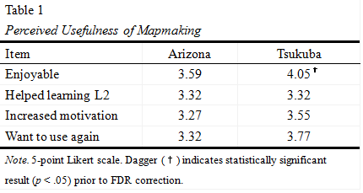
Quantitative Results for mapmaking
All positive results
Minor differences by context, no stat-sig differences (although close)
Fairly strong support for enjoyable (perhaps different)
Modest endorsement for helping L2, motivation
Larger sample size might yield statistical significance

Slide 7
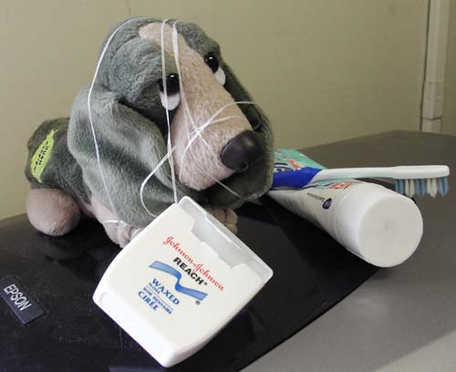
We’d be happy to entertain any questions at this time!
(sorry if we’ve tied you in knots)

Slide 8
References Cited
Benjamini, A., & Hochberg, A. (1995). Controlling the false discovery rate: A practical and powerful approach to multiple testing. Journal of the Royal Statistical Society. Series B (Methodological), 57, (1), 289-300.
Conner, M. L. (1997-2009). Introducing informal learning. Retrieved December 1, 2009, from http://marciaconner.com/intros/ informal.html#research
Falk, J. H., & Dierking, L. D. (2002). Lessons without limit: How free-choice learning is transforming education. Walnut Creek, CA: AltaMira Press).
Lafford, B. A. (2009). Toward an ecological CALL: Update to Garrett (1991). The Modern Language Journal, 93, Focus Issue, 673-696.
Levy, M. (2009). Technologies in use for second language learning. The Modern Language Journal, 93, Focus Issue, 769-782.
MacLean, G. R., & Elwood, J. A. (2009). Digital natives, learner perceptions and the use of ICT. In M. Thomas (Ed.), Handbook of research on Web 2.0 and second language learning (pp. 156-179). Hershey, PA: IGI.

