Slide 1
The Nuts and Bolts of Willingness to Use Technology
James A. Elwood & George R. MacLean
JALT-CALL, Kyōto Sangyō University
May 30, 2010
Notes:
Room 10405, 10:20 to 11:00

Slide 2
What is WUT?
The WUT instrument is a series of questions asking about preference for using tech or using non-tech means for 11 tasks. Those 11 tasks are:
Notes:
Here add pics of USB, e-mail, and paper copy

Slide 3
What is WUT?
Writing a memo
Taking a test
Writing a 5-page report
Contacting one’s teacher
Doing a budget
Viewing reference material
Notes:
Here add pics of USB, e-mail, and paper copy

Slide 4
What is WUT?
Getting class info
Doing a presentation
Dividing a restaurant check
Exchanging mail
Chatting (F2F vs. Internet chat)
Notes:
Here add pics of USB, e-mail, and paper copy

Slide 5
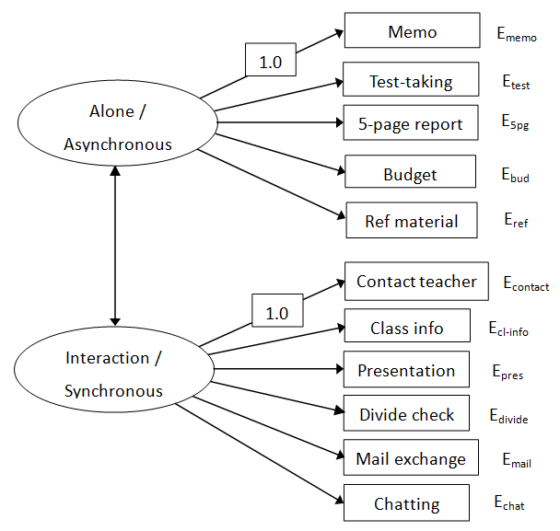
3. SEM Confirmatory Factor Analysis
Notes:
Here add pics of USB, e-mail, and paper copy

Slide 6
3. SEM Confirmatory Factor Analysis
Notice the error terms…
Mainly interested
in paths (arrows)
Notes:
Here add pics of USB, e-mail, and paper copy

Slide 7
3. SEM Confirmatory Factor Analysis
Notes:
Here add pics of USB, e-mail, and paper copy

Slide 8
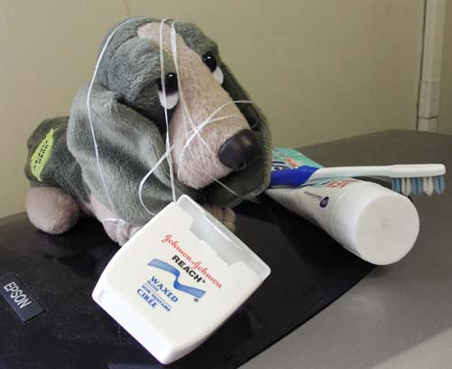
We’d be happy to entertain any questions at this time!
(sorry if we’ve tied you in knots)

Slide 9
3. SEM Confirmatory Factor Analysis
Notes:
Here add pics of USB, e-mail, and paper copy

