Slide 1
The Nuts and Bolts of Willingness to Use Technology
James A. Elwood & George R. MacLean
JALT-CALL, Kyōto Sangyō University
May 30, 2010
Notes:
Room 10405, 10:20 to 11:00

Slide 2
What is WUT?

Slide 3
What is WUT?
A recent example … last week I collected writing homework from 81 students. The homework could be
handwritten or done on a computer (class is in a computer classroom), and
handed in in any of four different ways…
Notes:
Here add pics of USB, e-mail, and paper copy

Slide 4
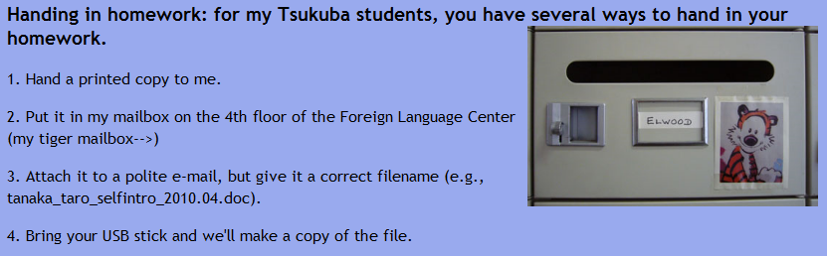
What is WUT?
The four options:
Notes:
Here add pics of USB, e-mail, and paper copy

Slide 5
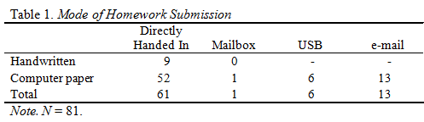
What is WUT?
What did my victims hand in?
Paper = 76.5%, tech = 23.5%
Notes:
Here add pics of USB, e-mail, and paper copy

Slide 6
What is WUT?
What did my victims hand in?
Paper = 76.5%, tech = 23.5%
Notes:
Here add pics of USB, e-mail, and paper copy

Slide 7
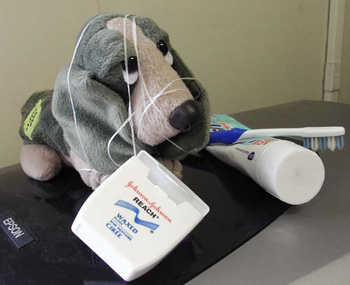
We’d be happy to entertain any questions at this time!
(sorry if we’ve tied you in knots)

