Slide 1
Formulating Your Research: Part I
Barron J. Orr, PhD
University of Arizona
March 22, 2014
For: Dissertation Writing and Research Series
National Graduate Institute for Policy Studies (GRIPS) Tokyo, Japan

Slide 2
Barron J. Orr Professor and Geospatial Extension Specialist Office of Arid Lands Studies School of Natural Resources and the Environment University of Arizona

Slide 3
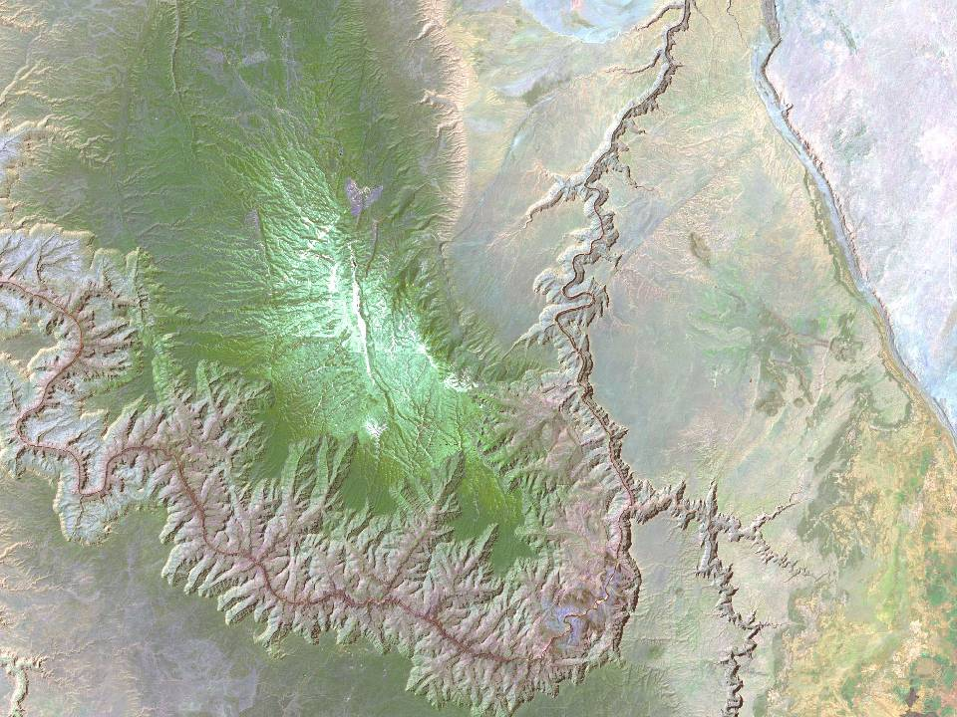
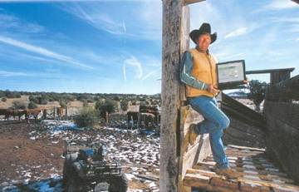
The Geospatial Extension Program in Arizona
Bringing people and geospatial technology together

Slide 4
A Convergence of User Needs and Agency Missions
Notes:
A Convergence of Missions and Needs
-NASA Office of Earth Science has sought informal education in the availability and use of “Earth Observing System” products (satellite images, computerized mapping, global positioning system).
-NASA Space Grant provides access to a network of researchers, educators, and commercial firms.
-The Land Grant system provides an unmatched network of contacts and informal education with the public.
-Sea Grant, a more recent partner, provides marine resource expertise.
---Working together, these agencies can optimize technology transfer---

Slide 5
Land Grant Universities
Land-grant universities (also called land-grant colleges or land grant institutions) are institutions of higher education in the United States which have been designated by Congress to receive the benefits of the Morrill Acts of 1862 and 1890.
http://www.aplu.org/
The strength of Land Grant institutions is that they have three (instead of the traditional two) missions: instruction, research and extension. They are loosely tied through the Association of Public and Land-Grant University (now APLU, previously NASULGC), a voluntary, non-profit association of public universities, the nation's land-grant institutions and many state university systems.

Slide 6
Historic Context: The “Land Grant” Mission
1862 – The Morrill Act
The U.S. Congress established a system of universities (at least on in each state for educating the public in “agriculture and the mechanic arts” (Land Grant Universities).
1897 – The Hatch Act
The U.S. Congress added an explicit research function (Agricultural Experiment Station).
1914 – The Smith-Lever Act
The U.S. Congress created a mechanism by which “practical applications of research knowledge” might be made by “persons not attending or resident in said colleges” (Cooperative Extension).

Slide 7
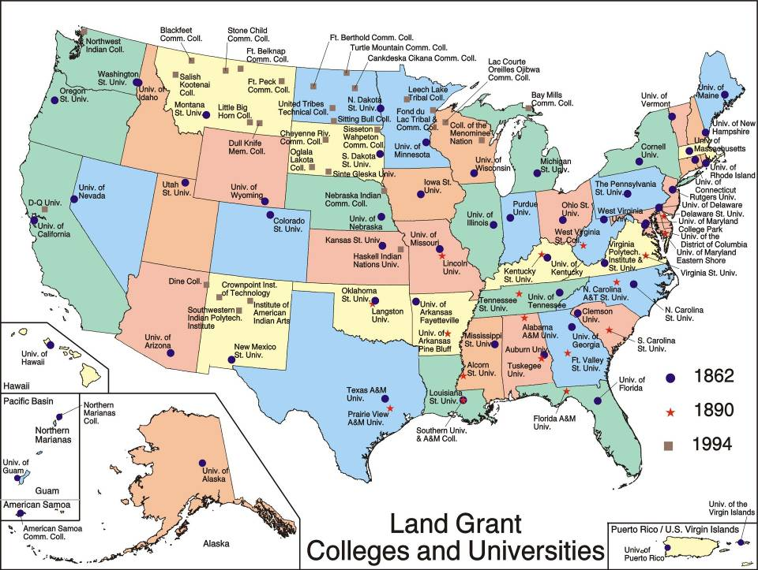
Land Grant Network

Slide 8
The Applied Science program benchmarks practical uses of NASA-sponsored observations from Earth observation systems and predictions from Earth science models. NASA implements projects that carry forth this mission through partnerships with public, private, and academic organizations. These partnerships focus on innovative approaches for using Earth-Sun system science information to provide decision support that can be adapted in applications worldwide.
Notes:
The Applied Science program benchmarks practical uses of NASA-sponsored observations from Earth observation systems and predictions from Earth science models. NASA implements projects that carry forth this mission through partnerships with public, private, and academic organizations. These partnerships focus on innovative approaches for using Earth-Sun system science information to provide decision support that can be adapted in applications worldwide

Slide 9
NASA Space Grant Mission
… to expand opportunities for Americans to learn about and participate in NASA's aeronautics and space programs by supporting and enhancing science, and engineering education, research, and outreach programs. These programs integrate research with education to help build a diverse, scientifically literate citizenry and a well-prepared science, engineering and technology workforce.

Slide 10
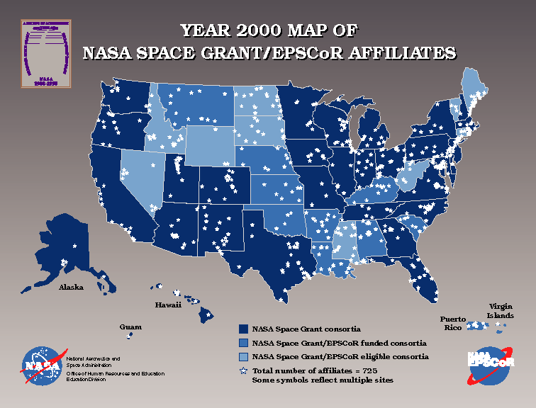
Space Grant Network

Slide 11
Formulating Your Research (Part 1)
Research Design: Structure and Flow
Beware of the “Literature Review”
Problem Statement
Qualitative vs. Quantitative Research
Purpose Statement
Research Question(s)
Research Design Logic: Graphic Models & Tools
Creating an Information Plan

Slide 12
First things first …

Slide 13
Research Formulation Steps/Methods
Where does the problem origination or discovery begin?
Previous experience
Triggered interest
Potential problem fields
Criteria of problems and problem statement
Goals and planning
Search, explore and gather evidence
Generate creative and alternative solutions
Notes:
Source: http://www.public.asu.edu/~kroel/www500/hypothesis.pdf

Slide 14
Research structure helps create research that is:
Notes:
http://www.public.asu.edu/~kroel/www500/hypothesis.pdf
The research structure helps us create research that is :
Quantifiable Verifiable Replicable Defensible
Corollaries among the model, common sense & paper formatModelCommon SensePaper FormatResearch QuestionWhyIntroDevelop a TheoryYour Answer IntroIdentify Variables (if applicable)HowMethodIdentify hypothesesExpectations MethodTest the hypothesesCollect/Analyze data ResultsEvaluate the ResultsWhat it MeansConclusionCritical ReviewWhat it doesn’t MeanConclusion

Slide 15
The hourglass notion of research
BEGIN WITH BROAD QUESTIONS
NARROW DOWN, FOCUS IN
OPERATIONALIZE
OBSERVE
ANALYZE DATA
REACH CONCLUSIONS
GENERALIZE BACK TO QUESTIONS
Notes:
http://www.public.asu.edu/~kroel/www500/hypothesis.pdf

Slide 16
Should the problem be researched?
Will your study fill a gap or void in the existing literature?
Will your study replicate a past study but examine different participants and different research sites?
Will your study extend past research or examine the topic more thoroughly?
Will your study give voice to people not heard, silenced, or rejected in society?
Will your study inform practice?
Notes:
Source: http://www.fischlerschool.nova.edu/Resources/uploads/app/35/files/ARC_Doc/from_problem_statement_to_research_questions.pdf

Slide 17
Should the problem be researched?
This is an iterative process between you (your interests and goals), science (will it advance knowledge), and practicalities (time, resources, skills, access to data/sites etc.).
Start with your ideas!
Check the literature (e.g. Web of Knowledge)
Refine your ideas accordingly
Do it again.
And again.
And Again!
Notes:
Primary source: http://www.ehow.com/how_5946958_formulate-problem-statement.html

Slide 18
Beware of the “Literature Review”

Slide 19
Why beware?
Student 1: “What are you working on?”
Student 2: “Reading.”
Student 1: “What are you reading?”
Student 2: “Everything.”
Student 1: “Why?”
Student 2: “Because my advisor told me I need to in order to write my literature review.”
What is the moral to this story?
When designing your research, ALWAYS read with a specific goal in mind!

Slide 20
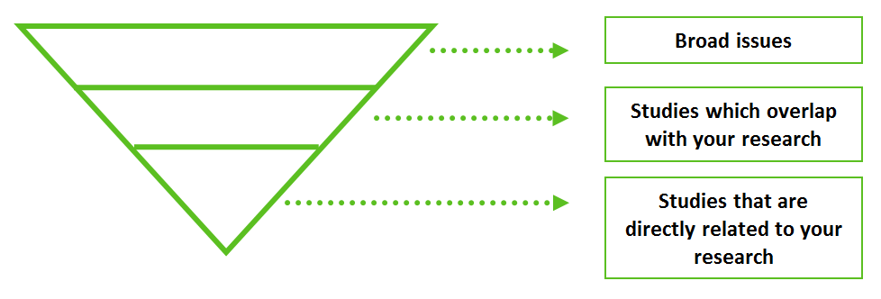
When reviewing the literature…
Use an index of scholarly literature (before any other tools)
Keep track of your searches in an Excel file
Iterate between more general terms and very specific terms
Keep in mind how you will eventually actually write your Introduction (where the Literature Review belongs).
Start out with the big issues and then become more specific.
Concept Mapping (introduced later) can be very useful here.

Slide 21
Scholarly Literature Search Engines
Start with an aggregate tool (covering many disciplines)
Free
Google Scholar (http://scholar.google.co.jp/)
CiteSeerX (http://citeseerx.ist.psu.edu/)
getCITED (http://www.getcited.org/)
Subscription (generally by institutions)
Web of Science (http://wokinfo.com/)
Scopus (http://www.scopus.com/)
Next, refine using discipline-specific academic databases/search engines
Wikipedia list: http://en.wikipedia.org/wiki/Academic_databases_and_search_engines
Notes:
http://en.wikipedia.org/wiki/Academic_databases_and_search_engines

Slide 22
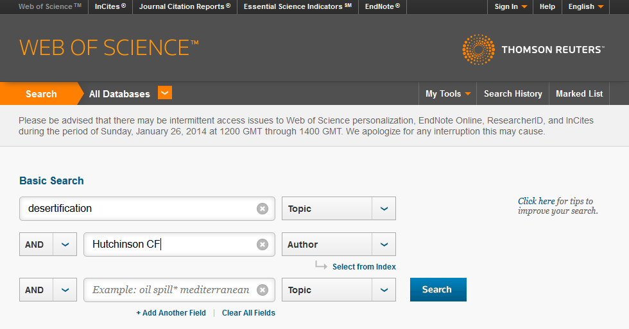
Web of Knowledge Example (now also called “Web of Science – All Databases”)
At the University of Arizona library, you can find this under “Articles and Databases”
http://www.library.arizona.edu/search/articles/index.php

Slide 23
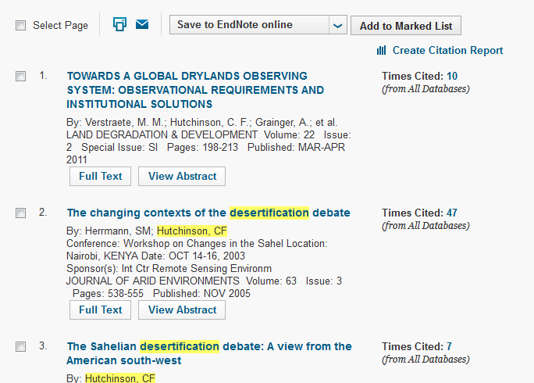
Web of Knowledge

Slide 24
Why an “overall” engine first?
These are focused on a broad array of peer-reviewed literature
These are comprehensive on most topics
These often permit going “backwards” (who the authors cited) and “forwards” (who has cited them)
This makes it easier to find “seminal” papers (key “nodes” in each sub-topic necessary to build up to your research)
These can include direct links to an inititution’s library subscriptions, making it easier to obtain the .pdf of important articles
These are often linked to automatic referenceing/citation tools such as EndNote, which can help manage citations

Slide 25
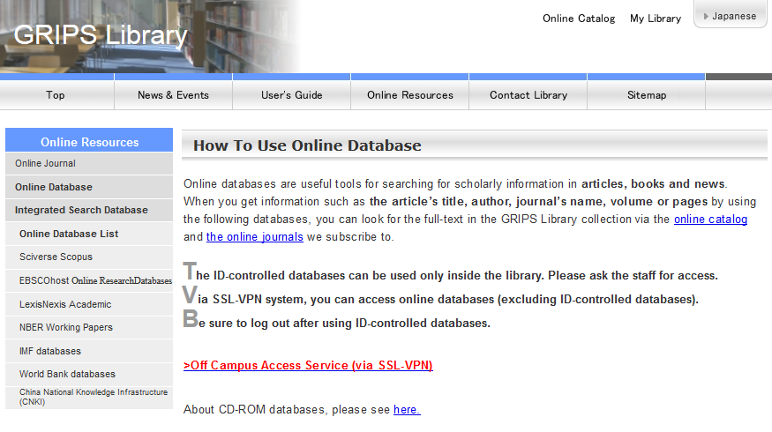
After, consider the many other valuable databases your library provides access to
http://www.grips.ac.jp/main/lib/onlyinside/database.html

Slide 26
GRIPS subscribes to many…
SciVerse Scopus
EBSCOhost Online Research Databases
EconLit, the American Economic Association's electronic database
EBSCO Academic Search Premier
LexisNexis Academic
NBER Working Papers (National Bureau of Economic Research papers)
IMF databases
International Financial Statistics (IFS)
Balance of Payments (BOPS)
Direction of Trade statistics (DOTS)
Government Finance Statistics (GFS)
World Bank databases World Development Indicators (WDI)
Global Development Finance (GDF)
China National Knowledge Infrastructure (CNKI)
http://www.grips.ac.jp/main/lib/onlyinside/database.html

Slide 27
Problem Statement
A research problem statement is a clear, concise description of what a particular body of research (context) the study intends to focus on.
It is not necessarily a “problem” in the normal sense of the word, but rather an unknown worth investigating.
The problem statement is used to limit the scope of the problem.
Well constructed problem statements will convince the target audience that the problem is real, important (significant), and interesting (compelling) enough to be investigated.
Useful problem statements have point to research that has the potential to advance knowledge and, when applied, contribute to practice.
Notes:
Primary source: http://www.ehow.com/how_5946958_formulate-problem-statement.html

Slide 28
Standards of Adequacy for a General Research Problem
Does the statement of the general research problem imply the possibility of empirical investigation?
Does the problem statement restrict the scope of the study?
Does the problem statement give the educational/academic/research context in which the problem lies?
Notes:
Source: http://www.upei.ca/~xliu/ed611/day3.htm

Slide 29
Is the significance of the problem discussed in terms of one or more of the following criteria?
Develops knowledge of an enduring practice;
Develops theory;
Generalizable--that is, expands knowledge or theory;
Provides extension of understandings;
Advances methodology;
Is related to a current social or political issue;
Evaluates a specific practice at a given site;
Is exploratory research.
Notes:
Source: http://www.upei.ca/~xliu/ed611/day3.htm

Slide 30
Locating the Problem Statement
Read the opening paragraphs of existing studies for one or more of the following:
What is the issue or problem?
What controversy/unknown leads to the need for study?
What concern is being addressed behind the study?
Is there a sentence such as, “The problem being addressed in this study is…”?
Notes:
Source: http://www.fischlerschool.nova.edu/Resources/uploads/app/35/files/ARC_Doc/from_problem_statement_to_research_questions.pdf

Slide 31
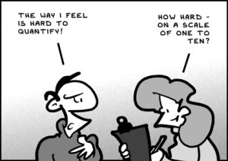
Quantitative and Qualitative Approaches

Slide 32
Quantitative Approaches
Quantitative approaches aim to test hypotheses, and usually to identify numerical differences between groups (i.e., quantities). The focus is on measurement, hypothesis-testing, explanation, and prediction. The goal (or claim) is objectivity.

Slide 33
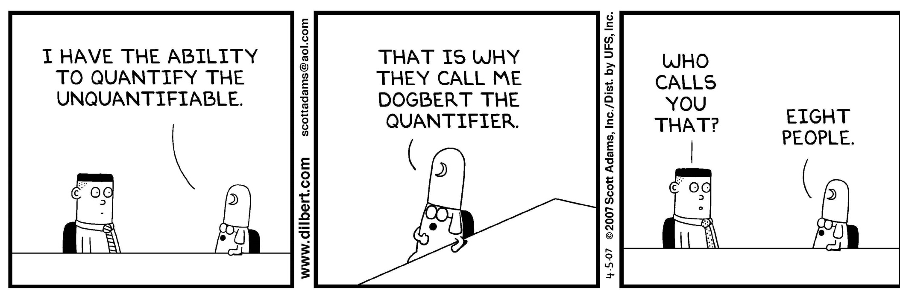
In quantitative research, sample size matters!

Slide 34
Qualitative Approaches
Qualitative approaches deal with how people understand their experiences (i.e., qualities). The focus is on exploration, pattern definition, obtaining meaning, achieving understanding, and being able to interpret. Qualitative research admits and accepts subjectivity.

Slide 35
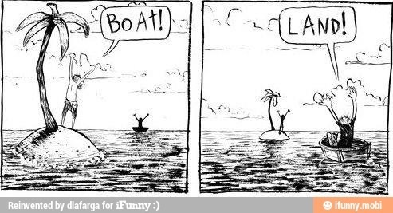
In qualitative research, perspective matters!

Slide 36
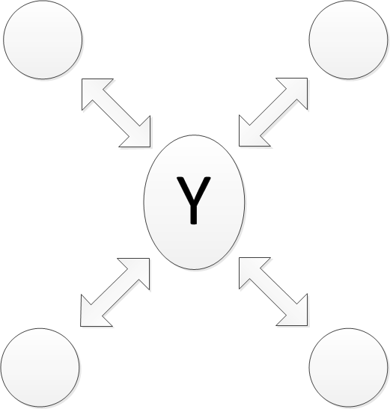
Quantitative: Explaining or predicting variables
Qualitative: Understanding or exploring a central phenomenon
The independent variable (X) influences a dependent variable (Y)
In-depth understanding of Y; external forces shape and are shaped by Y
Notes:
Primary source: http://www.fischlerschool.nova.edu/Resources/uploads/app/35/files/ARC_Doc/from_problem_statement_to_research_questions.pdf

Slide 37
Logic of Quantitative Problems
Quantitative research problems are formulated through a deductive logic, that is starting with a general construct or theory, then identifying some operational variables to quantify the general construct or theory, and finally deciding on which variables to be observed.
Review of the construct;
Identification of variables;
Operational definitions of variables.
Notes:
http://www.upei.ca/~xliu/ed611/day3.htm

Slide 38
Logic of Qualitative Problems
Qualitative research employs primarily inductive reasoning .
The research problem is stated initially in planning for the study, reformulated just before data collection begins, and reformulated as necessary throughout data collection.
The continuing reformulation of the research problem reflects an emergent design.
The specific research problem emerges and is condensed toward the end of data collection.
Notes:
http://www.upei.ca/~xliu/ed611/day3.htm

Slide 39
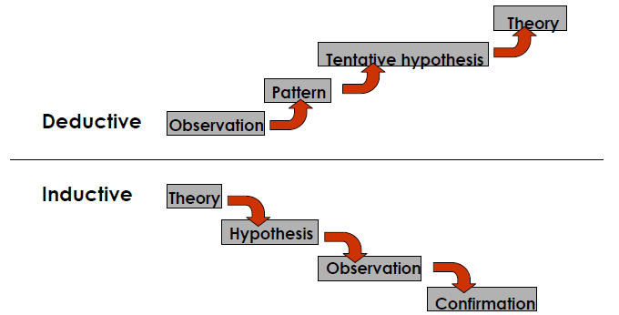
Quantitative
Quantitative research involves deductive reasoning, a top-down approach that works from the general to the specific. It considers a potential cause of something and hopes to verify its effect.
vs.
Qualitative research involves Inductive reasoning , a bottom-up approach that moves from the specific to the general. The process is iterative, and as patterns emerge, new questions or concepts may also.
Qualitative

Slide 40
More detail on the differences…
10-Creswell JD. (2009) Research Design: Qualitative, Quantitative, and Mixed Methods Approaches. Sage, p.4
11-Creswell JD. (2009) Research Design: Qualitative, Quantitative, and Mixed Methods Approaches. Sage, p.4
12-Abbas T. and Creswell JW. (2007) Editorial: The New Era of Mixed Methods. Journal of Mixed Methods Research, 1,1: 3-7.
Table is taken from: UK National Health Service (NHS) Information Pack for Health & Social Care Researchers
http://www.rds-sc.nihr.ac.uk/public-patient-involvement/information-for-researchers/

Slide 41
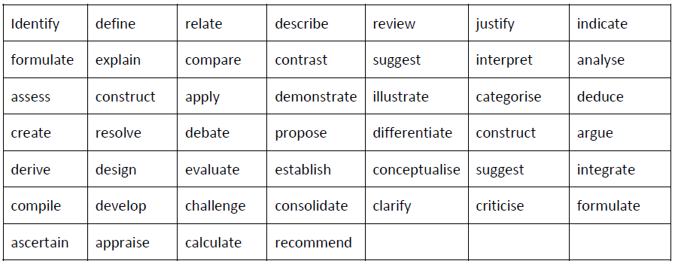
Quantitative Purpose Statement
A quantitative purpose statement identifies the variables, and their relationships…
It begins something like “The purpose of this study…followed by an outcome-based verb like that can help describe the relationship between the variables:
Notes:
Sources: http://www.wbs.ac.za/download_files/research/research_problem_statement.pdf
http://www.fischlerschool.nova.edu/Resources/uploads/app/35/files/ARC_Doc/from_problem_statement_to_research_questions.pdf

Slide 42
Quantitative Purpose Statement (cont.):
A quantitative purpose statement identifies the variables, and their relationships, the site for research, and when appropriate, the theory to be tested.
Independent variable (1st position in sentence)
Dependent variable (2nd position in sentence)
Control and/or mediating variable (3rd position in sentence)
Research site
Participants
Notes:
Sources: http://www.wbs.ac.za/download_files/research/research_problem_statement.pdf
http://www.fischlerschool.nova.edu/Resources/uploads/app/35/files/ARC_Doc/from_problem_statement_to_research_questions.pdf

Slide 43
Qualitative Purpose Statement
A single sentence
A statement such as,
“The purpose of this study . . . ”
The central phenomenon
A statement identifying the type of qualitative design
Qualitative words (e.g., “explore,” “understand,” “discover”)
The participants
The research site

Slide 44
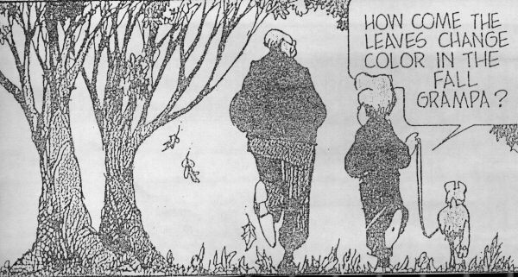
Research Questions
A research question is a clear, focused, concise, complex and arguable question around which you center your research.
It focuses the study by providing a path through the research and writing process.

Slide 45
Research questions…
Research questions are those that the researcher would like answered or addressed in the study.
Research questions must identify
The variables under study
The population being studied
The testability of the question
Research questions must be
Specific
Limited by time
Limited by space

Slide 46
Quantitative Research Questions
Types of quantitative research questions
Describe results of your variables.
Compare two or more groups on the independent variable in terms of the dependent variable.
Relate two or more variables.
Quantitative research questions are more closed:
Probable cause/effect
Why did it happen?
Use of theories
Why did it happen in view of an explanation or theory?
Assess differences and magnitude
How much happened?
How many times did it happen?
What were the differences among groups in what happened?
Notes:
Source: http://www.fischlerschool.nova.edu/Resources/uploads/app/35/files/ARC_Doc/from_problem_statement_to_research_questions.pdf

Slide 47
Guidelines for Writing Quantitative Research Questions
Pose a question.
Begin with “how,” “what,” or “why.”
Specify the independent, dependent, and mediating or control variables.
Use the words describe, compare,or relate to indicate the action or connection among the variables.
Indicate the participants and the research site for the study.
Notes:
Source: http://www.fischlerschool.nova.edu/Resources/uploads/app/35/files/ARC_Doc/from_problem_statement_to_research_questions.pdf

Slide 48
Qualitative Research Questions
Qualitative research questions are more open
Descriptive
What happened?
Interpretive
What was the meaning to people of what happened?
Process oriented
What happened over time?

Slide 49
Types of Qualitative Research Questions
The central question is the overarching question to be explored in the research study.
Subquestions divide the central question into smaller, specific questions.
Issue sub-questions: Narrow the focus of the central question into specific issues.
Procedural sub-questions: Indicate the steps to be used in analyzing the data in a qualitative study.
Interview questions are asked during a physical interview and are based on the sub-questions and central question.
Notes:
Source: http://www.fischlerschool.nova.edu/Resources/uploads/app/35/files/ARC_Doc/from_problem_statement_to_research_questions.pdf

Slide 50
Examples
Does client-centered therapy produce more satisfaction in clients than traditional therapy? (experimental design)
Does behavior modification reduce aggression in autistic children? (single-subject experimental design)
Are the descriptions of people in social studies discussions biased? (grounded theory design)
What goes on in an elementary school classroom during an average week? (ethnographic design)
Do teachers behave differently toward students of different genders? (causal-comparative design)
How do parents feel about the school counseling program? (survey design)
How can a principal improve faculty morale? (interview design)

Slide 51
Differences among the research topic, problem, purpose and question
General
Topic
Distance learning
Lack of students in distance classes
To study why students do not attend distance education classes at a community college
Does the use of Website technology in the classroom deter students from enrolling in a distance education class?
Research Problem
Purpose Statement
Specific
Research Question

Slide 52
Will logic make a difference?
Some Useful Tools
Concept Mapping
Logic Model
Information Plan

Slide 53
Concept Mapping
Concept mapping is a general method that can be used to help any individual or group to describe their ideas about some topic in a pictorial form.
Concept mapping is a type of structured conceptualization which can be used by groups to develop a conceptual framework which can guide evaluation or planning.
Concept maps are graphical tools for organizing and representing knowledge.
Useful source: http://www.socialresearchmethods.net/mapping/mapping.htm

Slide 54
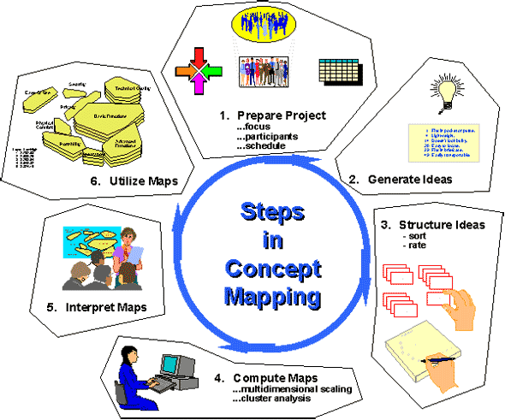
Concept Mapping
Concept Mapping from the Trochim, W. (1999). The Research Methods Knowledge Base.
http://www.socialresearchmethods.net/kb/conmap.htm

Slide 55
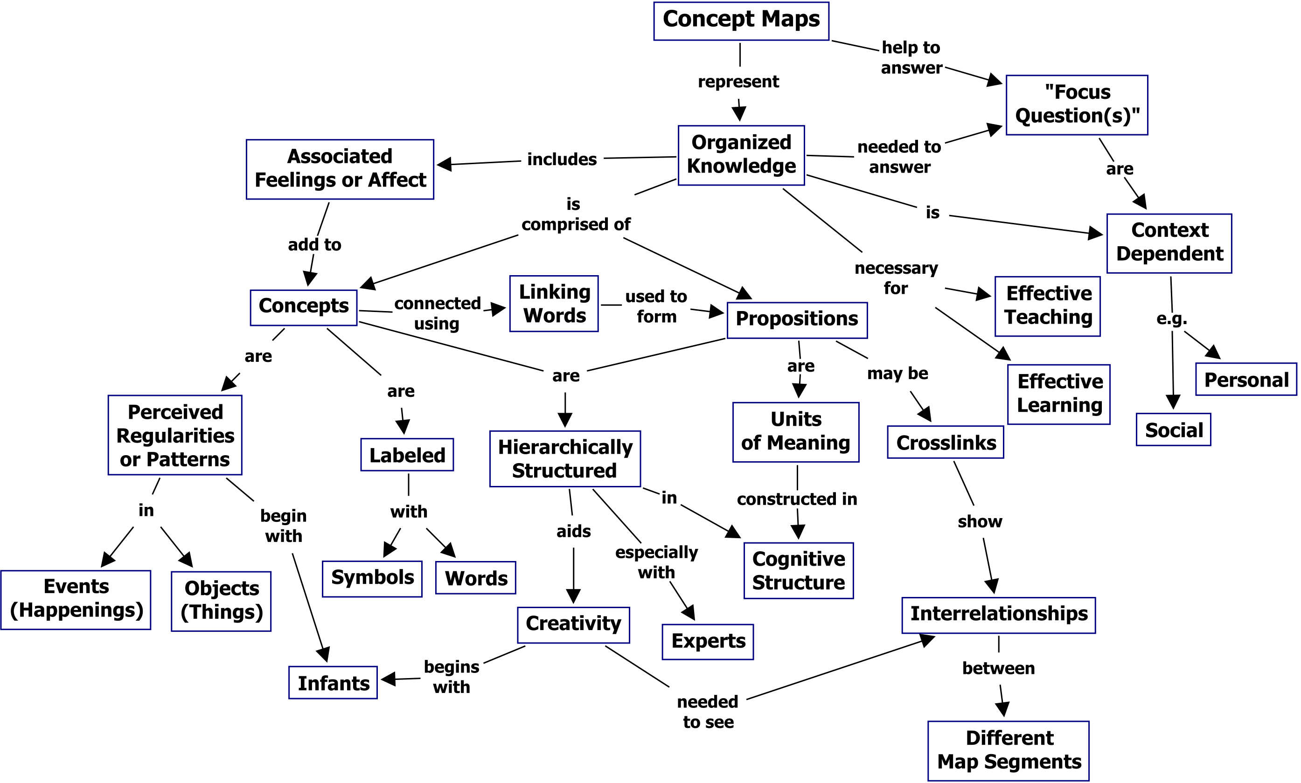
A concept map showing the key features of concept maps
Novak, J. D. & A. J. Cañas, The Theory Underlying Concept Maps and How to Construct Them, Technical Report IHMC CmapTools 2006-01 Rev 01-2008, Florida Institute for Human and Machine Cognition, 2008", available at: http://cmap.ihmc.us/Publications/ResearchPapers/TheoryUnderlyingConceptMaps.pdf.
Notes:
Novak, J. D. & A. J. Cañas, The Theory Underlying Concept Maps and How to Construct Them, Technical Report IHMC CmapTools 2006-01 Rev 01-2008, Florida Institute for Human and Machine Cognition, 2008", available at: http://cmap.ihmc.us/Publications/ResearchPapers/TheoryUnderlyingConceptMaps.pdf.

Slide 56
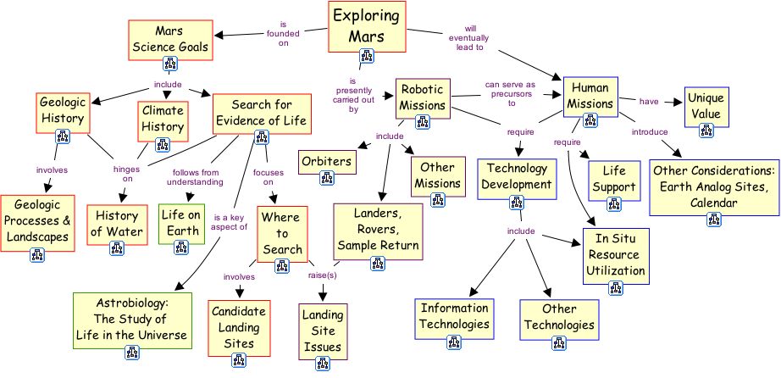
A concept map for the knowledge portfolio created by NASA for Mars Exploration
Novak, J. D. & A. J. Cañas, The Theory Underlying Concept Maps and How to Construct Them, Technical Report IHMC CmapTools 2006-01 Rev 01-2008, Florida Institute for Human and Machine Cognition, 2008", available at: http://cmap.ihmc.us/Publications/ResearchPapers/TheoryUnderlyingConceptMaps.pdf.

Slide 57
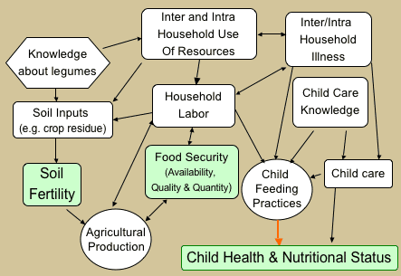
A concept map for a food security study
This research project attempts to improve child nutritional status, household food security and soil fertility through use of different legume options which can improve the quality and quantity of food available within the household as well as provide organic inputs to improve soil fertility.
Notes:
The SFHC research project attempts to improve child nutritional status, household food security and soil fertility through use of different legume options which can improve the quality and quantity of food available within the household as well as provide organic inputs to improve soil fertility

Slide 58
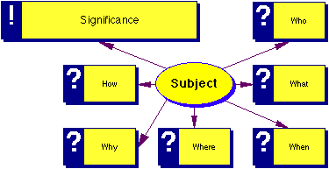
Simple concept map for establishing the significance of a research topic
1999, Jon Margerum-Leys and The University of Michigan
http://www-personal.umich.edu/~jmargeru/conceptmap/types.htm

Slide 59
Logic Model
A Logic Model is:
A depiction of a program showing what the program will do and what it is to accomplish.
A series of “if-then” relationships that, if implemented as intended, lead to the desired outcomes .
The core of program planning and evaluation
Many people say a logic model is a road map
It is a tool used to design and monitor programs.
However, it has elements that can be useful in designing and conducting research projects.

Slide 60
Logic Model in its simplest form
University of Wisconsin Extension
http://www.uwex.edu/ces/pdande/evaluation/evallogicmodel.html
Logic Model Development Guide: Using Logic Models to Bring Together Planning, Evaluation, and Action, W. K. Kellogg Foundation
http://www.wkkf.org/resource-directory/resource/2006/02/wk-kellogg-foundation-logic-model-development-guide

Slide 61
Logical chain of connections showing what the program is to accomplish
INPUTS
OUTPUTS
OUTCOMES
Program investments
Long-term
Activities
Participation
Short
Medium
What we invest
What we do
Who we reach
What results

Slide 62
How will activities lead to desired outcomes? A series of if-then relationships
Tutoring program example
IF then
IF then
IF then
IF then
IF then
We invest time and money
We can provide tutoring 3 hrs/week for 1 school year to 50 children
Students struggling academically can be tutored
They will learn and improve their skills
They will get better grades
They will move to next grade level on time

Slide 63
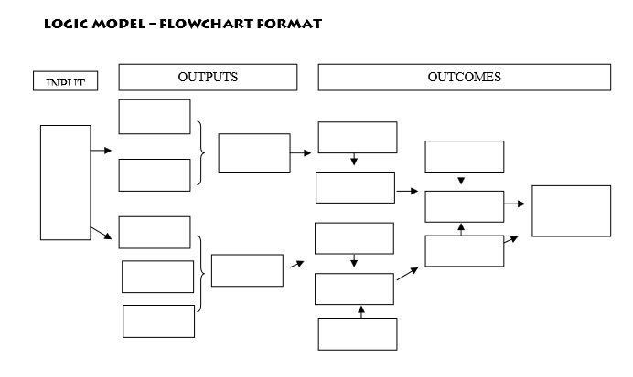
The flowchart approach

Slide 64
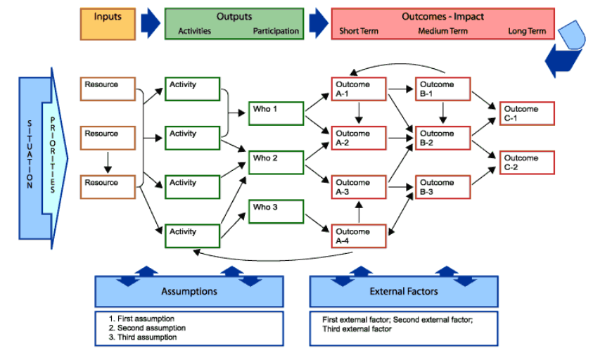
More detailed depiction

Slide 65
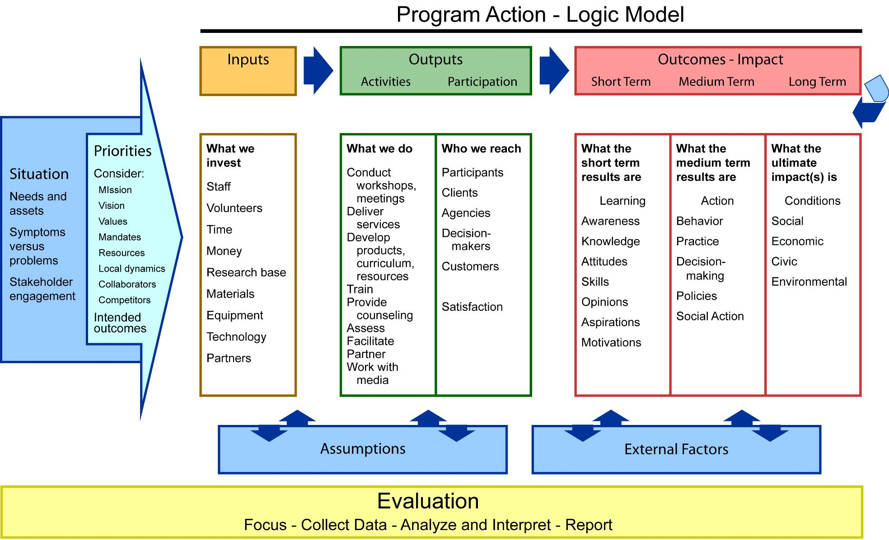
Fully detailed logic model
Notes:
Here we have a full depiction of program development. We see that everything starts with a clear articulation of the originating situation from which priorities are set. This sets into motion the programmatic response – as displayed in the logic model of what is expected to occur…the connections and relationships between inputs-outputs- and outcomes.
Often not included in the graphical LM display but important to articulate are
Assumptions
External factors, for example, do financial institutions exist; are they accessible
(barriers and facilitators)
Evaluation runs over the course of the program and is part of the program design.
Looks linear but is not…

Slide 66
Notes:
INPUTS include such resources as staff, time, money, staff, technology, research base, partnerships
In order to be able to deliver

Slide 67
OUTPUTS What we do Who we reach
ACTIVITIES Train, teach Deliver services Develop products and resources Network with others Build partnerships Assess Facilitate Work with the media … | PARTICIPATION Participants Clients Customers Agencies Decision makers Policy makers
Satisfaction
Notes:
OUTPUTS are the activities that are undertaken to reach targeted participants/populations. Thus, outputs include Activities and Participation. Some people refer to “participation” as “reach” – who the program is to reach;
Activities might include (Examples)
Create a community-wide coalition
Train staff and volunteers
Develop a communication strategy
Implement an action plan
Participation (who the program is to reach; who is supposed to participate - individuals, families, groups, businesses, organization, communities). Examples might include:
All low income families living in the city of Grant
Businesses with fewer than 50 employees
Community groups in Palmetto neighborhood
Middle school youth identified as low achievers
All dairy producers in Milk County
Employees of Able City Government
Be as specific as possible with “who” is targeted.
Note SATISFACTION: Satisfaction is not an outcome because being “satisfied” with something doesn’t mean that someone has changed or improved. Being satisfied is often a precursor to learning, but does not guarantee learning. Participants may be satisfied with the program, or like you as a person, or want to come again, but such reactions do not indicate that they have changed or benefited in any way. Thus, in the UWEX logic model, satisfaction is considered an Output, not an Outcome.

Slide 68
OUTCOMES What results for individuals, families, communities..…
SHORT Learning Changes in Awareness Knowledge Attitudes Skills Opinion Aspirations Motivation Behavioral intent | MEDIUM Action Changes in Behavior Decision-making Policies Social action | LONG-TERM Conditions Changes in Conditions Social (well-being) Health Economic Civic Environmental
C H A I N OF O U T C O M E S
Notes:
OUTCOMES
In order to facilitate/achieve outcomes, that extend along a continuum – or chain of outcomes from short to long-term or impact. For example, changes in knowledge, skills, attitudes and intent:
Change in knowledge might be increased understanding of the purpose of a budget, or loan terms
Change in skills might be how to develop a spending plan
Change in attitude might be
Change in confidence might be increased confidence to ask questions; go to a bank and seek service
Change in intent might be
Change in behavior
Change in decision making
Change in individual, family, financial institution, community conditions
Unit of analysis??
Sebstad provides illustrative outcomes for 5 thematic areas
Outcomes are the changes or benefits for individuals, families, groups, businesses, organizations, and communities.
Outcomes occur along a path from short-term achievements to longer-term end results (impacts). Outcomes include
Short-term: Changes in awareness, knowledge, skills, attitudes, opinions, motivation, intent such as
Increased knowledge of poverty’s impact on individuals and the community
Goal represents a general, big picture statement of desired results.
Increased skills in leading a group
Greater intention to exercise
Medium-term: Changes in behaviors, decision making, action
Participating youth use a spending plan
Producers make informed decisions concerning farm transfer
Community installs bike paths
Long-term: Changes in social, economic, civic, environmental conditions such as
Reduced debt
Improved water quality
Increased community safety
The ultimate result of a program is usually referred to as “impact”. Impacts might be achieved in one year or take 10 or more years to be achieved. Such long-term impacts may or may not be reflected in the logic model, depending on scope of the initiative, purpose and audience of the logic model.

Slide 69
Tend not be included in a logic model graphic:
Situational statement
Priorities
List of assumptions
List of external factors
Evaluation methods

Slide 70
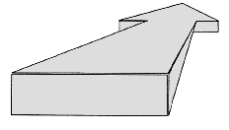
Hierarchy of effects
Social-economic-environmental improvements
Source: Bennett and Rockwell, 1995, Targeting Outcomes of Programs
Actions
Changes in behaviors and practices
Learning
Changes in knowledge, attitudes, skills, aspirations
Reactions
Degree of satisfaction with program; level of interest; feelings toward activities, educational methods
Participation
Number and characteristics of people reached; frequency and intensity of contact
Notes:
Many Extension staff will remember the Bennett hierarchy of the 1970’s that was so popular and widely used throughout Extension. The Bennett hierarchy is a precursor of the present day logic model. You can see the similarities in this graphic.
Rockwell and Bennett have since developed a toolkit titled, Targeting Outcomes of Programs (TOP) that is available on the web at http://citnews.unl.edu/TOP/english/
See it for more information.

Slide 71
Logic Model of a training workshop
Situation: Funder requires grantees to include a logic model in their funding request; grantees have limited understanding of logic models and are unable to fulfill the funding requirement
This logic model depicts a 3 hour training workshop. The trainer will measure outcomes at the short-term level – “accountable here” - commensurate with the scope of the training and what could be expected from a 3 hour workshop.

Slide 72
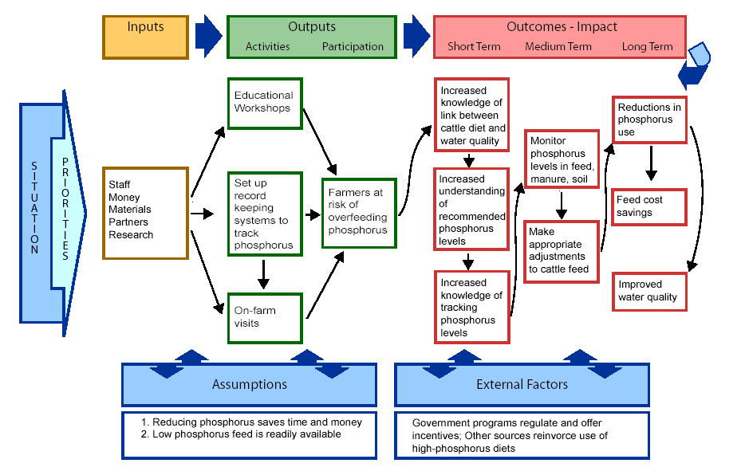
Water Quality Example

Slide 73
The Relationship between Research Design, Data and Results
The logic model frames your research
Data will be captured, collected, derived, etc. within that framework
Data will be “cleaned” (prepared for analysis)
Data will be “reduced” (analyzed in some way that leads to summary results and inferences)
The “what” and “how” of all of your research steps can be complex, risking oversights (gaps) or unnecessary duplication (redundancies).
Solution: Map out your “information plan”

Slide 74
Variables, variables, variables
A variable is an object, event, idea, feeling, time period, or any other type of category you are trying to measure. Some studies (often called “experimental studies” focus on how some variables influence other variables.
Independent | Dependent
As this changes… | …changes in this are observed
Cause | Effect
Before | After
Input | Output
What you do | What happens
Predictor | Response
Regressor | Regressand
Explanatory | Explained
Manipulated | Measured
Notes:
http://www.teachforever.com/2007/10/project-idea-independent-vs-dependent.html

Slide 75
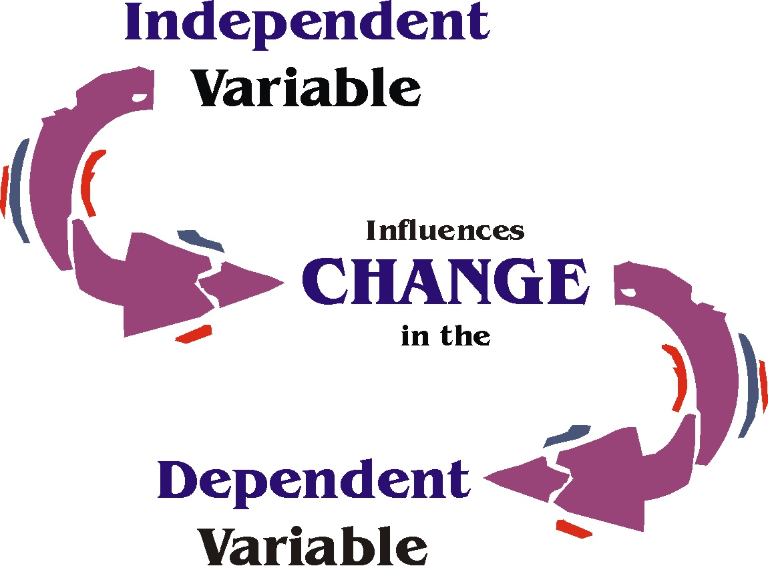
Source: http://arose.iweb.bsu.edu/BSUCourses/ITEDU_699/LP/Variable.jpg
Notes:
http://arose.iweb.bsu.edu/BSUCourses/ITEDU_699/LP/Variable.jpg

Slide 76
Variables in Correlation Studies
NOT all studies are about cause and effect.
Sometimes we want to know about how (the extent to which) two or more variables relate to each other.
The intent here is to examine associations and predict events, NOT establish causal relationships between variables.
In a correlation study, the researcher does NOT manipulate a treatment, rather the researcher measures two or more variables (called measured variables) and then examines the direction and magnitude of their relationship to each other.
Source: http://arose.iweb.bsu.edu/BSUCourses/ITEDU_699/LP/LP_4%5Bvariables%5D.htm
Notes:
http://arose.iweb.bsu.edu/BSUCourses/ITEDU_699/LP/LP_4%5Bvariables%5D.htm

Slide 77
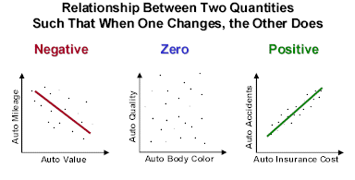
Correlation Studies
Source: Source: Russell Investments, 2012.

Slide 78
What variables do I need to collect?
Variables that I plan to manipulate, measure predict, compare, etc.
Contextual variables
these might influence outcomes and you will need to know whether they do or not
Potentially confounding variables
Ask yourself “What else might explain what is happening that I have not thought of?”
If your research design considers all of these from the outset, it may be possible to control or otherwise account for contextual/potentially confounding variables.

Slide 79
Don’t forget about validation
Can you demonstrate your research is independent? Based on an observable research design? Representative? Reproducible?

Slide 80
Validation
Validation is the process used by the scientific community to acquire the necessary information to assess the ability of a data set, technique or procedure to reliably obtain a desired result.
Validation determines the conditions under which results can be obtained and determines the limitations of the data, technique or procedure.
The validation process identifies the critical aspects of the technique or procedure that must be carefully controlled and monitored.
Notes:
Validation of Research and Technology http://www.swgfast.org/documents/validation/010808_Validation_1.0_UpdatedFormat_Archived.pdf

Slide 81
Not all research can truly be validated
For example, Oreskes et al. (1994) argue that numerical models of natural systems can not be truly validated because natural systems are never closed and because model results are always nonunique.
However, these models can be confirmed by the demonstration of agreement between observation and prediction, but confirmation is inherently partial.
In qualitative research, methods such as triangulation of data provides a means to cross-validate the information collected.
…but it is essential that your research design provides the means to confirm the results obtained.
Notes:
Naomi Oreskes, Kristin Shrader-Frechette, Kenneth Belitz. Verification, Validation, and Confirmation of Numerical Models in the Earth Sciences
Science 4 February 1994: Vol. 263 no. 5147 pp. 641-646 DOI: 10.1126/science.263.5147.641
Nonunique: In geophysical interpretation and mathematical modeling, a problem for which two or more subsurface models satisfy the data equally well.

Slide 82
The beginnings of a research “Information Plan”: an organized list of all the components
Sources (Instruments, Databases, Preliminary Analysis) | Data Collection Methods (How are you going to get the data?) | Input Variables (a.k.a. Fields, Attributes, Themes, Subthemes, etc.) | Analysis Methods (What do you have to do to extract relevant info?} | Output Variables | Expected Outcomes (e.g., the hypothesized answers to your research questions)

Slide 83
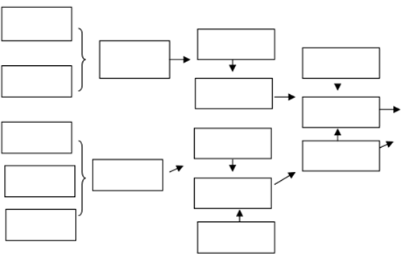
Turning your information plan into a flow chart
Data Collected and Cleaned | Input Variables | Analyses | Output Variables | Integration | Results

Slide 84
A good (and evolving) Concept Map, Logic Model, and Information Plan at the outset of your research provide the foundation for obtaining and reporting your results.

Slide 85
Thank you!
Barron J. Orr
barron.orr@gmail.com

