Slide 1








Formulating Your Research: Part II
Barron J. Orr, PhD
University of Arizona
March 23, 2014
For:
Dissertation Writing and Research Series
National Graduate Institute for Policy Studies (GRIPS)
Tokyo, Japan

Slide 2
Formulating Your Research (Part II)
Conceptual scientific frameworks
Knowledge transfer
Diffusion of innovation
Local vs. scientific knowledge
Informal & problem-based learning
Participatory research methods

Slide 3
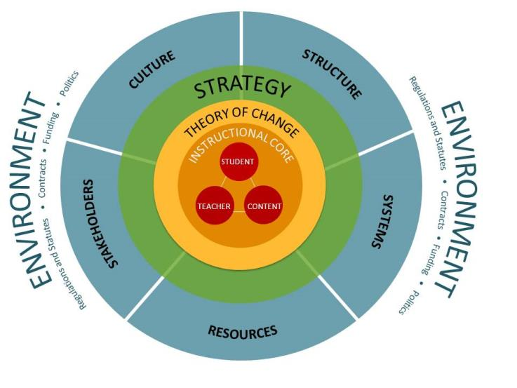
The Value of Frameworks
An example of a conceptual framework adapted from Tushman and O'Reilly's Congruence Model, 2002 by Harvard’s Public Education Leadership Project (PELP)
http://www.hbs.edu/pelp/framework.html
Notes:
Adapted from Tushman and O'Reilly's Congruence Model, 2002
Copyright © 2012 Presidents and Fellows of Harvard College
http://www.hbs.edu/pelp/framework.html

Slide 4
The value of a conceptual framework
A defined protocol for identifying, developing and refining indicators can provide scientific rigor to the process and help ensure the indicators capture the complexities of the system and provide the information needed for decision making, ideally so that when they are taken together, they can capture the causality in the system among driving forces, state of the environment, and impacts of changes.
This in turn can help decision makers connect the underlying processes with impacts, make linkages to related assessment areas, and ultimately more directly support decision making.
This approach suggests the need for a causality-based conceptual framework as a foundation for monitoring and assessment and the development, refinement and selection of associated indicators.

Slide 5
Conceptual frameworks based on Stress-Response & Demand-Supply
Environmental statistics, or indicators , information categories based on system components help, but are not enough.
The framework should emphasize the causal relationships between forces acting on the environment, associated consequences, and societal response through a set of interlinked indicators
The MA describes desertification as being “…a result of a long-term failure to balance demand for and supply of ecosystem services in drylands.”
Thus, a “balance-sheet” framework tracking changes in ecosystems services is warranted, linking environmental change and human well-being.

Slide 6
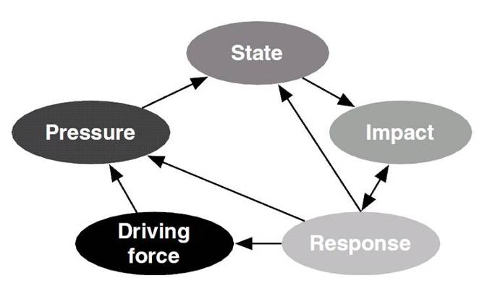
Driving Force-Pressure-State-Impact-Response (DPSIR)
Source: Niemeijer and de Groot 2008
A number of pressure-response frameworks are similar in that each addresses both the origins and consequences of whatever issue is being conceptualized, but differ in how each subdivides the causal chain. DPSIR is a very commonly used framework.

Slide 7
Driving Force-Pressure-State-Impact-Response (DPSIR)
Driving forces are indirect or underlying factors that result in pressures that in turn cause changes in the quality and quantity or state of the resources.
Pressures are indirect drivers (stresses) that human activities place on the environment.
State variables are indicators of the condition of the system (including bio-physical and socio-economic factors).
Impacts are the measure of the effects on human well-being induced by state changes.
Responses are the actions or interventions (regulatory and otherwise) that are taken in response to predicted impacts.

Slide 8
Ecosystem Services:
An ecologist’s definition
“…the conditions and processes
through which natural ecosystems,
and the species that make them up,
sustain and fulfill human life.”
Gretchen Daily
Nature’s Services 1997
Island Press

Slide 9
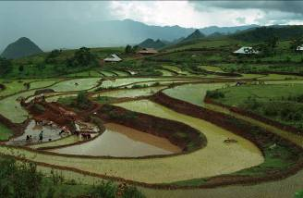
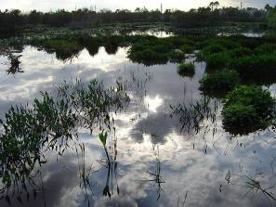
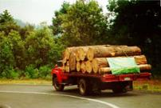
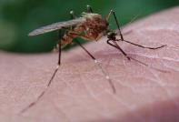
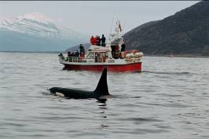
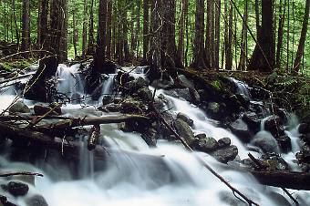

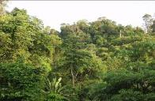
Millennium Ecosystem Assessment Categories
Provisioning
Protecting
Cultural
Supporting

Slide 10
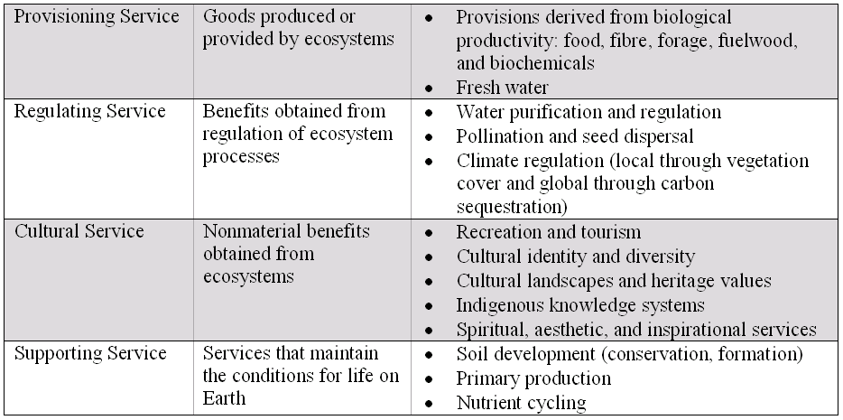
Dryland ecosystem services
Source: Millennium Ecosystem Assessment (2005) Ecosystems and Human Well-Being Desertification Synthesis

Slide 11
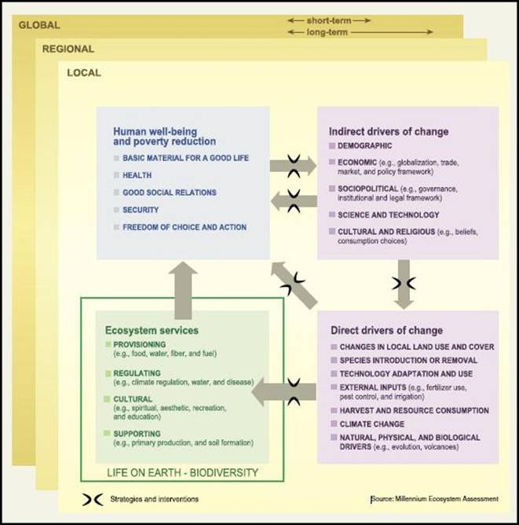
MA conceptual framework
Source: MA 2005

Slide 12
Panarchy
Framework to account for the dual (and seemingly contradictory) characteristics of all complex systems: stability & change
Came (in part) from the observation that when systems were managed for a single variable, changes went unnoticed until they triggered an abrupt change (e.g., fisheries collapse)
Notes:
-developed by ecologists & still mainly used to consider the management of regional ecosystems.

Slide 13
4 key characteristics of Panarchy
Change is not continuous or gradual, nor continuously chaotic. It is episodic, regulated by interactions b/w fast & slow variables
Non-linear processes reorganize resources across levels
Multiple equilibria are common.
Management systems must be flexible and adaptive at the appropriate scale levels
Notes:
2. Different scale levels concentrate resources and potential in different ways
3. Ecosystems do not have a single equilibrium; multiple equilibria are common. Ecosystems have processes that maintain stability in terms of productivity and biogeochemical cycles; as well as processes that are destabilizing, which provide diversity, resilience and opportunity.
4. Management systems must take into account these dynamic features of ecosystems and be flexible, adaptive and experiment at scale levels compatible with the levels of critical ecosystem functions

Slide 14
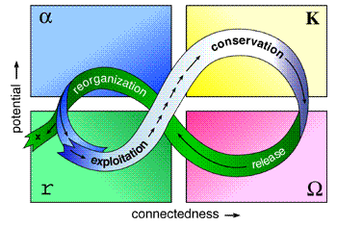
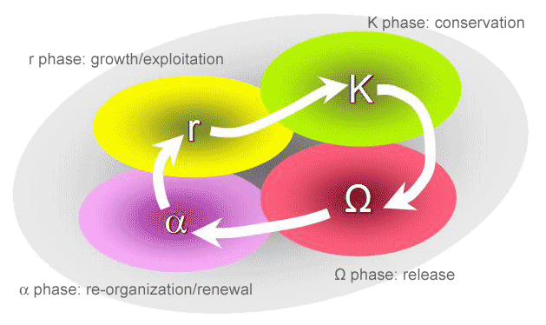

Slide 15
Stages of the Adaptive Cycle
r: birth/growth/exploitation
K: growth/maturation/conservation
Ω: destruction/release
α: renewal/re-organization
-Ω-phase & α-phase allow a system’s structures and processes to be re-organized. This reshuffling allows for the establishment of new system configurations & opportunities for the incorporation of new entrants into the system. The adaptive cycle explicitly introduces mutations & re-arrangements as a periodic process.

Slide 16
Properties of Adaptive Cycles
Potential: sets the limits to what it possible
Connectedness: amount of internal control, as distinct from external variables
Resilience: how vulnerable a system is to unexpected disturbances that can exceed control
Notes:
-Potential: the number and kind of future options available (e.g. high levels of biodiversity provide more future options than low biodiversity)
-Connectedness: the degree to which a system can control it’s own destiny through internal controls (very high in “K”)
-Resilience:

Slide 17
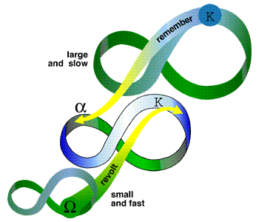
Interconnectedness of Levels
Revolt: fast variables overwhelm slow ones
Remember: potential stored in slow levels influences re-organization
Notes:
-panarchy places great emphasis on the interconnectedness of levels, between the smallest and the largest, and the fastest and the slowest.
-slow cycles set the conditions for the faster cycles to operate
-but the faster cycles can also have an impact on slow cycles
-many possible points of interconnectedness, but 2 important ones are:
-Revolt: fast variables overwhelm slow ones. E.g. a small dire spread to the crowns of trees & then to a larger patch, and eventually the entire forest
-Remember: potential accumulated and stored in the slower levels influences re-organization. E.g. after the forest fire, the processes and resources accumulated at a slower level provide the options for renewal (seed back, physical structures, nearby species)

Slide 18
How is Panarchy different?
Importance of the adaptive cycle, esp. the α-phase as the engine of variety
Connections b/w levels. There are potentially multiple connections b/w phases at 1 level and phases at another level
Hierarchies become dynamic structures
Attempts to connect ecosystem function w/ economic activities & human institutions
Panarchy is both creative and conserving
Notes:
-conceptual framework

Slide 19
From Panarchy to Social-Ecological Systems
“The answers are not simple because we have just begun to develop the concepts, technology and methods that can address the generic nature of the problems. Characteristically, these problems tend to be systems problems, where aspects of behaviour are complex and unpredictable and where causes, while at times simple (when finally understood) are always multiple. They are non-linear in nature, cross-scale in time and in space. And have an evolutionary character. This is true for both natural and social systems. In fact, they are one system, with critical feedbacks across temporal and spatial scales.”
-Holling et al. 1998
NB: If Panarchy is more of a conceptual framework, the SES framework is more tangible
Notes:
-framework to promote building of knowledge
-organize info to understand structure
-cumulative capacities to diagnose the problems of linked SESs
-partly came from frustration at not being able to do meta-analysis
-but also really aware & apprehensive about panaceas
-Ostrom’s background
-interest in common property systems
-taking traditional economics to task…

Slide 20
Ostrom’s Social-Ecological Systems (SES) Framework
Framework to promote building of knowledge
Organize information to understand structure
Nested, multi-tier framework
Cumulative capacities to diagnose the problems of linked SESs
Ostrom’s background
  interest in common property systems
  taking traditional economics to task…
Notes:
-if panarchy is more of a conceptual framework, the SES framework is more tangible (way to organize)
-Really helpful. Especially for whatever elements (social aspects, economic, etc.) don’t come easily to you…

Slide 21
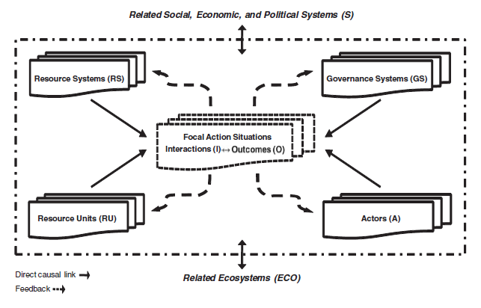
Notes:
-nested, multi-tier framework
-organize analysis of how attributes jointly affect and are indirectly affected by interactions and resulting outcomes achieved at a particular time and place.
-organize how these attributes may affect and be affected by larger socioeconomic, political, and ecological settings in which they are embedded, as well as smaller ones.
-long-term goal is to recognize which combination of variables tends to lead to relatively sustainable and productive use of particular resource systems.

Slide 22
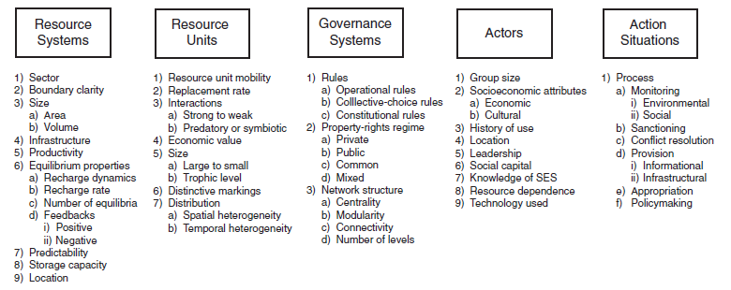
Second-tier variable for analyzing an SES
Unpacking the SES framework into multiple levels
Notes:
-many more specific variables are identified at deeper levels

Slide 23
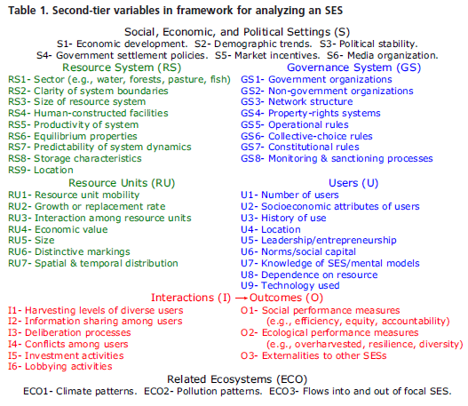

Slide 24
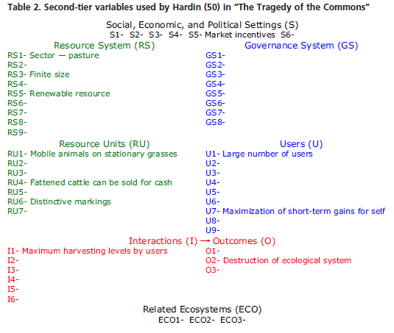

Slide 25
A Decomposable System
Key characteristic that allows scientific progress
Conceptual partitioning of variables into classes & subclasses
Relatively separate subsystems that are independent in many ways, but eventually affect each other’s performance
Complex systems are greater than the sum of their parts
Nested systems w/ larger & smaller SESs
Notes:
-all of these variables are not relevant in every study

Slide 26
Dryland Development Paradigm
The DDP addresses the livelihoods of human populations in drylands, via the study of coupled human-environmental (H-E) systems.
It is a product of a diverse array of research in desertification, vulnerability, poverty alleviation, and community development
From Reynolds et al. (2007) based on Stafford Smith and Reynolds (2002).

Slide 27
The DDP is based on 5 principles
H-E systems are coupled, dynamic and co-adapting, so that their structure, function and interrelationships change over time.
A limited suite of ‘slow’ variables are critical determinants of H-E system dynamics

Slide 28
The DDP is based on 5 principles
Thresholds in key slow variables define different states of H-E systems, often with different controlling processes; thresholds may change over time.
Coupled H-E systems are hierarchical, nested and networked across multiple scales
The maintenance of a body of up-to-date local environmental knowledge (LEK) is key to functional co-adaptation of H-E systems

Slide 29
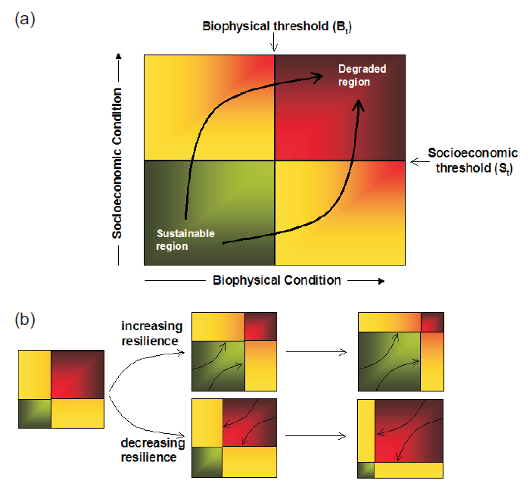
Conceptual representation of degradation framework
Notes:
http://biology.duke.edu/aridnet/pdfs/Dahlem%20Book%20Chaps/21-StaffordSmith_en.pdf
Figure 21.3 (a) Conceptual representation of degradation framework. Desertification must simultaneously
include both biophysical and socioeconomic dimensions (x and y axes, respectively here). The
various states of a system are shown as sustainable (green, with boundaries at Btand St), unsustainable
(yellow), and permanently-degraded (red); these boundaries are often fuzzier than shown here. Although
a two-dimensional representation is an oversimplification, there are a limited number of ways in
which local factors interact to create a “syndrome of desertification” (Assertion 9). (b) The size of each
of the “states” is dynamic, driven by both internal and external factors, which may differ substantially
year-to-year so that the risk of crossing a threshold may vary over time but also can be proactively managed
to increase resilience (Assertion 3). Importantly, a key component of the proposed framework is
the concept of slow variables (Assertion 2) in determining system dynamics. Based on Fernández et al.
(2002).

Slide 30
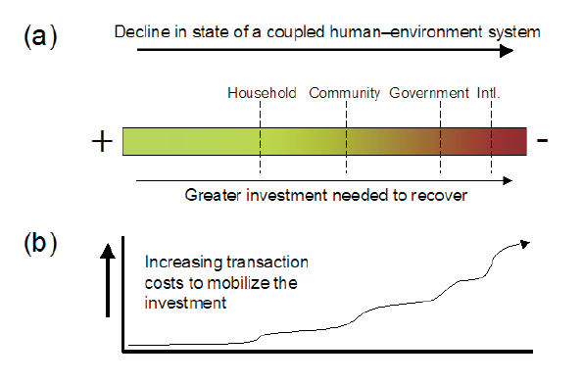
Why does it matter?
Notes:
http://biology.duke.edu/aridnet/pdfs/Dahlem%20Book%20Chaps/21-StaffordSmith_en.pdf
Figure 21.4 (a) Increasing resources are needed to recover larger declines in the state of coupled human–
environment systems, which usually means calling on higher scales with (b) associated higher
transactions costs. Investment in social capital and appropriate networks (itself a transaction cost) can
decrease the size of the steps in (b).

Slide 31
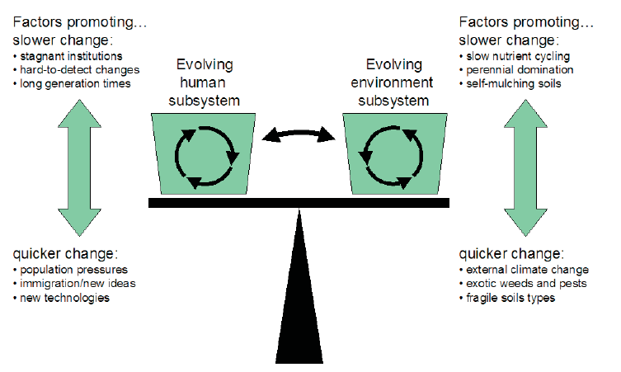
The Delicate H-E Balance
Notes:
http://biology.duke.edu/aridnet/pdfs/Dahlem%20Book%20Chaps/21-StaffordSmith_en.pdf
Figure 21.5 Coupled human–environment systems change over time, in response to external forces
(e.g., immigration, climate change) and intrinsic changes (e.g., population growth, vegetation composition)
as mediated by the characteristics of particular systems (e.g., institutional conservatism, soil type
fragility). These factors may result in quicker or slower rates of change in each subsystem, and thereby
determine whether the rates of change in each system are in synchrony with each other, or get out of step
such that the overall human–environment system becomes dysfunctional (see Robbins et al. 2002).

Slide 32
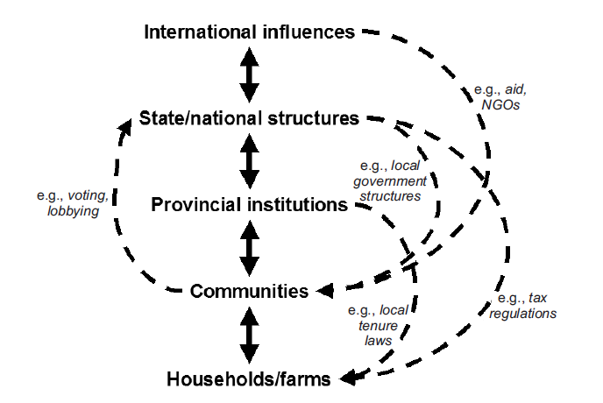
The key systems of interest are hierarchically structured
Notes:
http://biology.duke.edu/aridnet/pdfs/Dahlem%20Book%20Chaps/21-StaffordSmith_en.pdf
Figure 21.7 Our systems of interest are hierarchically structured (see Table 21.2 and Assertion 8),
with strong relationships between levels and some weaker (but still important) linkages that jump levels.
At present, mechanisms for feeding influences upwards are usually much more poorly developed
than the reverse, leading to feelings of powerlessness and policy remoteness in drylands.

Slide 33
If the systems are nested hierarchies, why not the solutions?
At present, mechanisms for feeding influences upwards are usually much more poorly developed than the reverse.
  Leads to management decision often disconnected from local realities
  Leads to decisions in “silos”
  Leads to feelings of powerlessness and policy remoteness, particularly in drylands

Slide 34
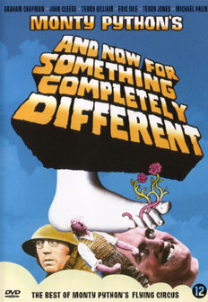


Slide 35

Knowledge Transfer

Slide 36
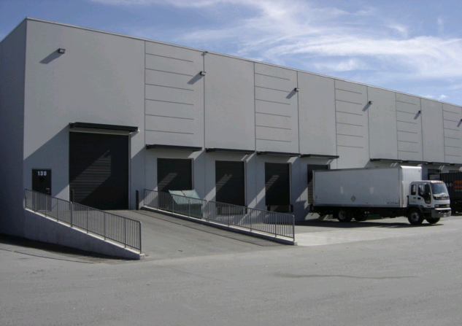
The traditional approach to scientific knowledge transfer
S C I E N C E F A C T O R Y
The “Loading Dock” Model
Society
Pick-Up
Source: http://en.wikipedia.org/wiki/File:Warehouse_Loading_Dock.JPG
Notes:
Source of image: http://en.wikipedia.org/wiki/File:Warehouse_Loading_Dock.JPG

Slide 37
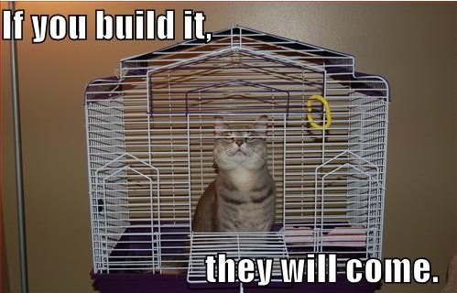
The traditional approach to technology transfer
The “Build it and They Will Come” Model
http://www.webspecks.com/Blog_Continue_Aug_Sept_10.htm
Notes:
Source of image: http://en.wikipedia.org/wiki/File:Warehouse_Loading_Dock.JPG

Slide 38

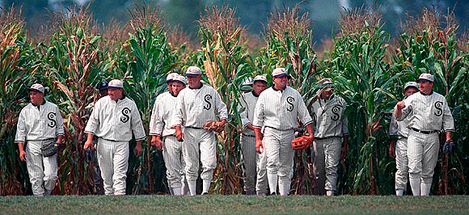
Is technology/knowledge transfer a field of dreams?

Slide 39
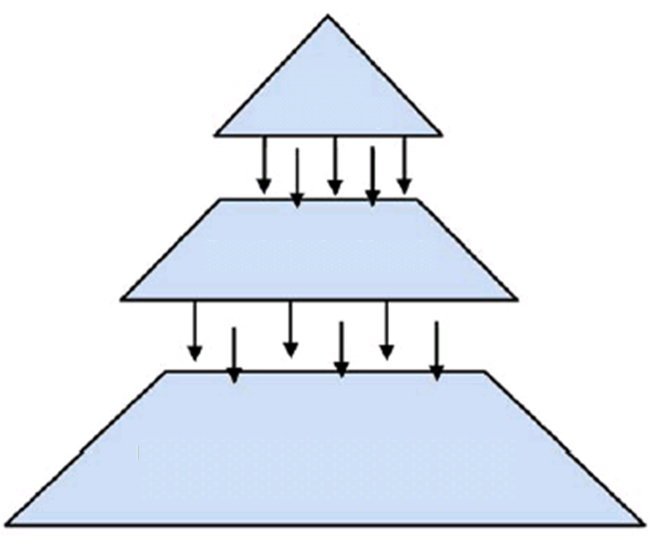
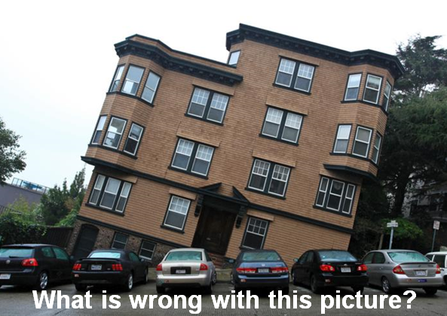
Typical Environmental Assessment
Vision that is, ideally, based on monitoring & evaluation
Experts give vision
Practitioners/
Managers plan and facilitate actions
Actions, ideally,
based on “best” practices
Ideally,
both obtain benefit
Community/Individuals (Stakeholders) … and the Environment respond

Slide 40
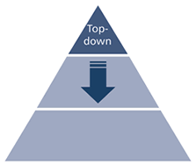
Typical Environmental Assessment
Vision that is, ideally, based on monitoring & evaluation
Experts give vision
Practitioners/
Managers plan and facilitate actions
Actions, ideally,
based on “best” practices
Ideally,
both obtain benefit
Community/Individuals (Stakeholders) … and the Environment respond

Slide 41
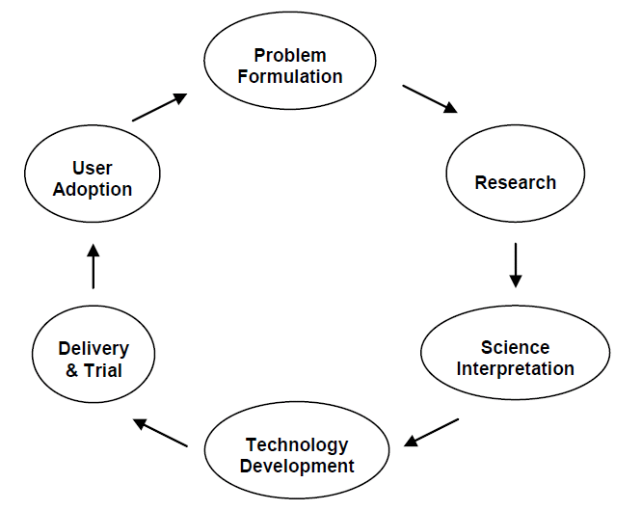
Adding science to community engagement…
  …however….
  is the top-down problem actually solved?
Adapted from USDA Forest Service FireScience Application Cycle (2004) http://www.firescience.gov/projects/04-4-2-01/project/04-4-2-01_vw_jfsp_final_report.pdf
Notes:
More recently, in 2004, the R&D, S&PF, and NFS Deputy Chiefs formed an interdeputy team to evaluate the agency’s science technology and application efforts. Though it was never implemented, this team drafted a plan of action for improving the delivery and application of science-based technology in support of the Forest Service’s mission. The plan defined science and technology application as a ―cycle‖ of activities (Figure 1). The agency’s Rocky Mountain Research Station has used this cycle to provide context for their recent development of a Science Application and Integration Program. The research reported here focuses on the delivery and user adoption parts of the cycle, by striving to understand influences to the adoption of wildland fire and fuels research among different potential user groups.

Slide 42
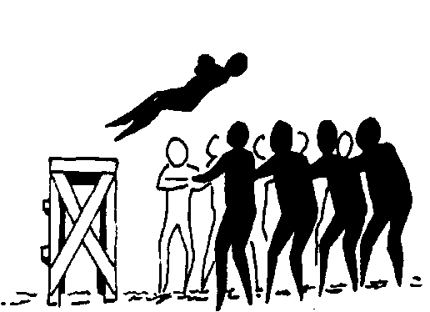
Expert-led, top-down approaches
…may be useful biophysically…however…
They also result in a uni-directional flow of knowledge,
which is less likely to result in:
  adoption
  trustworthy relations
  a supportive and
  well-informed
  constituency
  retention

Slide 43
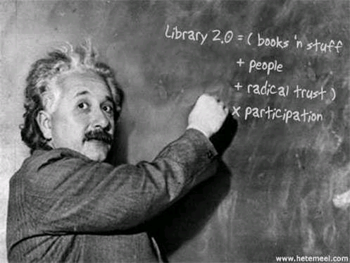



Slide 44
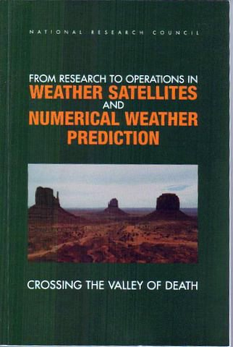
The technology transfer challenge
“Crossing the Valley of Death”
is sometimes used in industry to describe the fundamental challenge of transitioning from research to implementation.
National Research Council
2000
Notes:
Successful transitions R&D to operational implementation always require:

Slide 45
Successful crossings
Require:
  An understanding of the importance (and risks) of the transition
  Development and maintenance of appropriate transition plans
  Adequate resource provision
  Continuous feedback (in both directions) between R&D and operational activities
  Making outreach bidirectional: “Inreach”
National Research Council, 2000

Slide 46
Formative R&D
Approach
If research and
development
are adaptive,
can allow for midstream adjustment in
research plans
through continual evaluation and user feedback.

Slide 47

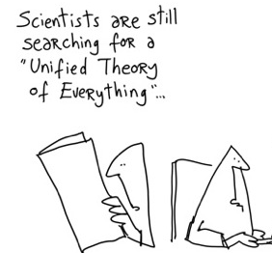
What might theory offer?
Notes:
http://www.ccdf.ca/ccdf/NewCoach/english/ccoache/e4a_bp_theory.htm
http://sophlylaughing.blogspot.nl/2011/11/theories-of-everything.html

Slide 48


Theoretical Framework
Constructivism vs. Positivism
Science in Service for Society
(Translational Science)
“High Tech, High Touch”
Two-way Knowledge Exchange
Positive Deviance
Diffusion of Innovations
Local Knowledge
Active Learning
Informal Learning
Notes:
Our program moves basic research findings to end-users while moving user needs and knowledge back to researchers. This
promotes interaction between researchers, technology sponsors and users that results in innovation and the adoption of new ideas,
products and procedures.

Slide 49
Positivism vs. Constructivism
The Positivist View
The Constructivist View
Notes:
Our program moves basic research findings to end-users while moving user needs and knowledge back to researchers. This
promotes interaction between researchers, technology sponsors and users that results in innovation and the adoption of new ideas,
products and procedures.

Slide 50
Positivism vs. Constructivism
The Positivist View
  The nature of reality is regarded as independent of consciousness and objective, and thus can be studied independently of the inquirer. Thus, different observers should arrive at the same conclusions.
The Constructivist View
  Reality is essentially subjective, and "truth" is a construction which is located within our experience (historically, culturally, experientially).
Notes:
Our program moves basic research findings to end-users while moving user needs and knowledge back to researchers. This
promotes interaction between researchers, technology sponsors and users that results in innovation and the adoption of new ideas,
products and procedures.

Slide 51
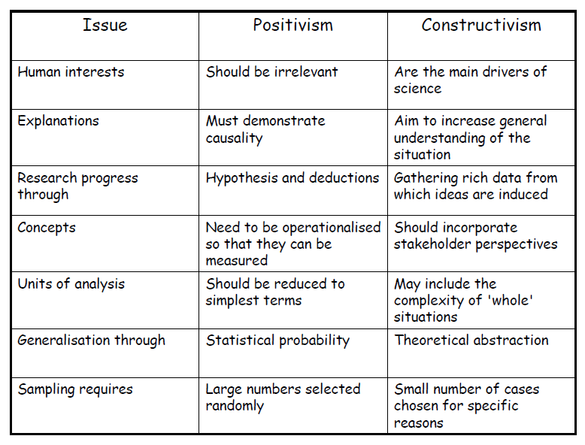
Source: Steve Evans on “Action Research” http://www.ifm.eng.cam.ac.uk/resmeth/09slides/steve_evans.pdf
Theoretical Framework
Notes:
The Positivist View
The nature of reality is regarded as independent of consciousness and objective, and thus can be studied independently of the inquirer. Thus, different observers should arrive at the same conclusions.
The Constructivist View
Reality is essentially subjective, and "truth" is a construction which is located within our experience (historically, culturally, experientially).

Slide 52
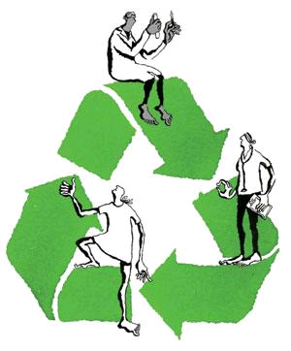
Translational Science
Translational science is about moving research findings (expert knowledge) to patients…
….while moving patients’ knowledge to researchers.
“Results can be thrust from bench to bedside, but there is also much to be learned by pushing the other way.”
Heidi Ledford | 11 June 2008 | Nature 453, 843-845 (2008) | doi:10.1038/453843a
Notes:
http://www.nature.com/news/2008/080611/full/453843a.html

Slide 53
Translational Research
Translational research is:
Formative: Research is ‘formative’ when feedback from the participants is iteratively used to adapt the research to better address the actual needs of the participants. Not only can the answers change based on what is learned—so can the questions.
Participatory: Stakeholders should be able to share the same state-of-the-art model of how things work. Some stakeholders have adapted / innovated. Their solutions may be better suited to local conditions. And they may be in need of solutions.

Slide 54
Barriers to Translational Science
Every researcher thinks they are translational!
  Who is not? A researcher who…
    “Cloned a gene from a human cell line or tissue”
    “Developed a new class of drugs”
  Who is? A individual whose work attempts to…
    “Improve the diagnosis or prognosis in patients”
    “Improve prevention in patients”
    “Conceive and execute a new treatment in patients”
Interdisciplinary (Cross-cutting horizontally)
  More than one department working together
  Even where there is a strong interdisciplinary tradition, not always rewarded
After Birmingham 2002; Nadler, AACR 04/08/02

Slide 55
Barriers to Translational Science
Participatory (Cross-cutting vertically)
  Researchers and clients needed to be linked
  Often through knowledge brokers
Usually not an individual, rather a TEAM
  Science community traditionally rewards independent research
  “Translational Team” – medical example
    Laboratory-based investigators
    Clinical investigators
    Surgeons, pathologists, etc.
    Statisticians
    Research nurses
    Data managers
    Patients
After Birmingham 2002; Nadler, AACR 04/08/02

Slide 56

High Tech – High Touch
John Naisbitt was prescient in 1982 when he suggested “whenever new technology is introduced
into society, there must be a counterbalancing human response—that is, high touch—or the technology is lost.
The more high tech, the more high touch.”

Slide 57

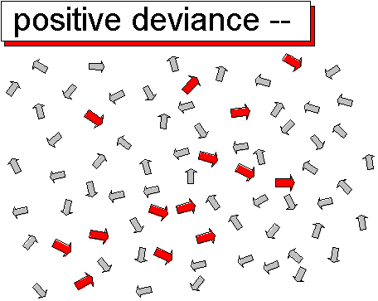
Positive Deviance
(Organizational Change)
Positive deviance says that if you want to create change, you must scale it down to the lowest level of granularity and look for people within the social system who are already manifesting the desired future state. Take only the arrows that are already pointing toward the way you want to go, and ignore the others. Identify and differentiate those people who are headed in the right direction. Give them visibility and resources. Bring them together. Aggregate them. Barbara Waugh
Notes:
Positive Deviance is a model of organizational change based on the premise that organizations already contain members that are instantiating the desired end state of a change process. These are the secret change agents in the organization. The idea is that these people can lead the change in the broader organization.

Slide 58
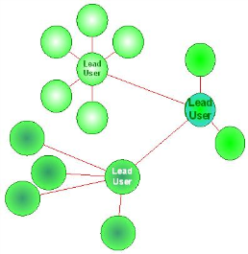
Diffusion of Innovations
Diffusion, or the spread of an idea, method, practice, or product throughout a social system, occurs gradually as some users wait to see how it has worked for others before they are willing to adopt a new method.
Rogers, 2003
Notes:
Rogers, E.M. 2003. Diffusion of Innovations. New York: Free Press.

Slide 59

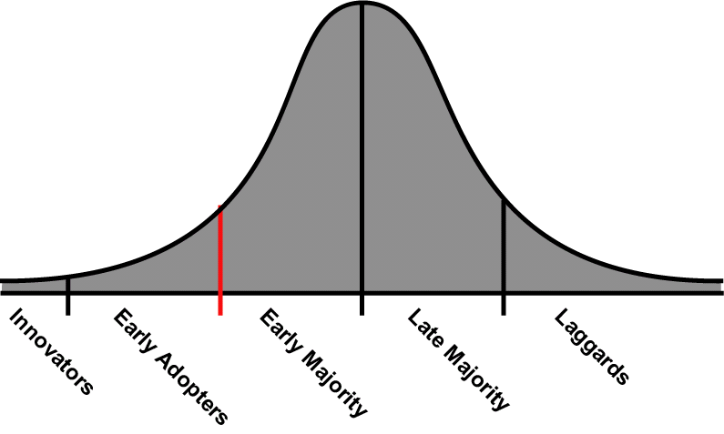
Diffusion of Innovations
Adoption Life Cycle
Time
Notes:
Transferring ideas (particularly those associated with High Tech) necessitates a deep understand of the market based on each individual’s potential to adopt. The classic diffusion paradigm (developed by Ryan and Gross in a 1943 hybrid-seed corn study in Iowa) is indispensable. (e.g. identifying and engaging early adopters, use of demonstration, etc.) Note the red line between “early adopters” and “early majority.” In High Tech, this is called “The Chasm” as it is where most ventures fail. It is essential to adjust educational programming when you are ready to try and cross this chasm. (I.e. know the difference in behavior of these different types of customers, with different constraints leading to or impeding adoption.)

Slide 60
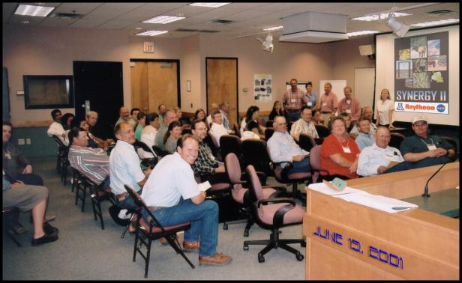


Diffusion: “Early Adopters” Influence Others

Slide 61
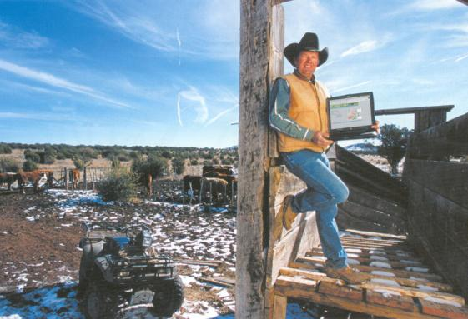
Diffusion: “Early Adopters” Influence Others

Slide 62
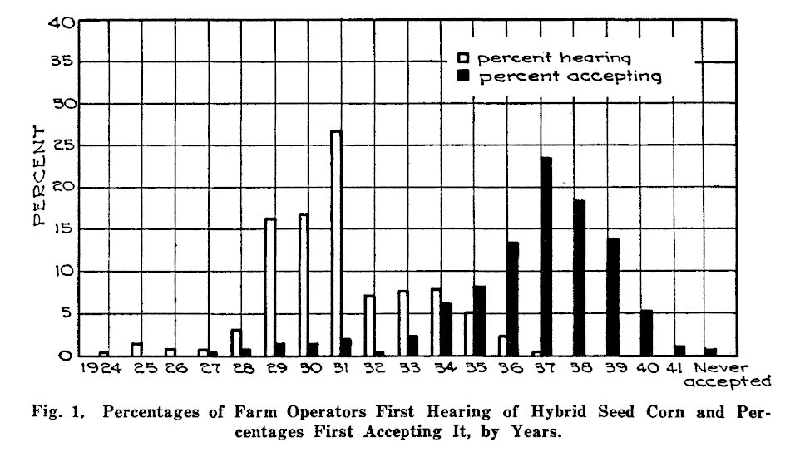
The first documented adoption cycle: The introduction of hybrid seed corn in 1927 (Iowa, USA)
Ryan, Bryce, and N.C. Gross. 1943. The Diffusion of Hybrid Seed Corn in Two Iowa Communities,” Rural Sociology 8:15-24.

Slide 63
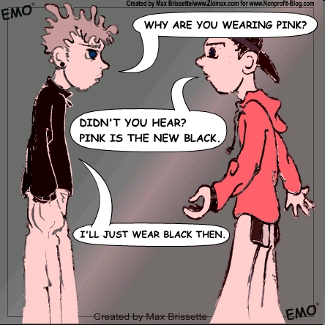


Next time you see an advertisement, try and figure out the target audience (where they are on the adoption cycle curve)…

Slide 64
Successful diffusion depends on
  understanding how the needs of adopters will change over time
  how adopters influence each other
Laggards
and
nonadopters
Number of New Adopters
Innovators
Early
majority
34%
Late
majority
34%
Early
adopters
13.5%
16%
2.5%
Time
Risk taking
visionaries
(beta testers)
Super-Informed
Mobile
Sophisticated
Little influence
on market
Visionaries
Progressive
Opinion leaders
Curious
Visible
Informed
Mobile
Patient with
testing phase
Pragmatists
Cautious
Attentive to
early adopters
Require much
information
before adopting
Must work first time
Conservative
Suspicious of
new ideas
Look to
preceding
groups for
information
Very suspicious
Hard to reach
Can negatively influence other users
if brought in too early
Notes:
9

Slide 65

Agents of Change
A key element of successful diffusion of innovations is the “change agent”…the “lead user” or early adopter.
Early adopters tend to be respected
and visible in
their community;
they provide
practical evidence
that an innovation
actually works,
which is important to later adopters.

Slide 66
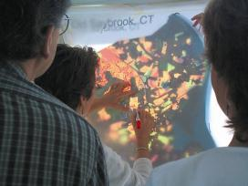



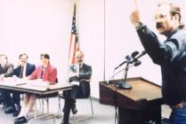
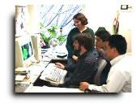
Knowledge brokers
Science & Technology Rich
Science & Technology Poor
Knowledge
Brokers
Understand Needs
Translate Knowledge
Facilitate Communication
Research
Highly Trained
Access to Data
Cutting Edge
Science
High Turnover
Complex Problems
Untrained
Knowledge Deficit
Need DSS Help
decision support tools, workshops, newsletters, seminars, courses, articles, user groups, fact sheets, websites, discussion lists

Slide 67
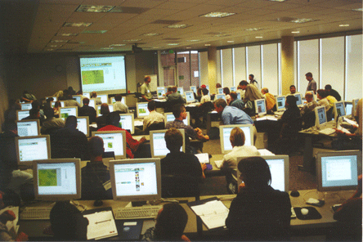
Two-way Knowledge Exchange: Outreach and Inreach
Enhanced decision support: Using MODIS & AVHRR for Ecological Forecasting (RangeView October 2002 Workshop)
Notes:
Training Scene at the October 4-5, 2002 RangeView Workshop – 53 natural resource managers from 18 different government agencies participated.

Slide 68
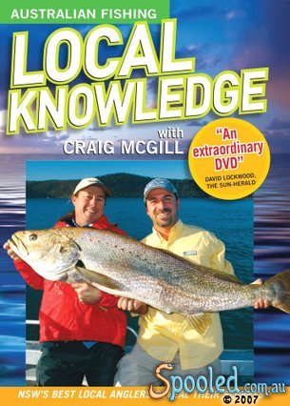
Local Knowledge
Local knowledge, indigenous knowledge, traditional ecological knowledge, etc.
…the cumulative body
of knowledge, practice,
and belief, evolving by
adaptive processes and
handed down through
generations by
cultural transmission.
Local knowledge can help us find – and maybe even catch – the
big fish!

Slide 69
Traditional vs. Western
Knowledge Systems
The dichotomy implied by using the terms “western” and “traditional” to describe different knowledge systems suggests a static line between them.
In reality, it is the worldviews and logic behind the knowledge systems that differ, and the information associated with each is dynamic.
For example, think about the word “landscape”…

Slide 70
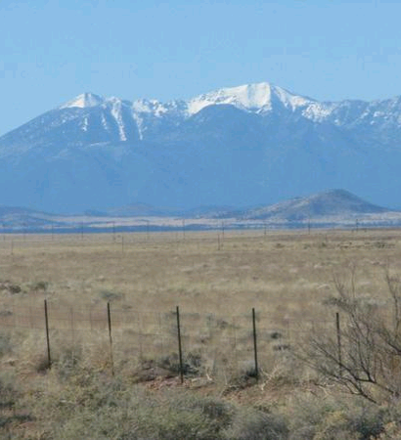
Define the landscape you see…

Slide 71
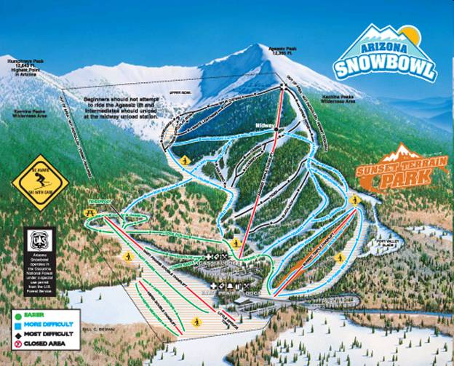
Was it this one?

Slide 72
LK and Natural Resource Management
The incorporation of LK into conservation science and the management of natural resources is increasing as researchers and practitioners alike recognize the importance of the connection between the experience of those who live locally, and their historical understanding of temporal and spatial ecological processes.
LK can be used to reconstruct and interpret the history of fishers and their interaction with the environment
It can be used to inform management decisions by addressing critical information gaps and supplementing other forms of data used for monitoring and evaluation. It can also help maximize limited resources for environmental monitoring.

Slide 73
LK and Natural Resource Management
Fundamental to an ecosystem-based management (EBM) approach to natural resource management are the natural and human functions, processes, and interactions necessary to sustain the services an ecosystem provides.
The “human” element requires assessment of local knowledge. It also is the key to move from a “species by species” approach to conservation to a “systems” approach.

Slide 74
LK and Natural Resource Management
The benefits can go well beyond the data.
The acquisition of LK in a participatory manner can result in the integration of local people and their perceptions into a management and planning program, helping develop feelings of ownership and representation while giving voice to locals in the process.
This means that environmental monitoring can simultaneously be knowledge transfer.

Slide 75


How can learning theory help?
Notes:
http://www.ccdf.ca/ccdf/NewCoach/english/ccoache/e4a_bp_theory.htm
http://sophlylaughing.blogspot.nl/2011/11/theories-of-everything.html

Slide 76


Learner-centered?

Slide 77


Example: Problem-based Learning
Key PBL concepts
  Active, experiential and auto-directed
  Facilitated (rather than taught)
  Groups, teams, etc.
  Scaffolding provides cognitive support
  to extend reach.
    Scaffolding is a multi-level, self-guided and transparent, constructive and goal-oriented framework for learning how
    to identify and solve problems.
  Task-oriented
  “Rails” make the “how” clear
  A trigger to hook the learner and make them aware of the problems around them.
  Rubric clarifies progress
  “Rewards” make the pursuit more fun/challenging
  Reflections (learn from oneself)

Slide 78

Outside the classroom:
Informal Learning
“Formal” learning
  Expert-led, in the classroom
“Non-formal” learning
  Expert-led outside class
“Informal” learning
  Voluntary
  Self-motivated
  Self-controlled
  Cumulative and enriching
  A daily, lifelong activity
  Personally guided by an individual’s needs & interests
Institute for Learning Innovation: http://www.ilinet.org/display/ILI/Home
Notes:
Falk, John H. & Dierking, Lynn D. (2002). Lessons Without Limit: How Free-Choice Learning is Transforming Education.
http://www.ilinet.org/display/ILI/Home
What Is Free-Choice Learning?
Learning is a lifelong activity. It is not confined to classes, workshops, or conferences, and is not just for students, or workers pursuing professional skills. Learning is an essential human endeavor – Everyone engages in free-choice learning every day:
At home, after work, and on the weekends
Visiting art, science, and history museums;
Exploring botanical gardens and state parks;
Reading books, magazines, and newspapers;
Surfing web sites, blogs, and online message boards;
Viewing video and film, listening to radio and podcasts.
Such informal, free-choice learning is:
Self-motivated and self-controlled;
Cumulative and enriching;
For the curious;
For the young, and young at heart.

Slide 79

Creating opportunities to learn

Slide 80






Creating opportunities to learn
Source: http://www.rdrop.com/~half/General/GameTips/space.cadet.html

Slide 81
Social Learning
Collective self-reflection through interaction and dialog among diverse participants
Co-production of knowledge
Stakeholder1
Research Study
Tools
Scientists & Researchers
Methods
Stakeholder2
Stakeholder3

Slide 82


Slide 83
Quantitative Approaches
Quantitative approaches aim to test hypotheses, and usually to identify numerical differences between groups (i.e. quantities). The focus is on measurement, hypothesis-testing, explanation, and prediction. The goal (or claim) is objectivity.

Slide 84
Qualitative Approaches
Qualitative approaches deal with how people understand their experiences (i.e. qualities). The focus is on exploration, pattern definition, obtaining meaning, achieving understanding, and being able to interpret. Qualitative research admits and accepts subjectivity.

Slide 85

Some Participatory Tools

Slide 86




Rapid Appraisal
Topical Outline

Slide 87

Stakeholder Platforms
How do we identify stakeholders and engage them?
A Multi-Stakeholder Platform (MSP) is a voluntary partnership of different stakeholders perceiving same resource management problem, realizing their interdependence for solving it and collaborating to find common solutions. (Steins & Edwards, 1999)

Slide 88

Help Ensure Representation:
Chain Referral

Slide 89

Community Meetings & Focus Groups

Slide 90


Key Respondent Interviews
(Semi-structured, Semi-directed, Non-directed)
Discussion Outline

Slide 91
Evaluating Participatory Outcomes
Questionnaires to examine how the participation had improved their understanding of the complexities of desertification, actions, and impacts
Surveys with open questions before and after each set of participatory activities to assess
  What participants think prior to the process
  Participants’ expectations
  What they had actually learned
  To what extent the learning was useful for their future decisions (management/production/use strategies)
  Whether they expected to continue sharing their experience
Hope to determine:
  Amount of change in behavior, attitude, skills, knowledge of participants
  The contribution of “social” learning to these changes
Kuper et al. 2009

Slide 92
To Evaluate Changes*
Pre -Surveys
Participatory Activities
Post -Surveys
Qualitative Appraisal
  key respondent interviews, focus groups, etc.
Pre- and Post-surveys with closed and open questions
Evaluate participation process, outputs, and outcomes
  Process: the implementation and linking of the different tools and methods
  Outputs: the immediate products of the process
  (Gottret and White 2001)
  *Outcomes: the amount of change in behavior, attitude, skills, knowledge of participants
  (Douthwaite et al. 2007)

Slide 93
Social Learning
Collective self-reflection through interaction and dialog among diverse participants
Co-production of knowledge
Stakeholder1
Tools
Scientists & Researchers
PRACTICE
Methods
Stakeholder2
Stakeholder3

Slide 94
To Evaluate Social Learning
Pre -Surveys
Participatory Activities
Post -Surveys
Pre- and Post- Surveys will address depth of learning following the criteria of Keen et al.
Single-loop: learning about the consequences of specific actions
Double-loop: learning about the assumptions underlying our actions
Triple-loop: learning that challenges the values and norms that underpin our assumptions and actions
Keen et al., 2005; Keen and Mahanty, 2006

Slide 95
To Evaluate Variation Among Responses
Pre -Surveys
Participatory Activities
Post -Surveys
Q method [Stephenson, 1979) may be considered discern patterns in participant responses (variation among stakeholders subjectively obtained).
Q is quantitative technique for eliciting, evaluating, and comparing human subjectivity
It offers a means for an in-depth study of small sample populations, answering questions like:
  What is the range of communicated ideas in a particular discourse?
  What are the prevalent variations in it?
  How do these variations logically relate to each other?
It results in the captured patterns of respondents to the stimulus presented, a topic on which opinions vary.
Those patterns can then be analyzed to discover groupings of response patterns, supporting effective inductive reasoning.

Slide 96


Participatory Mapping

Slide 97


Participatory Site Assessment

Slide 98

Knowledge Sharing: Explaining Management Actions

Slide 99

Knowledge Sharing:
Describing Impacts

Slide 100


Photo Elicitation & Photovoice

Slide 101


Slide 102

Identifying & Ranking Evaluation Criteria
(“Pack of Cards Method)

Slide 103

Revisions Based on What is Learned from Others

Slide 104

Putting it all together:
There are numerous methods for integrating indicators, data, and the judgments of individual stakeholders, and groups of stakeholders.

Slide 105
Decision Making & Science
Are Not Exactly the Same
Science is reductionist.
Decision making is synthetic.
  Decision makers often must act with whatever information is available.
  Supporting them requires approaches that incorporate the judgments and preferences of stakeholders in addressing problems that involve a set of alternatives that can be evaluated based on potentially conflicting and incommensurate objectives and attributes.
  Solution? tools that facilitate the synthesis of information that might be used in making a decision.

Slide 106

Preferences, Alternatives, Criteria

Slide 107

How do we choose amongst alternatives? What criteria?
Biophysical
Land Use
Society
Community
Economy
Firms
Households
Individuals
Economic Structure
and Change
Land-Use Change
and Social Context
Watershed Health
Source: Caroline Hermans presentation for Jon Erickson, U. of Vermont, FOR152 course
Notes:
Caroline Hermans http://www.uvm.edu/~jdericks/?Page=courses/FOR152.html
Part of a course taught by Dr. Jon D. Erickson, University of Vermont, Rubenstein School of Environment and Natural Resources Forest Resource Values (FOR 152, RM 152)

Slide 108
Synthesis tools such as:
Multi-criteria Decision Aiding/Analysis (MCDA)
GOAL
Alternative 1
Alternative 2
Alternative 3
C_{Ec}
C_{Sc}
C_{Ev}
C_{Ec}
C_{Sc}
C_{Ev}
C_{Ec}
C_{Sc}
C_{Ev}
Examples:
Economic (C_{Ec}): Employment, income, tax base
Social (C_{Sc}): Income distribution, landscape character
Environmental (C_{Ev}): Impervious surface, biodiversity
Source: Caroline Hermans presentation for Jon Erickson, U. of Vermont, FOR152 course

Slide 109

Technocratic vs. Democratic
Knowledge transfer approaches that provide answers and associated uncertainty, but which fail to incorporate the judgments of stakeholders and facilitate a deliberative process tend to be more technocratic than democratic, hindering public participation in decision making, and ultimately degrading decision quality.
Fiorino 1989; NRC 1996, 2005

Slide 110

Thank you!
Barron J. Orr
barron.orr@gmail.com

