Slide 1








Tips for Writing a Successful Proposal
Barron J. Orr, PhD
University of Arizona
March 23, 2014
For:
Dissertation Writing and Research Series
National Graduate Institute for Policy Studies (GRIPS)
Tokyo, Japan

Slide 2



Barron J. Orr
Professor and
Geospatial Extension Specialist
Office of Arid Lands Studies
School of Natural Resources
and the Environment
University of Arizona

Slide 3
WRITING SUCCESSFUL PROPOSALS
Original presentation made and given by
Barron J. Orr and
Charles F. Hutchinson
2007

Slide 4
Things to remember
Proposals you don’t write don’t get funded!!
Just like your school teacher told you: Read the instructions!!
  Assemble the proposal exactly as instructed, even if it doesn’t seem to make sense to you (it does to them).
    All proposals must be treated equally. If you don’t follow instructions like everybody else (e.g., format; page limits fonts), your proposal will be down-graded or rejected.
Keep it simple – use the Golden Rule approach.
Use diagrams to explain complicated things. They are often safer than words.

Slide 5
PROPOSAL ELEMENTS
Title
Project Summary. Explain your proposal briefly (abstract), don’t describe it.
  What is the problem?
  Why is it significant?
  What issues will be addressed?
  What techniques will be used?
  What outcomes are expected?

Slide 6
PROPOSAL ELEMENTS
Project description. Tell a story that leads the reader down a path to two inevitable conclusions: (a) the problem is really important and (b) you have the best solution.
  What is the nature of the problem?
  What are key issues?
  What other work has been done on the problem?
  How will this work contribute?
  What outcomes are expected?

Slide 7
PROPOSAL ELEMENTS
Preliminary results: If you have something tantalizing, put it in. If not, don’t.
Technical approach: Elaborate what was introduced in the project description.
  Explain what will be done, how it will be done, and by whom.
    Organize around sets of tasks that address each part of the problem.
    If you don’t have the skills necessary to do some part of the work, identify partners.
  Identify uncertainties and how they will be addressed.
  Describe how success will be measured.

Slide 8
PROPOSAL ELEMENTS
Management Approach: Explain how authority and responsibilities are distributed.
  Use an organogram to add clarity and save space; responsibilities can be inserted in the Gantt chart, too (below).
  Explain how project components will be integrated.
Schedule: Explain how the work is expected to unfold.
  Gantt charts are a useful tool. If you have organized your project around tasks, chart their duration, and mark significant milestones.
  Identify “critical paths” using your chart and consider how you will deal with them in the Approach if there is a problem.

Slide 9
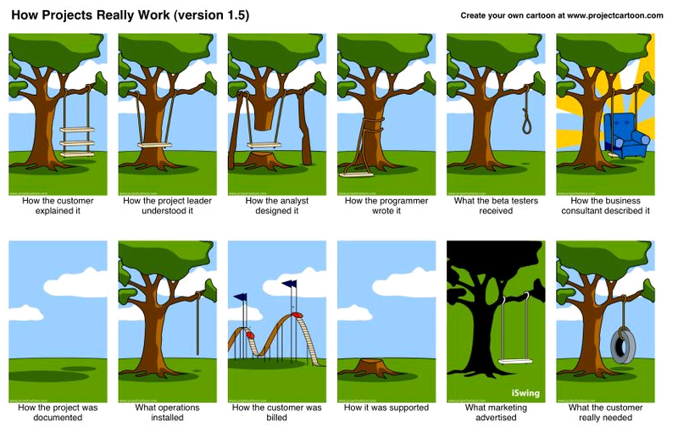
Who, when, how…

Slide 10

Gantt Chart
A Gantt chart is a graphical representation
of the duration of tasks against the
progression of time.
A Gantt chart is a useful tool for planning and scheduling projects.
A Gantt chart is helpful when monitoring a project's progress.
Source: KIDASA Softwware, http://www.ganttchart.com/
Henry Laurence Gantt (1861-1919) was a mechanical engineer and management consultant who is most famous for developing the Gantt chart in the 1910s. These Gantt charts were employed on major infrastructure projects including the Hoover Dam and Interstate highway system and still are an important tool in project management. The initial format of the chart was developed by Henry Gantt (1861-1919) in 1910 (see "Work, Wages and Profit" by H. L. Gantt, published by The Engineering Magazine, NY, 1910).
Source: http://en.wikipedia.org/wiki/Gantt
Notes:
Henry Laurence Gantt (1861-1919) was a mechanical engineer and management consultant who is most famous for developing the Gantt chart in the 1910s. These Gantt charts were employed on major infrastructure projects including the Hoover Dam and Interstate highway system and still are an important tool in project management. The initial format of the chart was developed by Henry Gantt (1861-1919) in 1910 (see "Work, Wages and Profit" by H. L. Gantt, published by The Engineering Magazine, NY, 1910).

Slide 11
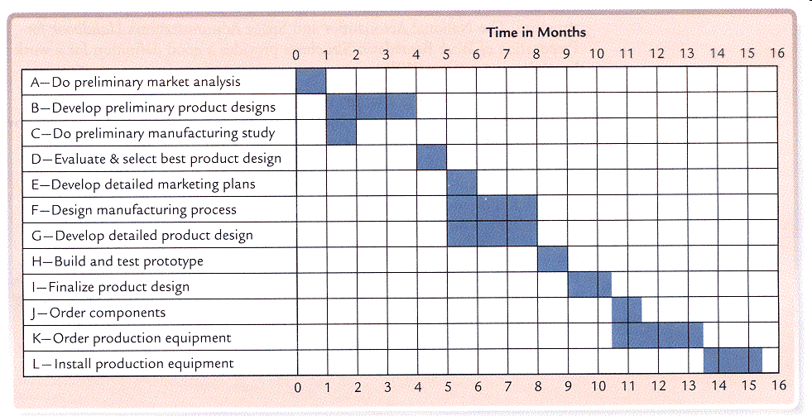
A Simple GANTT chart
Tasks

Slide 12
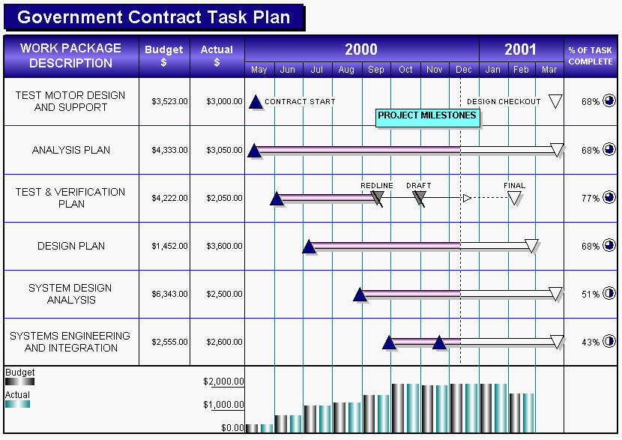
A More Advanced GANTT Chart
http://www.kidasa.com/information/examplesx/gov1.html

Slide 13
PROPOSAL ELEMENTS
References: Show your homework.
  Adds authority and honesty.
  Shows you know what’s important (and what’s not).
Budget
  Use a spreadsheet!
  Stay within guidelines (find them out).
  Add explanations where things might get confusing.
  Cost sharing doesn’t have to be scary!
Letters of support/testimonials
  If you have partners, make sure to include a letter that shows they are willing to participate.

Slide 14
PROPOSAL ELEMENTS
If at first you don’t succeed…
  Recycle
    Get reviewers’ comments
  Be a constructive reviewer (remember the golden rule – the ethic of reciprocity).

