Slide 1
American Island People
Shiho Tokuda
Yuri Maeda
Understanding Other Cultures Ⅱ
February 10, 2012

Slide 2
0. Introduction
How many islands US has?
→ more than 20 islands!
(Hawaii, Guam, Midway Atoll, Liberty Island, etc….)
Today, we will talk about
four islands of America!
They are…,

Slide 3
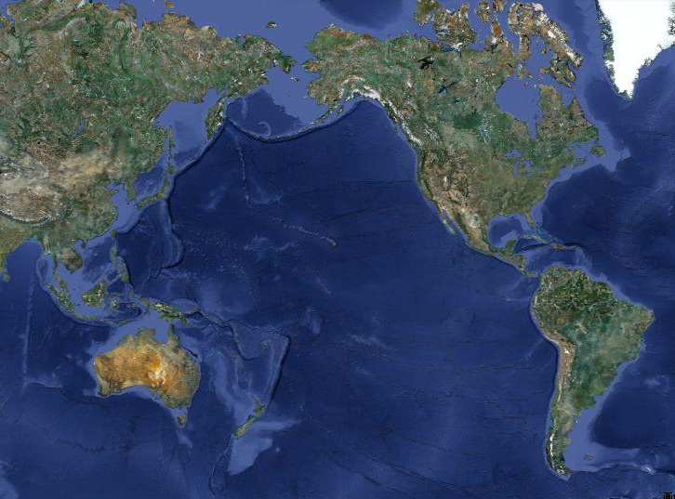
Hawaii
Puerto Rico
Guam
American Samoa

Slide 4
Preview of Today’s Talk
Hawaii
Guam
Puerto Rico
American Samoa
Voting Right in 4 Islands

Slide 5
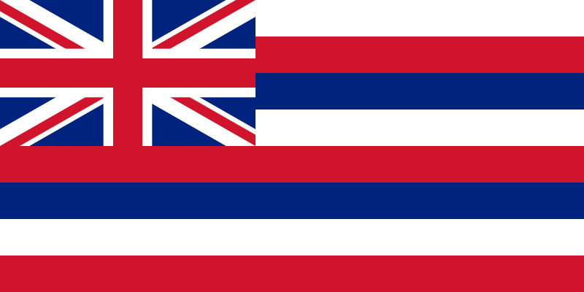
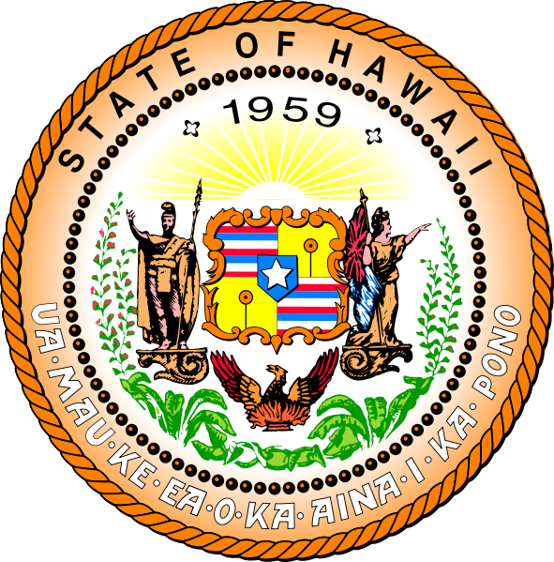
1-1. Hawaii
Population… 1,360,301(2010)
Area…28,311k㎡
Industries…
  the tourist industry
  military demand
  agriculture(pineapple)
Language… English, Hawaiian
Celebrity… Barack H. Obama

Slide 6
1-2. Hawaii -History-
About 250～
→Polynesia origin settles down
In 1778
→James Cook
In1789
→American
In1795
→Kamehameha the Great takes the throne
In1840
→Hawaiian constitution is promulgated

Slide 7
1-2. Hawaii -History-
In1894
→Republic birth in Hawaii
In1897
→Merger in Hawaii
In1900
→Hawaiian territory prefecture
In1959
→State of Hawaii
1795～
Hawaiian kingdom
1893～
Hawaiian republic
1900～
Territory Hawaii, U.S.A.
N O W
1959～
State of Hawaii

Slide 8
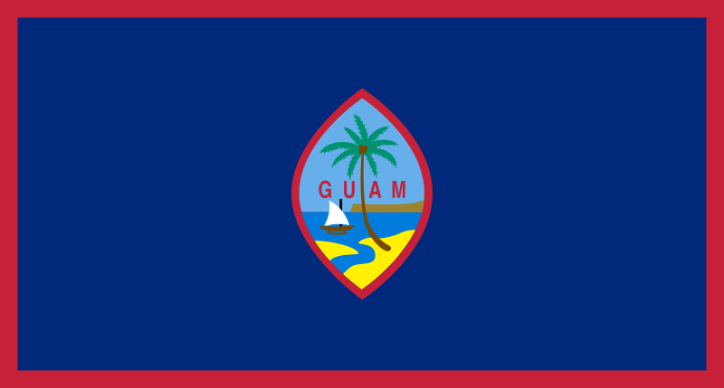
2-1. Guam
Population…163,941 (2003)
Area…549k㎡
Industries…
  the tourist industry
  the fishing industry (tuna)
Language… English, Chamorro(, Japanese)
Friendship City…Kashiwa city (Chiba)

Slide 9
2-2. Guam -History-
War!
B.C. 1500?
~ early 16century
→ Chamorro Age
1568 ~
→ occupied by Spain
1898 ~
→ occupied by US
1941 ~
→ occupied by Japan
In 1944
→ reigned by US
In 1950
→ became “organized unincorporated territory” in US
War!
Notes:
From B.C. 1500 (not certainly) to early 16century, Chamorro (who came from southeast Asia by voyaging canoe) started living in Guam.
In 1521, Magellan found Guam. He had been sailing all over the world, because he was ordered by king of Spain.
Magellan rested there for few days.
In 1568, king of Spain declared to occupy Guam.
In 1898, a war broke out among Spain and US. US won, and Guam was handed over from Spain to US.
In 1941, the Pacific War broke out. After Attack on Pearl Harbor, Japan attacked Guam, and took away Guam from US.
In 1944, US recaptured Guam, and in 1950, Guam became organized unincorporated territory(アメリカ合衆国自治的・未編入領域)

Slide 10
2-3. Guam
-Organized Unincorporated Territory-
What is “organized unincorporated territory”?
→It’s a place…
… which has Organic Act
established by United States Congress.
(organized)
… which Constitution of the United States isn’t applied there.
(unincorporated)
It’s not states, not territory,
but like as between them!
No Citizen!
Nationality
Notes:
A territory has original Organic Act(自治法) established (checked) by United States Congress(アメリカ合衆国議会),
but Constitution of the United States(アメリカ合衆国憲法) isn’t applied there.
So, although people who were born in American Samoa have American nationality, they don’t have American citizenship.
It’s not states, not territory, but like as between them.

Slide 11

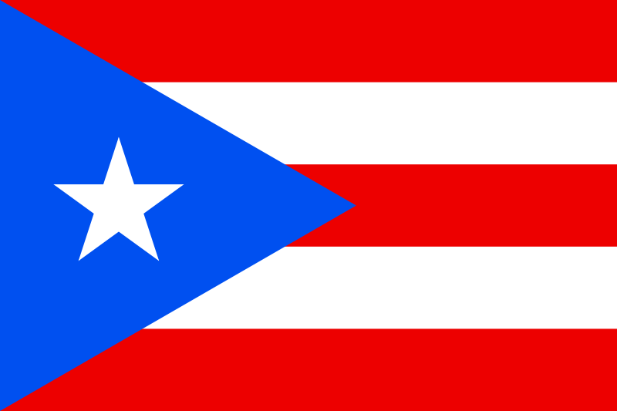
3-1. Puerto Rico
Population…3,749,009 (2010)
Area…9,104k㎡
Industries…
  the tourist industry
  medicine manufacture
  Rum production
  the fishing industry
Language… English, Spanish
Celebrity… Ricky Martin(singer)
♪ 1998 FIFA WORLD CUP

Slide 12
3-2. Puerto Rico -History-
Last Columbus period
Live…Aruak (Indian)
The Spanish colony times
In 1989
American-Spanish War
The United States of America territory times
In 1952
American Commonwealth
In1493
Cristobal Colon (European)
In 1508
Juan Ponce de León
(Spanish)

Slide 13
4-3. Puerto Rico
-American Commonwealth-
What is “American Commonwealth”?
⇒ American Soil or Protectorate
Recognize…The domestic administration
But…National defense and the diplomacy
⇒ the United States
organized unincorporated territory

Slide 14
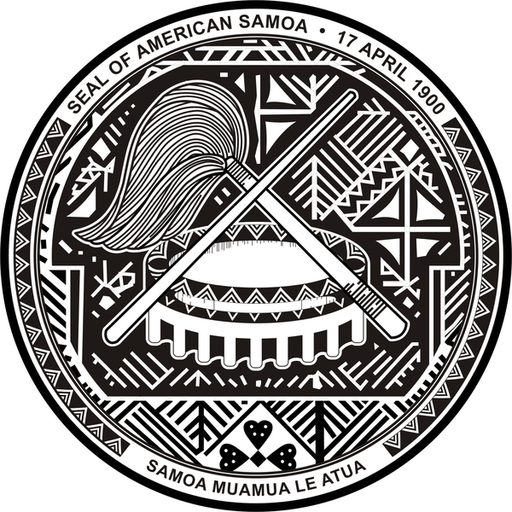
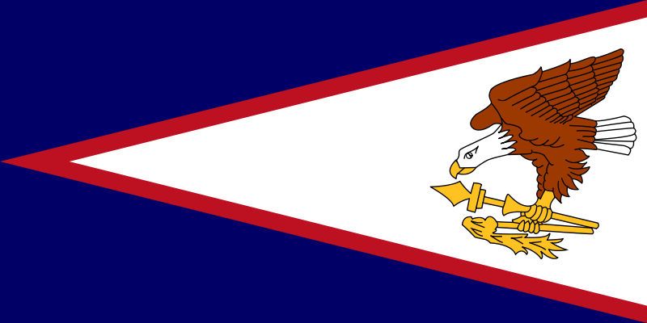
4-1. American Samoa
-East Samoa Islands-
Population…70,260 (2003)
Area…199k㎡(Tutuila Island, Aunu’u,
Manu’a, Rose Atoll, Swains Island)
Industries…
  agriculture(taro, yam, banana, coconut, etc….)
  the fishing industry (tuna)
  (the tourist industry)
Language…English, Samoa
Notes:
Perhaps tourist industry will develop in the future, because there are beautiful coral reefs around here.

Slide 15
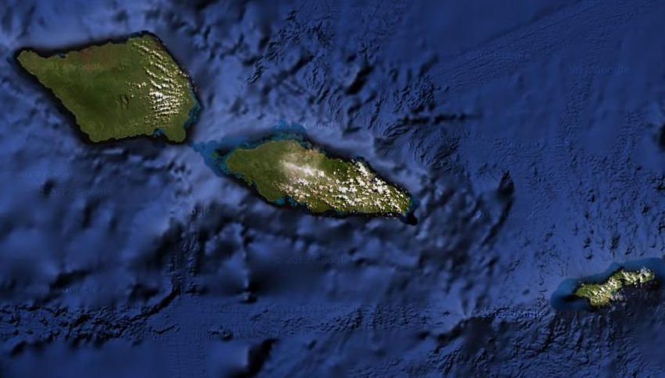
4-1. American Samoa
-Location-
↑ Swains Island
⇒American
Samoa
Independent State of Samoa
Tutuila Island
Aunu’u
The Samoa Islands
Manu’a Islands →
Rose Atoll
Notes:
These are the Samoa Islands.
Western part is Independent State of Samoa(サモア独立国).
Eastern part is American Samoa.

Slide 16
4-2. American Samoa -History-
~ 18century
→ no intervened
(connected with west)
In 18century
→ French explorer visited
In early 19century
→ spread Christianity
In 1889
→ attacked by German
In 1899
→ divided into
West and East
Fight?
Fight!
connected☺
The Samoa Islands
Notes:
Until 18century, the Samoa Islands was not visited by any foreigners, but east Samoa (now American Samoa) was well connected with west Samoa (now independent state of Samoa).
In 18century, the first foreigners came to Samoa. They were explorers came from France.
After that, some Europeans came to Samoa to invade.
Every invaders came, who live in Samoa fought against them.
In early 19century, Christianity was spread by missionaries of Congregational Church in London.
In 1889, German attacked Samoa.
In these days, US was in opposition to German, US also came to Samoa to compete with German.
Unfortunately, they met with bad weather, they lost their weapons and ships.
After all, they decided to have Samoa divided into West and East.
Eastern part is American.
Western part is German.
(※After that, western part had been protected by NZ since 1919, and indipended in 1962.)
Now, American Samoa is unorganized unincorporated territory (非自治的・未編入領域).

Slide 17
4-3. American Samoa
-Unorganized Unincorporated Territory-
What is “unorganized unincorporated territory”?
→It’s a place…
  … which doesn’t have Organic Act
established by United States Congress.
(unorganized)
  … which Constitution of the United States
isn’t applied there.
(unincorporated)
However, American Samoa has…
  … the original legislature, constitution, and self-government
No Citizen!
Nationality
Notes:
A territory doesn’t have original Organic Act(自治法) established (checked) by United States Congress(アメリカ合衆国議会),
and Constitution of the United States(アメリカ合衆国憲法) isn’t applied there.
So, although people who were born in American Samoa have American nationality, they don’t have American citizenship same as Guam and Puerto Rico.
American Samoa is not US legally, but they established the original legislature and made original constitution and self-government (自治政府).
American Samoa is a unique (unconventional) territory.

Slide 18
5-1. Voting Right –In the Islands-
Who live in there vote when there are elections of Governor, Lt. Governor, and members of congress in the islands.
Voters must…
 | be… | have… | live in there…
Hawaii | over 18 years old | US Nationality or Citizenship there | ―
Guam |  |  | ―
Puerto Rico |  |  | ―
American Samoa |  |  | for more than 2 years

Slide 19
5-2. Voting Right –President Election-
 | Position | US Nationality /Citizenship | Can they vote?
Hawaii
Guam
Puerto Rico
American Samoa
State
○/○
Yes!
Organized
Unincorporated
territory
○/×
No!
Commonwealth
(unincorporated)
○/×
No!
Unorganized
Unincorporated
territory
○/×
No!

Slide 20
Hawaii
Puerto Rico
Guam
American Samoa

Slide 21
Thank you for your listening!
Do you have any questions?

