Slide 1
Better than a Crescent Wrench: Poster Presentations
James A. Elwood
Meiji University
PanSIG 2016
Meio University, Nago, Okinawa
May 21, 2016

Slide 2
Outline
Poster Presentations?
The Humble Crescent Wrench
The Humble Poster
The Even-More-Humble Poster Presentation
The Course
Background
The Tasks
The Outcome
The Feedback
My Thoughts

Slide 3
The Humble Crescent Wrench
An all-purpose tool, the humble crescent wrench
Generally covered with a thin sheen of oil (in my father’s garages)
Very adaptable
“Spanner”?

Slide 4
The Humble Poster
An all-purpose tool, the humble poster
Seldom covered with oil
Very adaptable
Not called a “spanner”
Ubiquitous in my faculty

Slide 5
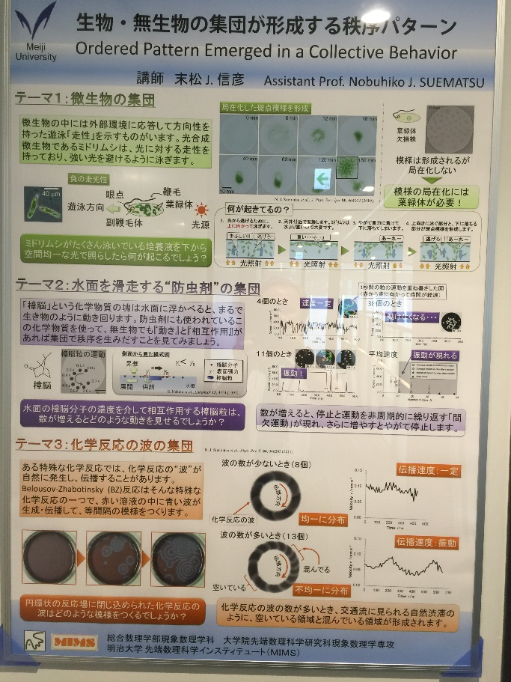
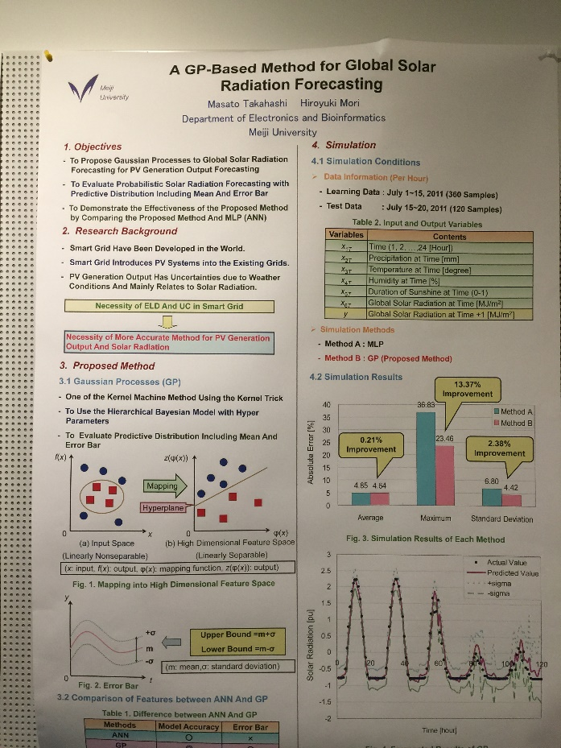
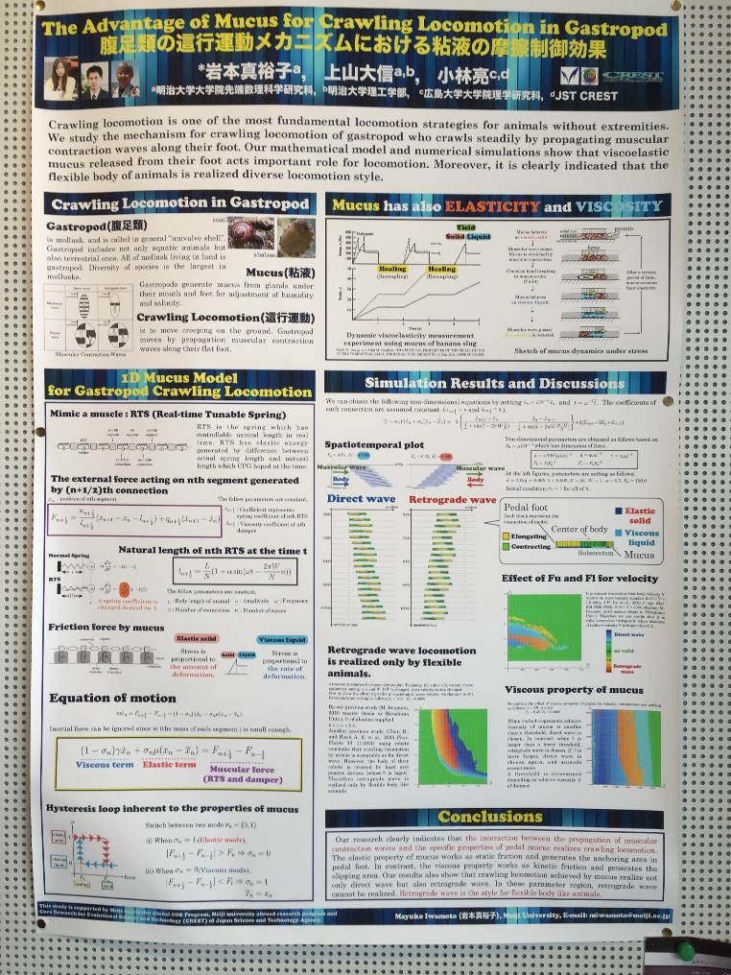
The Humble (Math) Poster
Mucus Gastropod Locomotion

Slide 6
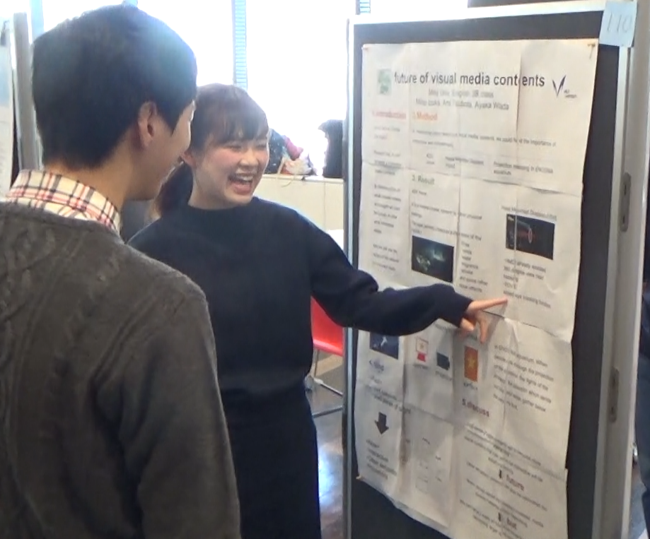
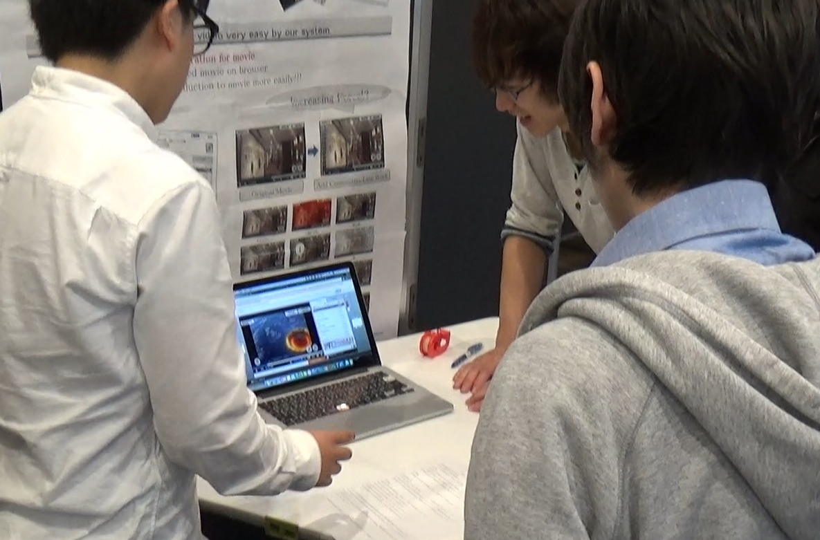
The Humble Poster

Slide 7
The Course Mandate
1. Prepare students for real world academic participation!
2. Oral presentations, of course, and …
3. Poster presentations

Slide 8
The Background
Recent faculty – founded in 2013-2014
Three departments
Grad school to begin in 2017-2018
Mandate: prep students for presentations
Year 1: RW course, SL course
Year 2: 4-skills course
Year 3: presentation course

Slide 9
Theory
1. Authentic content: from seminar (Gilmore, 2007)
2. Proposal creation and submission
3. Use of realia: actual posters
4. Non-contrived context: actual PP for classmates and department professors
5. Repetition: 90-min (akin to Pecha-Kucha?)
6. Autonomy: choose team members, select topic, construct PP (Pemberton et al., 1996)

Slide 10
The Timeline
English 3B (fall semester)
Week 1: Brainstorming, group formation (2-4 members)
Weeks 2-3: Writing proposals and abstracts
→ Submit proposal (which appears in program)
Week 5: Multiple-speaker formats
Week 8: Poster presentation (PP) introduction
Week 9: PP speaking (video clips)
Week 10: PP Q&A
Week 11: PP rehearsal
Week 12: PP
Week 13: Followup (debriefing)

Slide 11
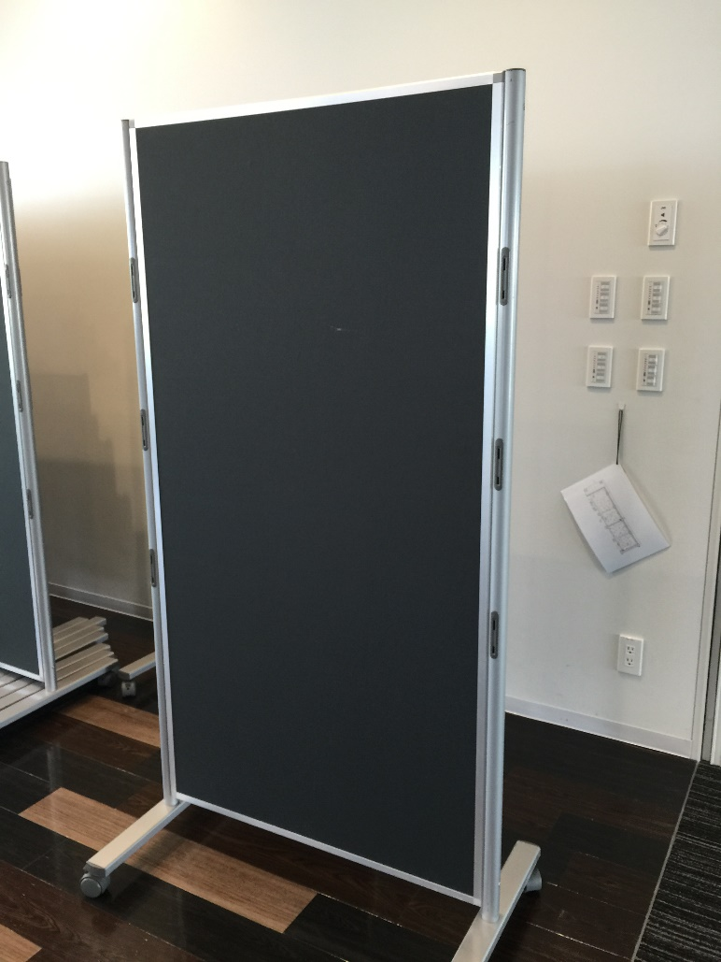
The Poster Presentation
Large student lounge
Poster board
Push-pins or tape

Slide 12
The Poster Presentation
3 classes of ca. 35 students, so 105 students
90 minutes
Faculty also invited
1 group member stayed at group’s poster, other members free to watch other groups

Slide 13
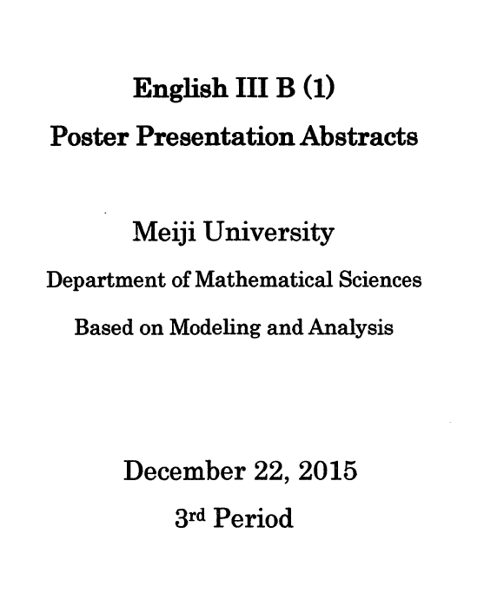
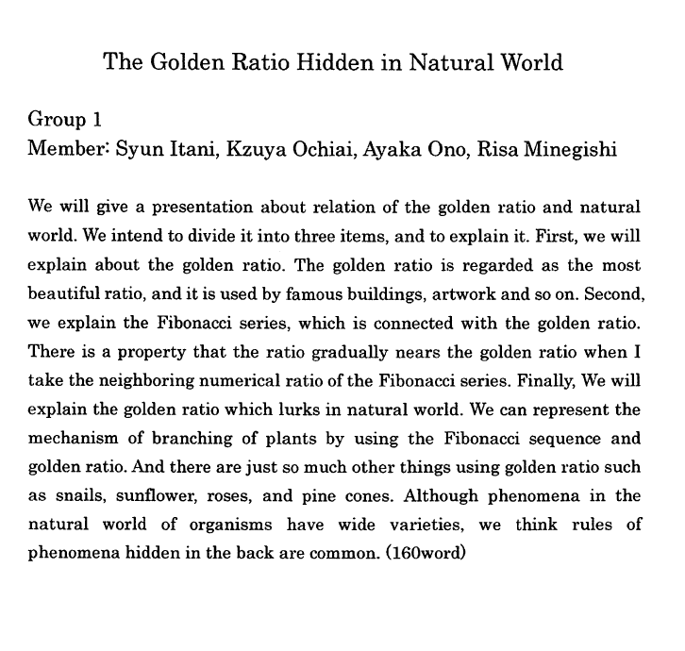
The Poster Presentation
Abstracts/proposals published in program

Slide 14
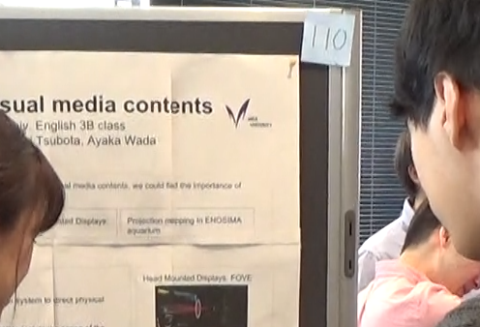
The Poster Presentation
Each group assigned place (poster board) with #
Students voted on best poster

Slide 15
The Poster Session
Let’s have a look …

Slide 16
The Followup
Each group submits self-critique one week later (several critiques during school year)
Announcement of Best Poster Award
Feedback from teacher to individual groups

Slide 17
The Feedback
Each student completed a questionnaire at the conclusion of the poster session (in addition to voting for the best poster)
Poster prep skills much improved (writing abstract, making poster)
Somewhat enjoyed making poster, but difficult
Prefer this type of class to regular class ☺
Could learn about other group’s research

Slide 18
The (Bad) Feedback
Frustration over printing (difficulty printing A0 size)
Group formation, composition
Poor English, difficult to understand
Difficulty choosing topic

Slide 19
My Thoughts
Perhaps the most realistic exercise I’ve ever taught
1000 moving parts
Institutional and faculty support (mostly!)
Very motivating (for all parties)

Slide 20
Conclusion

Slide 21
Furthermore …
Feel free to visit the class webpage for this endeavor at
www.jimelwood.net/students/meiji/english3B/ english3B.html
Feel free to use our material, too.

Slide 22
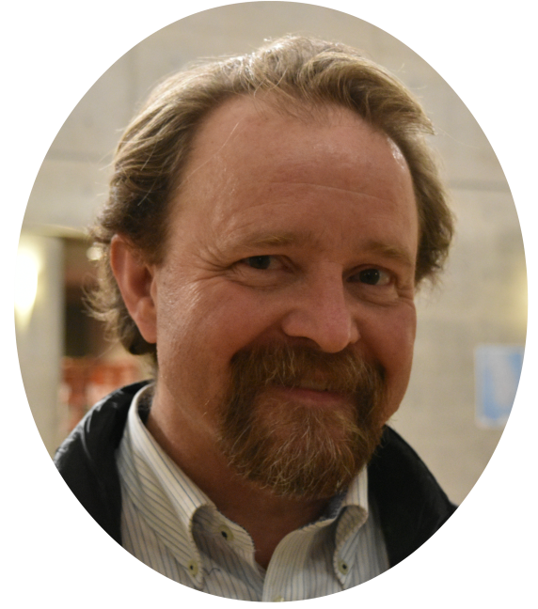
Finally …
I thank you for your kind attention.
elwood.jim@gmail.com

Slide 23
References
Gilmore, A. (2007). Authentic materials and authenticity in foreign language teaching. Language Teaching, 40(2), 97-118. doi: 10.1017/S0261444807004144
Pemberton, R., Li, E. S. L., Or, W. W. F, & Pierson, H. D. (Eds.) (1996). Taking control: Autonomy in language learning. Hong Kong: Hong Kong University Press.

