Slide 1
Land of the hornbills: Sarawak
MARTINI MOHAMAD SAFAIEE
Meiji University
March 4, 2014

Slide 2
ABOUT SARAWAK…
History
Geography
Demographics
Economy
Places

Slide 3
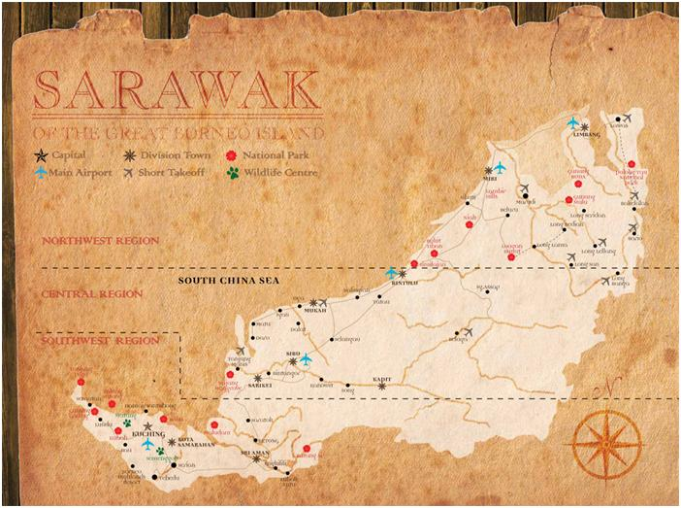
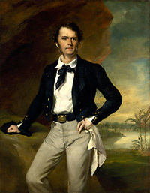
Lets talk a bit about history..
15th Century – Bruneian Empire
16th Century – Charted by Portuguese
19th Century – Restoration
24th September 1841 – Rajah of Sarawak
1841 – 1888 – Independent Kingdom
1941 – WW2 – Japanese Occupation
22 July 1963 – Independent
16 September 1963 – Formation of Federation of Malaysia

Slide 4
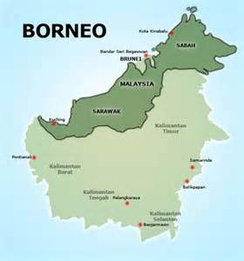
The Kingdom…
124,450 square kilometres
37.5% of Malaysia
Bordered by Brunei and Kalimantan (Indonesia)
Mountainous, caves and tropical forests

Slide 5
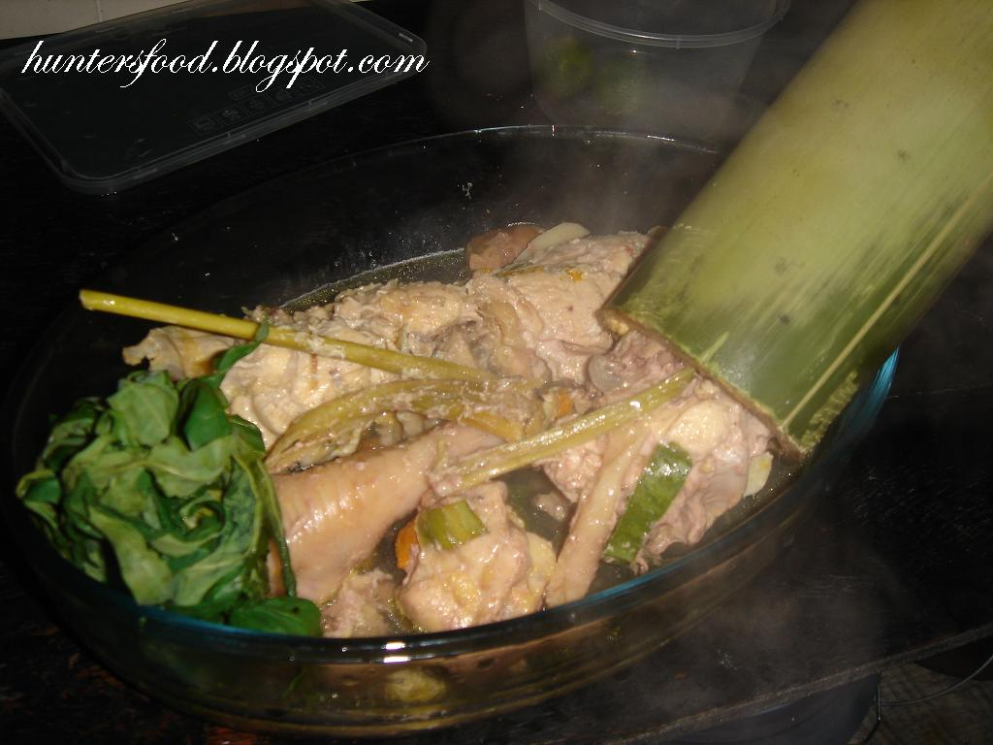
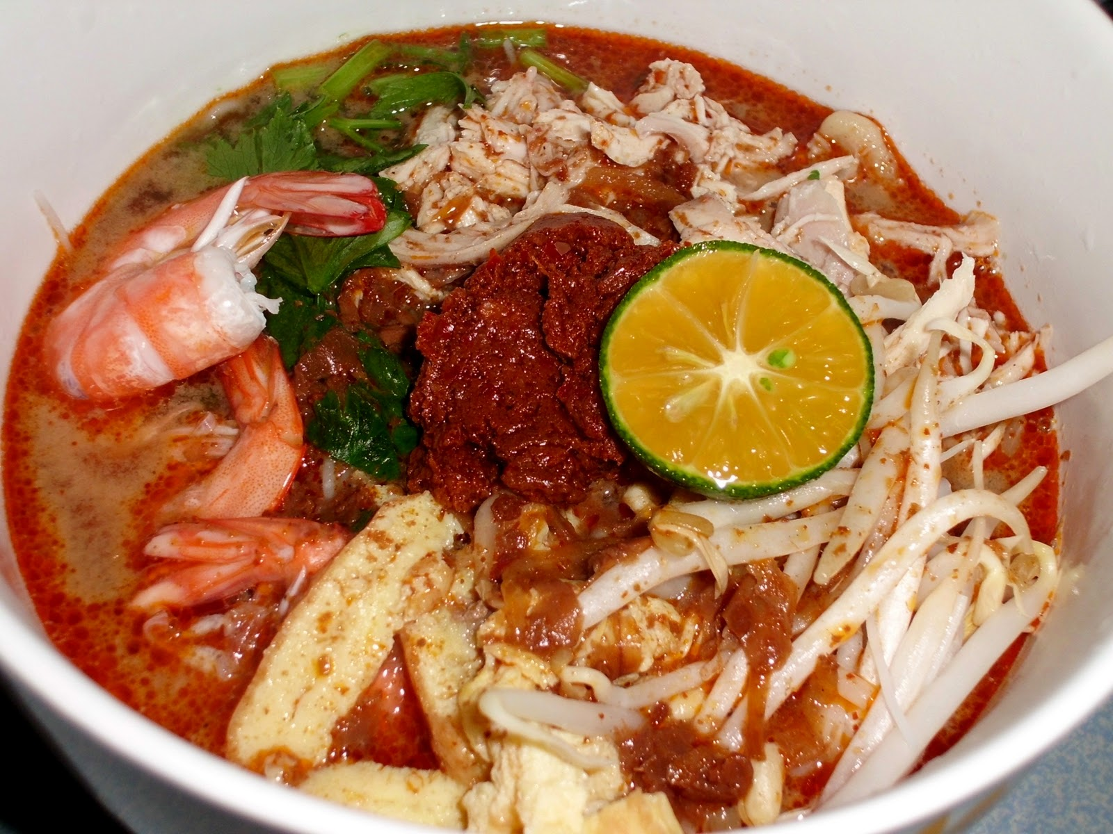
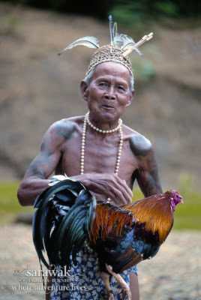
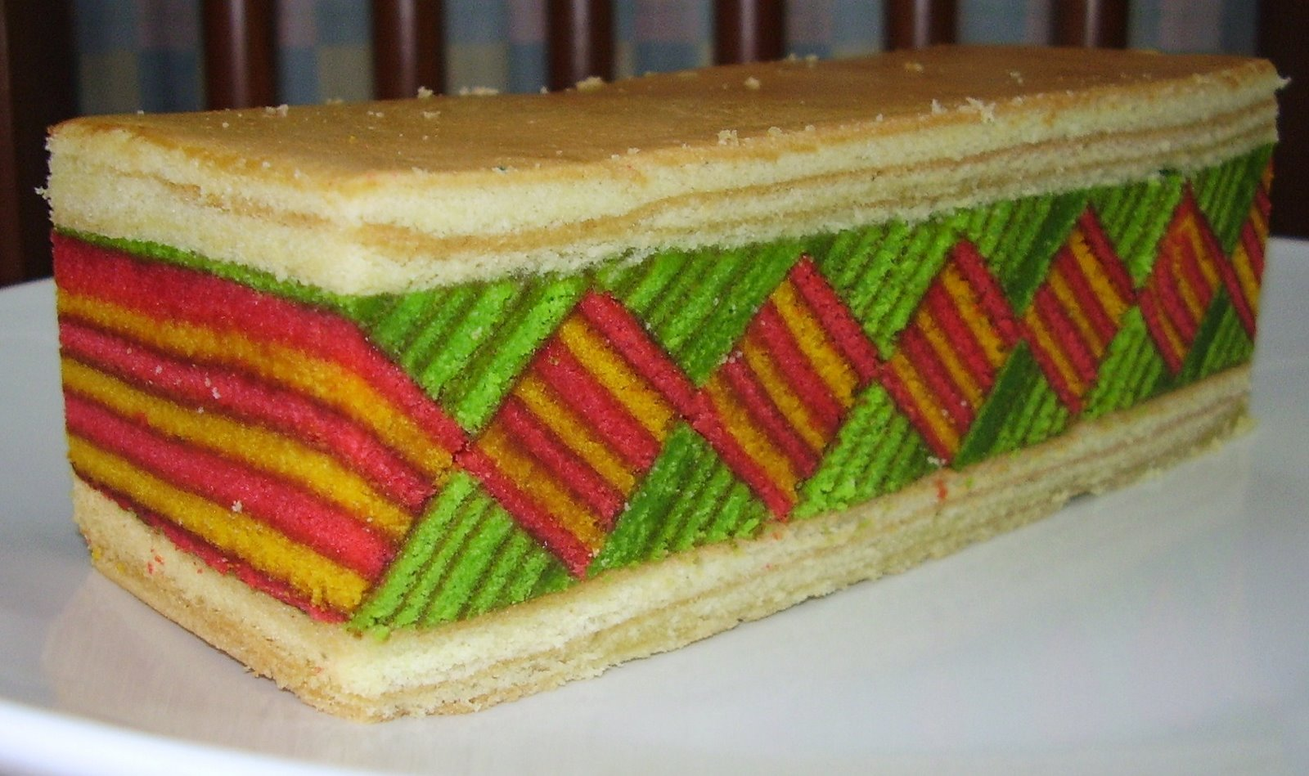
We are…
1473- 1521 – Sultan Bolkiah visited Jawa, Sumatra and Kalimantan.
Hardworking and very skillful in farming
Kedayan – mixed Jawa and Brunei
6th Century – as traders and explorers
Wide range of dialects – Cantonese, foochow, hakka
Ong Tiang Swee
(Kapitan China)
Iban
Chinese
Melanau
Bidayuh
Sarawak Malay
Kedayan

Slide 6
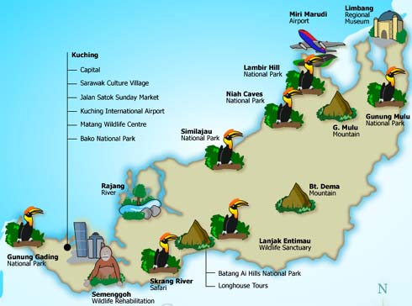
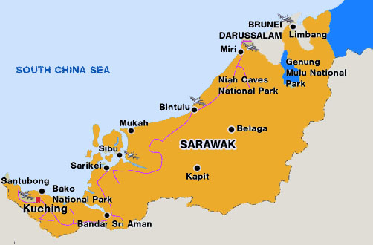
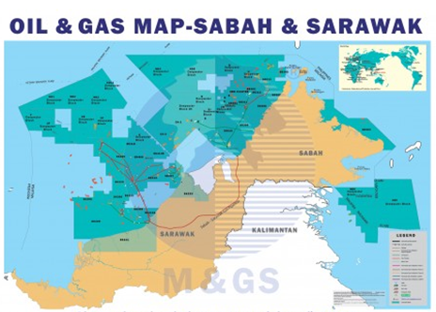
The development…economy
Natural resources
Tourism
One of Malaysia's biggest gas finds is in Block SK310 offshore Sarawak, where Newfield Exploration estimates initial gas in place at 1.5 trillion to 3 trillion cubic feet

Slide 7
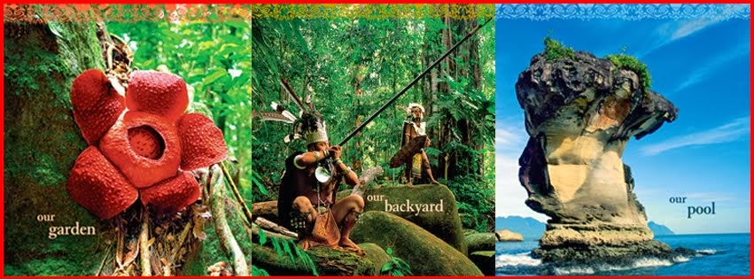
Visit us…you will never forget
Our garden..
Our backyard…
Our pools

Slide 9
Trima kasih THANK YOU

