Slide 1
TO JUKU or NOT TO JUKU
2015/01/20 Ishimoto marino
matsuo norie
Oda serera
Notes:
Hello everyone. I’m Marino and Norie. Today, we are going to tell you about Juku, which means cram school in Japanese.

Slide 2
overview
Activity ratio of Juku
Cost
Purpose of going to Juku
Parents opinions for school, policy of education, skills which parents want children to get
Comparison with other Asian countries
Our experiences
Discussion
Question
Notes:
We will talk about Juku for those points. 1st, ….2nd, ….Those 5parts will be explained by me (Marino) as the explanation of current situation of Juku in Japan. Next () parts will be talked by Ms. Matsuo.

Slide 3
1.Activity ratio of Juku
Total
Kindergarten
Elementary school
Junior high school
Senior high school
Notes:
Now I’m going to start my part. First one is about activity ratio of Juku.
This graph shows the activity ratio of each school. Junior high students’ activity ratio is the highest. That means many junior high school students go to Juku.

Slide 4
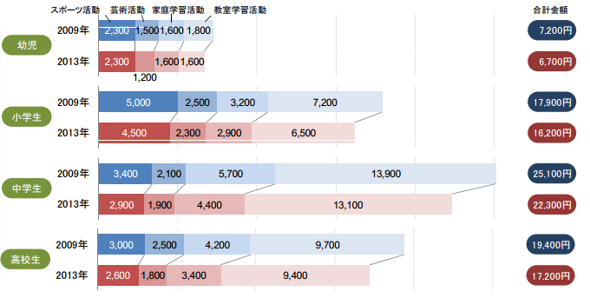
2.Cost
Kindergarten
Elementary school
Junior high
Senior high
Notes:
Next part is about cost. This graph shows the cost of educational activities except going to school per month. From left side of the bar, these numbers show the cost of sports activity, art activity, studying at home, and studying at Juku. The upper graph shows total cost, the graphs below shows the costs of each kind of schools. As you can see, the highest cost of each activity is going to Juku. No matter how low the income is, parents spend money for Juku the most.

Slide 5
If children take entrance exam for junior high…
Take the exam
Haven’t decided yet
Don’t take the exam
Notes:
If children decide to take entrance exam for junior high school, it costs over \40000.

Slide 6
3.Purpose of going to Juku
For entrance exam (12.0%)
To improve their English skill (11.1%)
To learn Japanese calligraphy and to have beautiful handwriting (7.4%)
Notes:
This is the purpose of going to Juku. Most children go to Juku for entrance exam, second for improving English skills, and third for learning Japanese calligraphy and having beautiful handwriting.

Slide 7
4.Parents’ opinions for school
・School education doesn’t suit of children’s skill
・Parents are satisfied with school education
・Teaching skill of teachers is getting lower
Notes:
From now, I’m going to talk about what the parents think about education. Firstly I’m going to tell you about their opinions for school. As you can see, Parents don’t expect so much to school.

Slide 8
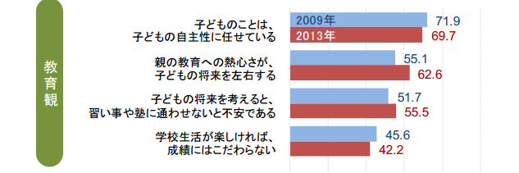
Parents’ policy of education
・Respect children’s independence
・Parents’ eagerness about education decides children’s future
・Considering children’s future,
parents worry about children if they don’t go to Juku
・If children enjoy their school life, parents don’t care about their score
Notes:
Second one is about parents policy of education. Over half of the parents think that they should consider more about children’s education. Moreover, over half of the parents will worry about their children’s future if the children don’t go to Juku. Many parents depend on Juku, may be since they can’t trust school.

Slide 9
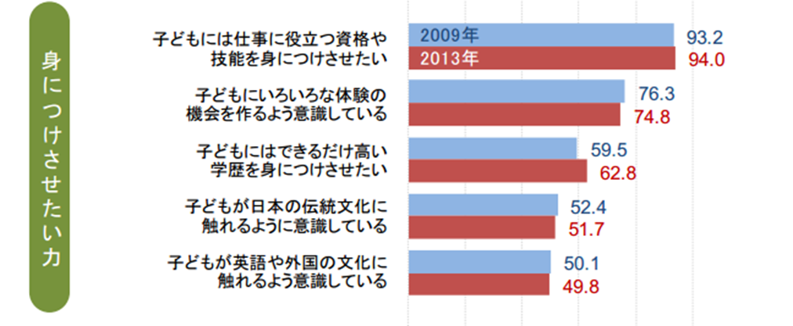
What kind of skills do parents want children to get?
・Skill and qualification for children’s jobs
・Various
experiences
・Better academic background
・Experiences of learning Japanese traditional culture
・Having experiences of learning foreign cultures and English
Notes:
Last one is about the skills which parents want children to get. Experience of learning Japanese culture might be related to many children’s learning Japanese calligraphy. Learning foreign cultures and English might be related to children’s learning English. Skill and qualification is related to both of them. Thinking about what kind of skills parents want children to learn might be related to what kind of Juku they want children to go.

Slide 10
5.To compare with other Asian countries…
Notes:
To compare with other Asian countries, in Seoul, which is capital city of Korea, many parents spend money for going to art school, English school, educational magazines and so on. In Bejing and 上海、the most popular Juku is art school.

Slide 11
6.Our experiences
In case of….
・Norie Matsuo
・Marino Ishimoto
・Serera Oda

Slide 12
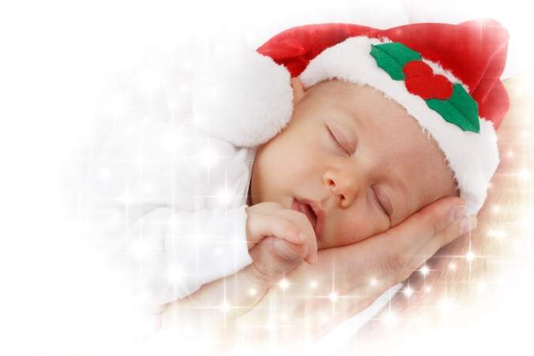
7.Discussion
If you are parents, teacher, government or so,
Do you want children to
go to Juku?
Why?

Slide 13
8.Question
Do you have any questions?

Slide 14
Thank you for your attention!

