Slide 1
IPA
(International Phonetic Alphabet)
Notes:
Background = “essential”

Slide 2
Again, the Japanese vowels
ア = / ɑ /
イ = / i /
ウ = / u /
エ = / ε /
オ = / o /

Slide 3


The vowel map…

Slide 4
The vowel map…

Slide 5
The vowel map…
i
u
ε
o
ɑ

Slide 6
Today, some new vowel sounds
/ ɪ / = hit, river, fish
/ æ / = hat, cash, fast
/ Λ / = up, lunch, butter
/ Ʊ / = foot, should, push

Slide 7
The vowel map…
i
u
ɪ
Ʊ
ε
Λ
o
æ
ɑ

Slide 8
Let’s practice ☺
/ rɪvr / = ______
river
/ mæʧ / = _______
match
/ mΛðr / = ________
mother
/ ʃƱ:d / = ________
should

Slide 9
Let’s practice ☺
/ ʃo: mi / = _________
Show me.
/ ʃu:z / = ______
shoes
/ bΛɾr / = _______
butter
/ fɪŋgr / = ______
finger

Slide 10
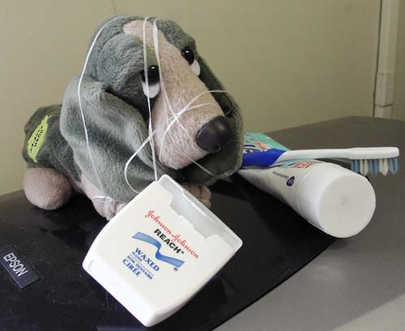
I’d be happy to entertain any questions at this time!
(sorry if I’ve tied you in knots)

