Slide 1
IPA (International Phonetic Alphabet)

Slide 2
First, an introduction…
“phonetic” means … sound
The basic idea is one symbol = one sound
IPA symbols are in slashes / … /

Slide 3
Today, the affricates
Sounds that combine a plosive and a fricative …
The symbol is thus also a combination of two symbols.
The place of articulation will be (almost) the same for both sounds, of course.

Slide 4
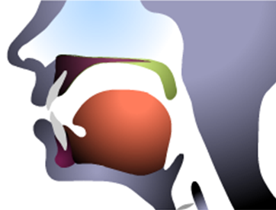
Place of Articulation Alveolar Ridge
Alveolar ridge

Slide 5
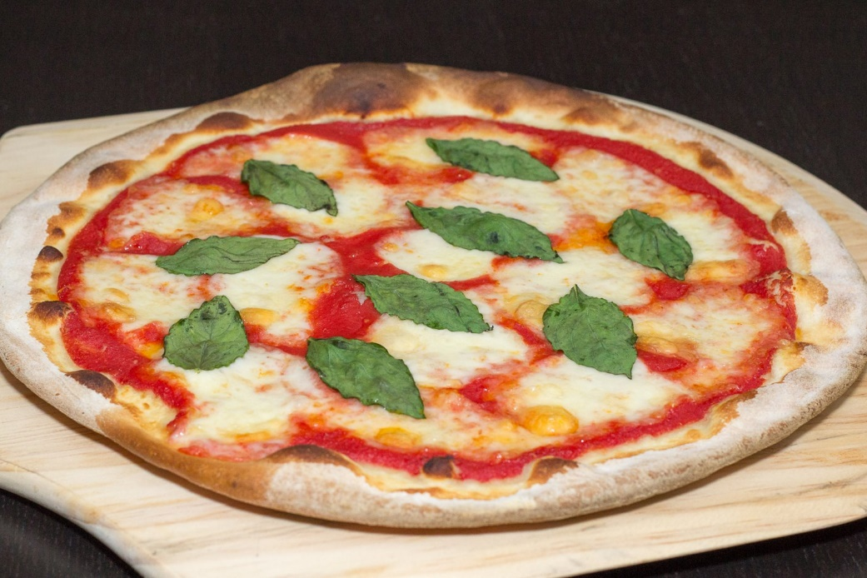
Alveolar Affricates?
Alveolar plosive + alveolar fricative … both voiceless
t + s = ____
The symbol is thus …
t s → t s → ts → ʦ

Slide 6
Alveolar Affricates?
Alveolar plosive + post-alveolar fricative … both voiceless
t + ʃ = ____ (“t” + “sh”)
The symbol is thus …
t ʃ → t ʃ → tʃ → ʧ
The sound? Of course, chair, each, …

Slide 7
Alveolar Affricates?
Alveolar plosive + post-alveolar fricative … both voiced
d + ʒ = ____ (“d” + “zh”)
The symbol is thus …
d ʒ → d ʒ → dʒ → ʤ
The sound? How about June, general, just, and Giants?

Slide 8
Thus, the affricates
ts = / ʦ / pizza, Let’s go!
ch = / ʧ / chair, each, cherry
g, j = / ʤ / Giants, June

Slide 9
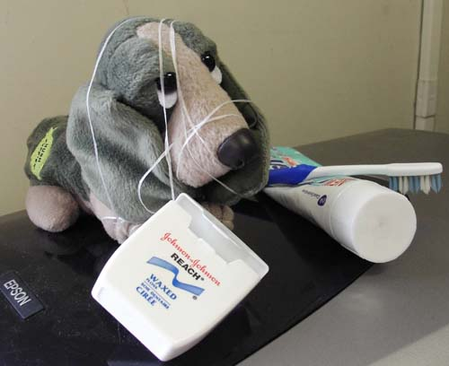
I’d be happy to entertain any questions at this time!
(sorry if I’ve tied you in knots)

