Slide 1
IPA (International Phonetic Alphabet)

Slide 2
First, an introduction…
“phonetic” means … sound
The basic idea is one symbol = one sound
IPA symbols are in slashes / … /

Slide 3
Today, the fricatives
Sounds based on friction …
Rub your hands together and feel the heat … which is from friction.

Slide 4
Places of Articulation
Articulation? How a word is said or pronounced …
First, imagine a person’s head…

Slide 5
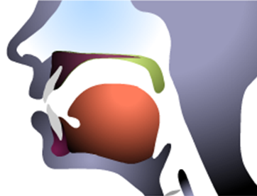
Inside Your Mouth
Now imagine inside the mouth…

Slide 6
Place of Articulation Lips
lips → labi, labio

Slide 7
Place of Articulation Teeth
teeth → dental

Slide 8
What would labio-dental mean?
How about labio + dental, or lips + teeth?
Thus, a labio-dental fricative would be …
f = / f / fish, alphabet
Note that / f / is voiceless, and …
v = / v / very, television, convenience

Slide 9
Place of Articulation Teeth
teeth → dental

Slide 10
How about dental fricatives?
How about dental (teeth) + your tongue?
Thus, a dental fricative would be …
th = / θ / theta, think, with
ð is an old letter called eth
The voiced counterpart is …
th = / ð / this, mother

Slide 11
Place of Articulation Alveolar Ridge
Alveolar ridge

Slide 12
Alveolar Fricatives?
How about your alveolar ridge + your tongue?
Thus, an alveolar fricative would be …
s = / s / sing, yes
The voiced counterpart is …
z = / z / zebra, rise

Slide 13
Post-alveolar Fricatives?
Move slightly back from your alveolar ridge and add your tongue …
Thus, a post-alveolar fricative is …
sh = / ʃ / she, fish
The voiced counterpart is …
zh = / ʒ / pleasure

Slide 14
Place of Articulation Glottis
Glottis

Slide 15
Glottal Fricatives
OK, one more time: How about a glottal fricative?
Thus, a glottal fricative would be …
h = / h / hello, how

Slide 16
Thus, the fricatives (part 1)
f = / f / fine, alphabet
v = / v / very, television
th (-voice) = / Ɵ / thank, with
th (+voice) = / ð / this, mother

Slide 17
Thus, the fricatives (part 2)
s = / s / sun, yes
z = / z / zebra, visit
sh = / ʃ / she, dish
zh = / ʒ / My pleasure.
h = / h / how, help

Slide 18
OK, Some Practice
/ ʃu:z /
/ fıʃ /
/ Ɵık /
/ ðıs /
/ …. /

Slide 19
OK, Some Practice
ʃu:z /
/ fiʃ /
/ Ɵik /
/ ðis /
/ …. /
/ ʒ /

Slide 20
I’d be happy to entertain any questions at this time!
(sorry if I’ve tied you in knots)

