Slide 1
IPA
(International Phonetic Alphabet)

Slide 2
First, an introduction…
“phonetic” means … sound
The basic idea is one symbol = one sound
IPA symbols are in slashes / … /

Slide 3
Today, the nasals
“Nasal” refers to your nose, so with nasal sounds the nose figures prominently.
For our purposes we will be looking at just three …

Slide 4

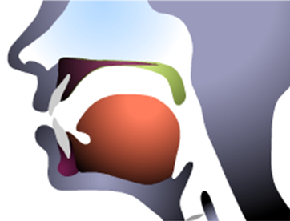
Place of Articulation
Nasal Cavity
Nasal cavity

Slide 5
Nasal Sounds
Bilabial nasal = ____
Remember our bilabial plosives, /b/ and /p/?
Thus, a bilabial nasal would be …
m = / m /

Slide 6
Nasal Sounds
Alveolar nasal = ____
Remember our alveolar plosives,
/t/ and /d/?
Thus, an alveolar nasal would be …
n = / n /
Wasn’t that easy?

Slide 7
Nasal Sounds
Velar nasal = __?__
Remember our velar plosives, / k / and / ɡ /?
When a nasal sound like /n/ appears before a velar plosive, it become velarized, like the n in think. The same is true for nɡ as in sinɡ / sıŋ /

Slide 8
Nasal Sounds
Imagine n before k in the word think.
The /n/ sound moves back toward the velum…
The symbol is a small n with a tail:
think =/ Ɵıŋk/
sing = / sıŋ/
ŋ

Slide 9
Thus, the nasals
m = / m / mother, lemon
n = / n / Newton, seven
nk, ng, = / ŋ / think, sing

Slide 10
Second, the glides
“Glide” refers to sounds which move or glide from one place to another
We will be looking at just two …

Slide 11
Glides
Our first glide is the labio-velar glide.
Labio- refers to lips, of course, while velar refers to the back top part of your mouth (what are the velar plosives, folks?)
Perhaps / k / and / g / ?
Thus, a labio-velar glide would be …

Slide 12
Places of Articulation
Velum
Lips

Slide 13
Glides
Got that? Of course, the labio-velar glide is W, which is cleverly written / w /.
Examples include water, wet, Wednesday, was, and so forth.
Note that question words, however, usually include a second sound …

Slide 14
Glides
when = / hwɛn /
what = / hwʌt /
why = / hwai /
where = / hwɛr /
However, note that one is different …
who = / hu: /

Slide 15
Glides
Our second glide is the alveolar-palatal glide.
Alveolar- refers to the little ridge behind your teeth, of course, while the palate refers to the top part of your mouth
Thus, our alveolar-palatal glide would be …

Slide 16
Alveolar-Palatal Glide
Remember our alveolar plosives, / t / and / d /?
How about our velar plosives, /k/ and /g/?
This glide will move from the front location to the back one …

Slide 17
Labio-velar Glide

Slide 18
Places of Articulation
Alveolar ridge
Palate

Slide 19
Glides
Alveolar-palatal glide = ____
Of course, the Y sound, which is written / j /
yes = / jɛs /
yellow = / jɛlo /
Yamamoto = / jɑmɑmoto /

Slide 20
Thus, the glides
w = / w / west, Elwood ☺
y = / j / yellow / jɛlo /

Slide 21
Finally, the liquids
“Liquid” refers to a water-like quality that these sounds possess, which makes them both beautiful and difficult (sorry).
We will be looking at four …
Of importance is whether the tongue touches the alveolar ridge or not.

Slide 22
Place of Articulation
Liquids
Not touching

Slide 23
L Sound
Alveolar liquid = ____
Remember our alveolar plosives,
/ t / and / d /?
In this sound, your tongue will touch the alveolar ridge as you say, “I like you.”
L = / l / ⬅ small L

Slide 24
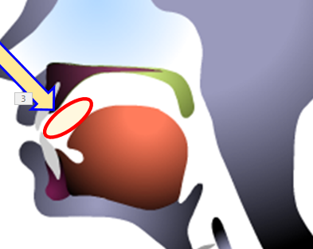
R Sound #1
R liquid, the basic R sound
Your tongue does NOT touch the top of your mouth.
R = / r /
red, rabbit, royal

Slide 25
R Sound #2
R liquid, the basic R sound as written “er” (e.g., mother, sure)
Again, your tongue does NOT touch the top of your mouth.
‘er’ = / ɚ /
mother = / mΛðɚ /
ɚ

Slide 26
R Sound #3
R liquid, which is used in the ら行 in Japanese
Here, your tongue DOES touch the top of your mouth.
ら = / ɾɑ /
Hiroshi = / hiɾoʃi /
ɾ

Slide 27
Thus, the liquids
L = / l / like, lemon, hello
R₁ = / r / red, rabbit,
R₂ = / ɚ / mother, sure
R₃ = / ɾ / ら [ɾɑ]

Slide 28
Today’s Sounds
nasals = / m n ŋ /
glides = / w j /
liquids = / l r ɚ ɾ /

Slide 29
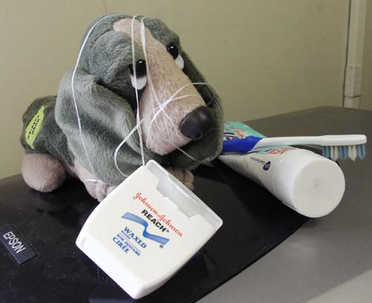
I’d be happy to entertain any questions at this time!
(sorry if I’ve tied you in knots)

