Slide 1

Cross-modal Effects:
Taste, Olfaction, and Vision
Student #1 & Student #2
English ⅢA
July 26, 2018

Slide 2
Today’s Topic
Introduction
Principle
Research: Cross-modal effects on olfaction and vision
Research: Smelling Shapes
Research: Meta-Cookie
Summary
Q&A

Slide 3
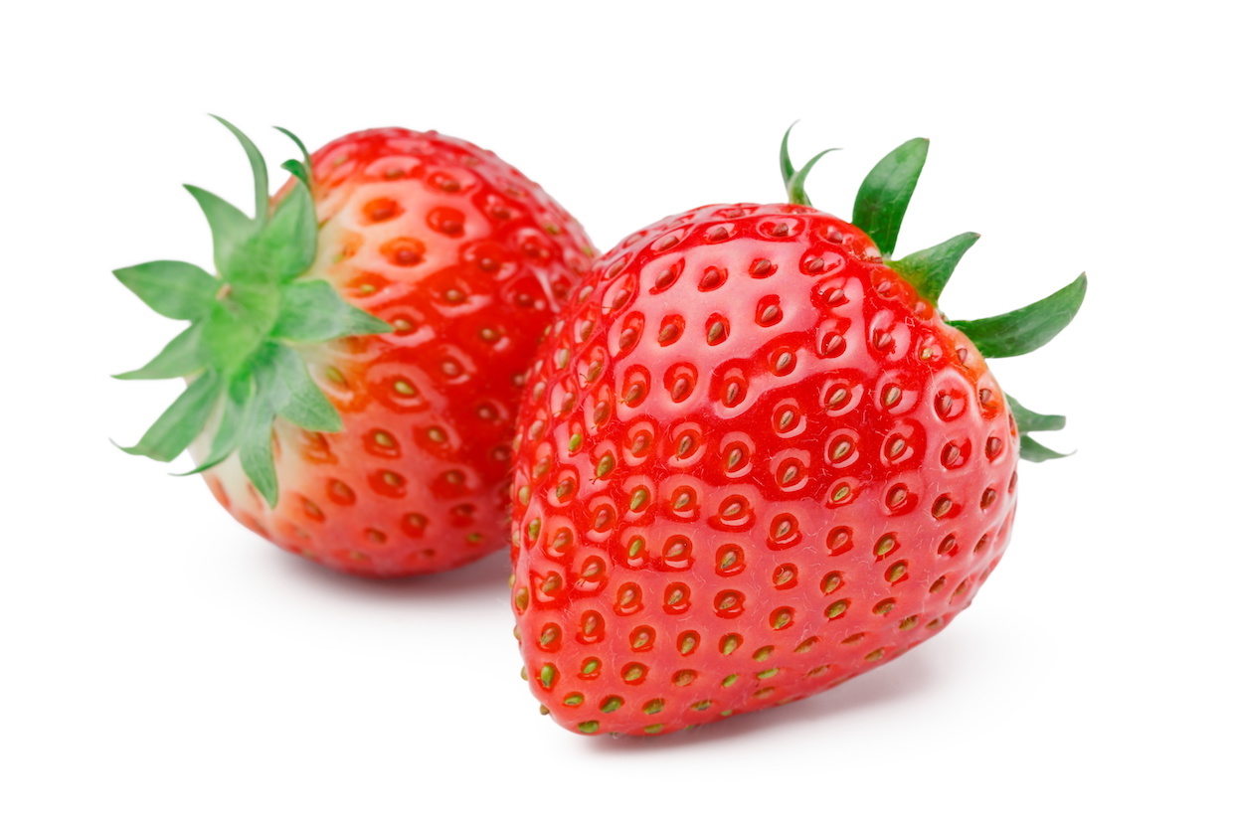
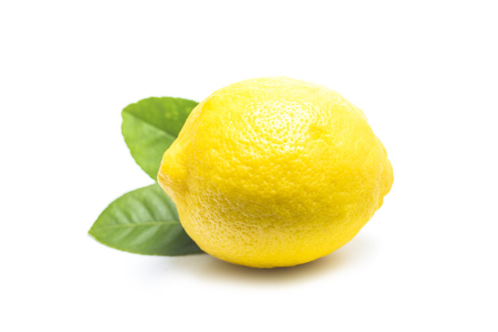
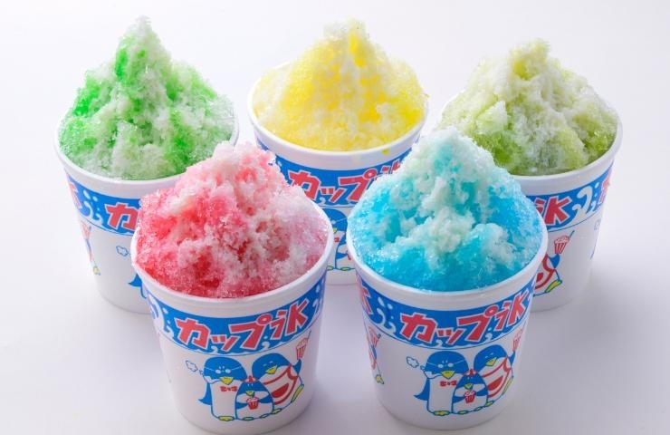
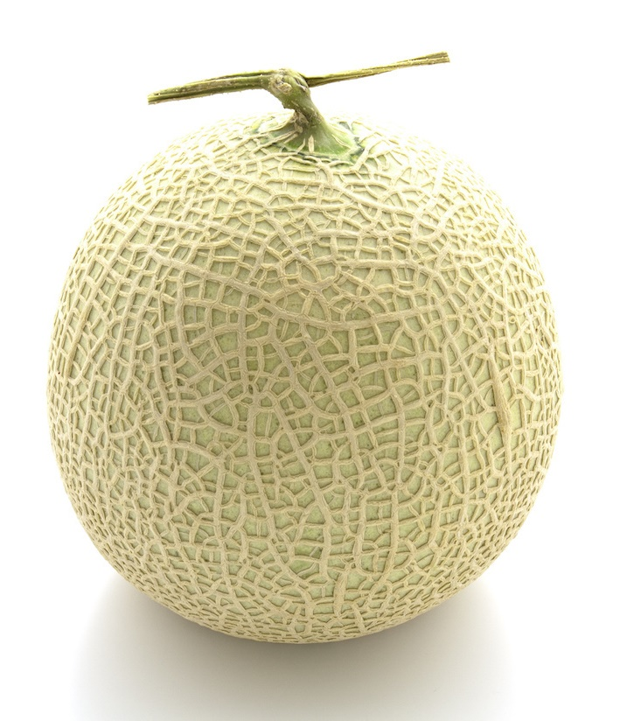
Introduction
Shaved Ice

Slide 4






What is Cross-modal effect ?
The simultaneous perception of several different pieces of information influence each other's senses

Slide 5
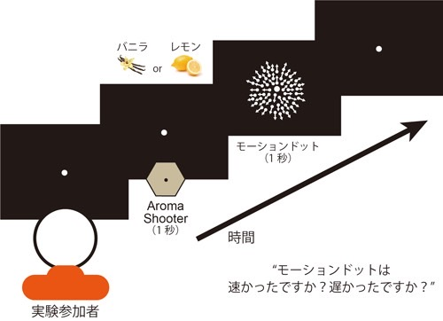
Olfactory Stimulation Modulates Visual Perception Without Training
Vanilla Lemon
Motion Dots (1s)
Aroma Shooter
(1s)
Time
Q. Is motion dot slow or fast?
Experiment participants

Slide 6
vision
hearing
tactile
olfaction
taste
eye(sight)
ear(sound)
skin(vibration)
nose(smell)
tongue(flavor)

Slide 7
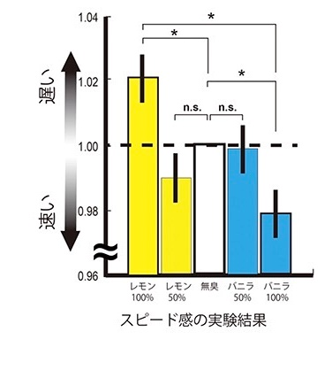

Result : a sense of speed
Lemon aroma
the image is perceived slower
Vanilla aroma
the image is perceived faster
Fast Slow
Odorless
Lemon
100% 50%
Vanilla
100% 50%

Slide 8
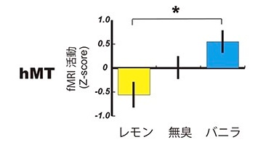
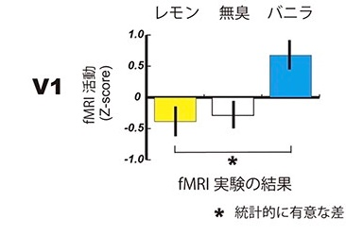
Results: fMRI
Scent alters brain motor activity in the visual cortex
Lemon
Odorless
Vanilla
Odorless
Lemon
Vanilla
significant difference

Slide 9
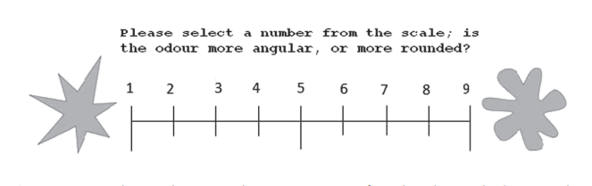
Smelling Shapes: Cross-modal Correspondences Between Odors and Shapes
Select a number from the scale
(whether the smell is more angular or more rounded)

Slide 10
vision
hearing
tactile
olfaction
taste
eye(sight)
ear(sound)
skin(vibration)
nose(smell)
tongue(flavor)

Slide 11



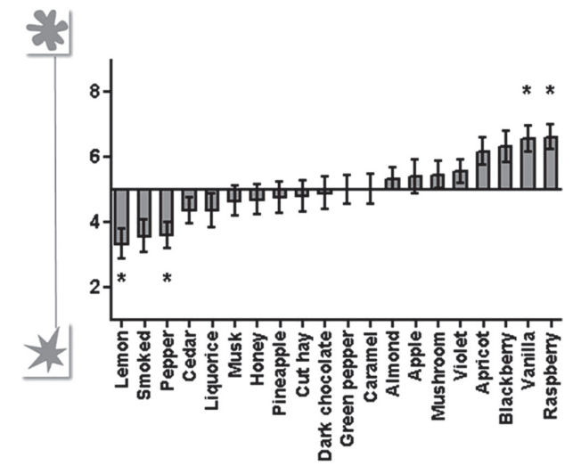
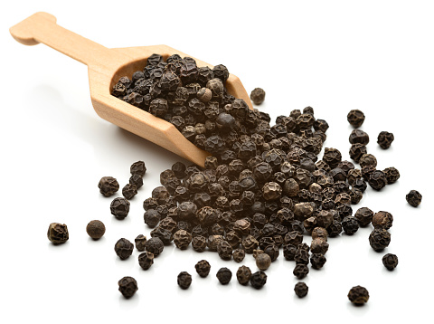

Result: Olfactory perception
Rounded shape
Angular shape

Slide 12




application example
Perfume
Wine

Slide 13
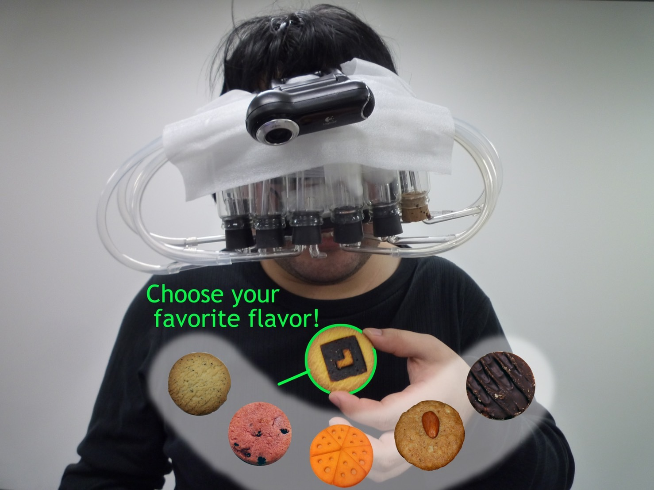
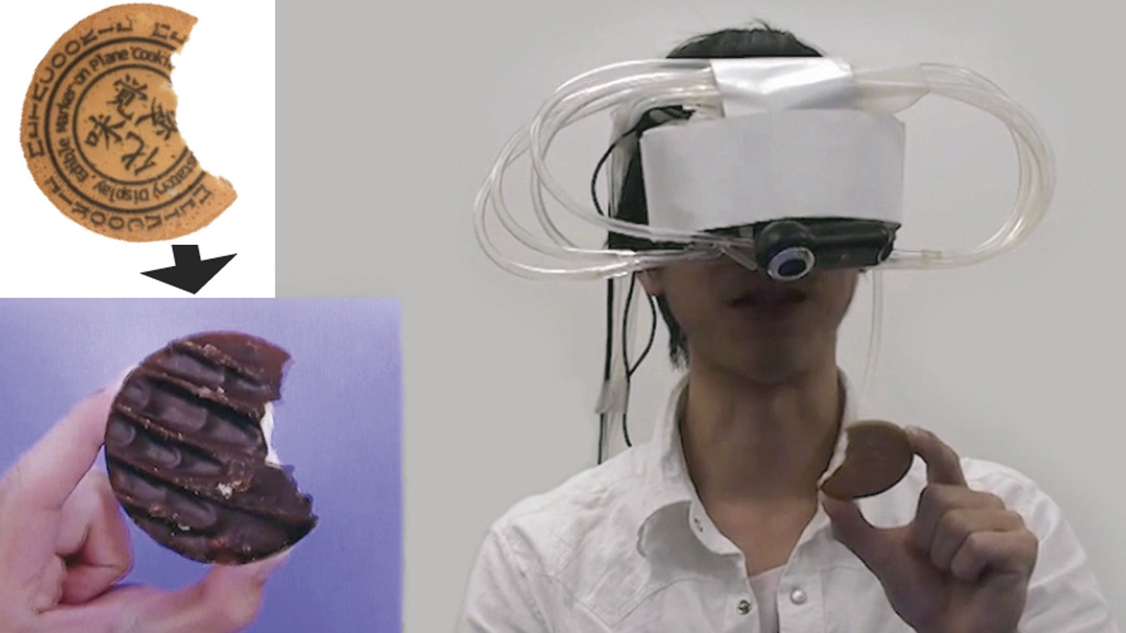
Meta Cookie: Pseudo-Gustatory Display Based on Cross-Modal Integration

Slide 14
vision
hearing
tactile
olfaction
taste
eye(sight)
ear(sound)
skin(vibration)
nose(smell)
tongue(flavor)

Slide 15
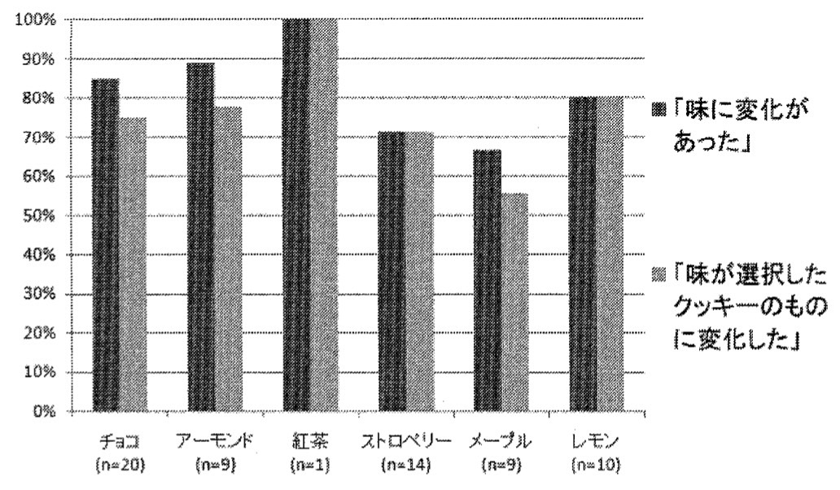
Result: Flavor perception
There was a change in taste
Taste changed to that of the cookie of choice
Chocolate Almond Tea Strawberry Maple Lemon

Slide 16


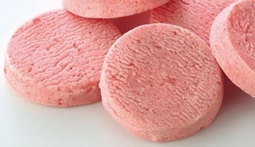

Summary
olfaction
vision
taste
hearing
tactile

Slide 17
Q&A
Do you have any questions?

Slide 18
Q&A (We got a question from our friend in advance.)
Q: How will the research on smell and speed
that was introduced in your talk be applied
in the future?

Slide 19
Finally ...
I thank you for your kind attention.

Slide 20
References
Hanson-Vaux, G., Crisinel, A.-S., & Spence, C. (2013). Smelling shapes: Crossmodal correspondences between odors and shapes. Chemical Senses, 38, 161-166. https://doi.org/10.1093/chemse/bjs087
Narumi, T., Tanikawa, T., Kajinami, T., & Hirose, M. (2010). Meta cookie: Pseudo-gustatory display based on cross-modal integration. TVRSJ, 15, 579-588. https://doi.org/10.18974/tvrsj.15.4_579
Tsushima, Y., Nishino, Y., & Ando, H. (2021). Olfactory stimulation modulates visual perception without training. Frontiers in Neuroscience, 15, 642584. https://doi.org/10.3389/fnins.2021.642584

