Slide 1
A Tale of Three (Wireless) Contexts
George R. MacLean & James A. Elwood
Tsukuba University
JALTCALL 2009
Tōyō Gakuen University
Tokyo
June 6, 2009

Slide 2
Background (MacLean & Elwood, 2009)
Investigate the concept of “digital native” (Prensky, 2001) ➔ what are students capable of?
Extend Willingness to Communicate (WTC; McCroskey, 1992) to our tech world ➔ Willingness to Use Technology?
Investigate technology effects on user perceptions (Beckers & Schmidt, 2001)
Explore student technology anxiety (Rosen & Weil, 1995)
Conduct needs analysis: what can we reasonably ask Ss to do outside classroom re technology?

Slide 3
Background (current study)
Extend to other contexts ➔ how do contexts in Japan, Cambodia, and Malaysia compare?
Check the instrument again (especially WUT)
Check whether observed trends persist (e.g., “digital natives” with accents?)
Elicit data for educational policy development given reality of funding decisions, limitations ➔ how tech can (or should) be introduced / integrated into foreign language classrooms
Establish baseline of ICT competency, perceptions, usage in three contexts

Slide 4
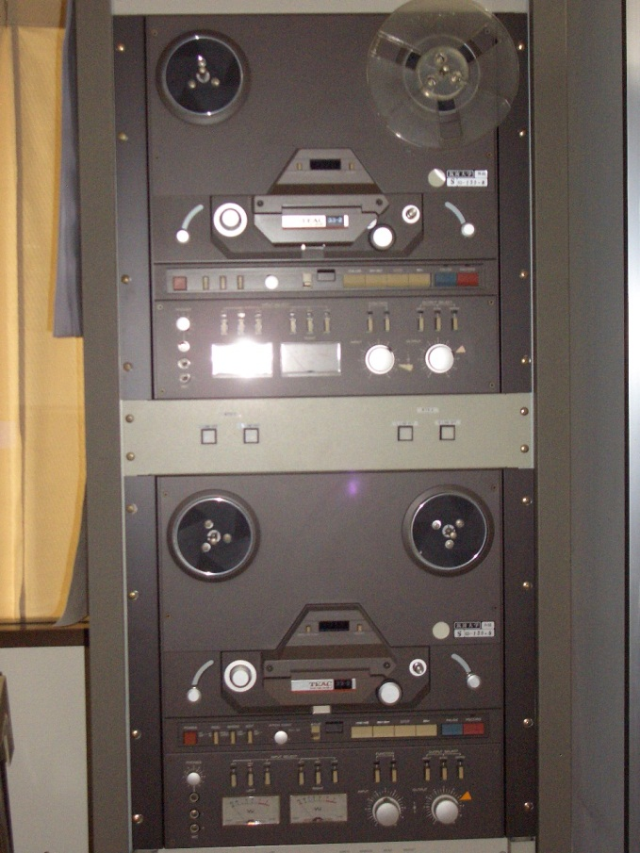
Three contexts
(Above: a preview of coming attractions…)

Slide 5
Cambodia
National Institute of Education (NIE)
1500 students, fewer than 40 computers
Outside uni access: internet shop-bases (slow speed, costly, mostly in cities and larger towns)
Internet provider monthly fee higher than Japan: 7000yen for evening-only dial-up
Cell phones: 95%, higher among uni Ss (basic operation tool for talking, texting)

Slide 6
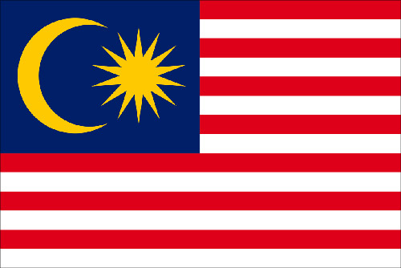
Malaysia
I
I

Slide 7
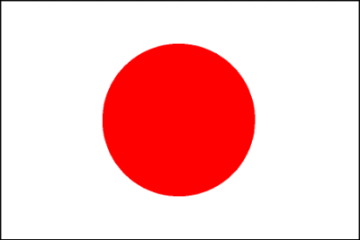
Japan
Tsukuba University
PCs widely available, uni PC labs
Some classroom tech available, some recent, some “not quite the latest”
Not all classrooms
Cell phones: 100% of uni students

Slide 8
Thus, we decided to ask about…
Competence with technology
Anxiety about technology
Actual use of technology (preference for paper vs. tech)
How WUT depends on the three points above
Where tech skills learned
Prospect of mobile tech supplanting or supplementing “land-line” tech

Slide 9
Today’s Talk
Background
The Three Venues
Methodology
Results
Q & A

Slide 10
Research Questions
How does the WUT instrument perform in these contexts?
How does technological competence influence WUT?
How do tech competence and perceived usefulness influence WUT?
Will participants prefer “land-line” computers or mobile devices for various tasks?
How do tech factors influence WUT?

Slide 11
Method Participants
University EFL students
Convenience sampling
n = 328 in Japan
n = 132 in Cambodia
n = 170 in Malaysia
N = 630 (total)

Slide 12
Method Instrument
Questionnaire & demographic information
52 Likert-scale items based on MacLean & Elwood (2009)
Percentages for some items
For remaining items, 5-point semantic-differentiation scale anchored by “strongly disagree” (1) and “strongly agree” (5) ➔ 3.00 = neutral midpoint

Slide 13
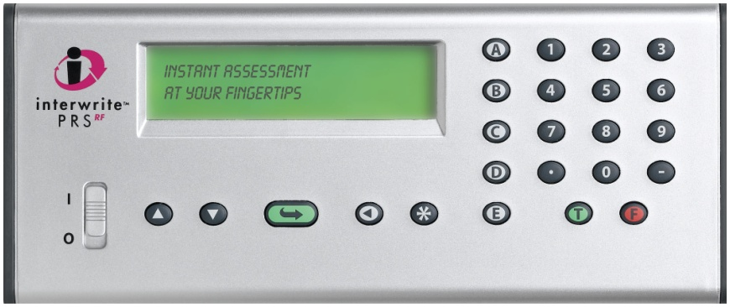
Method Procedure
Questionnaire
Malaysia and Cambodia data collected with paper
Japan data collected with “clickers” (personal response systems)

Slide 14
Data Analyses
WUT construct using Rasch analysis
Descriptive statistics
T-tests (corrected) for group differences
ANOVA for larger research questions
In today’s presentation, we’ll be looking at descriptive stats and t-tests ☺

Slide 15
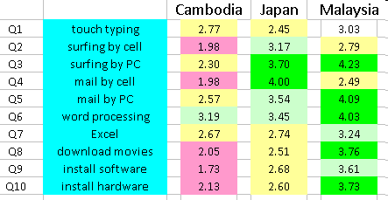
Results 1 Perceived Technological Competence
Subscale reliabilities adequate
Neutral midpoint = 3.00

Slide 16
Results 1 Perceived Technological Competence
Lower in Cambodia
Basic skills in Japan
Broader skills in Malaysia

Slide 17
Results 1 Perceived Technological Competence
Not skilled typists
Mail by cell (Q4) in Japan

Slide 18
Results (2) Anxiety
Very limited anxiety using tech in all three countries
“test-taking anxiety” slightly higher, but may be mix of technology anxiety and test anxiety

Slide 19
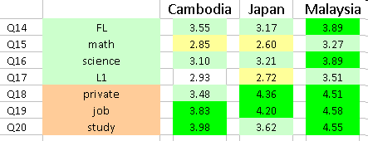
Results (3a) Perceived Usefulness
In Cambodia, foreign language (FL) highest of four school subjects
Same in Malaysia (tied) → good news for language ed
In general, ICT perceived as useful
Note differing perceptions re future use in Cambodia and Japan

Slide 20
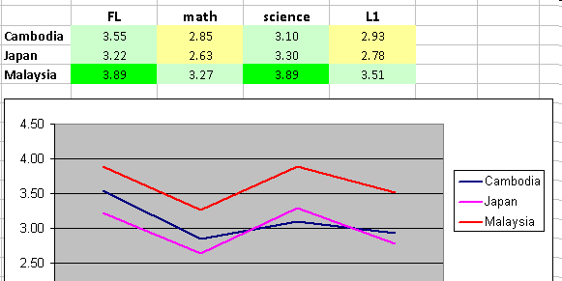
Results (3b) Perceived Usefulness
Re school subjects (rotated 90)
Consistent zig-zag pattern
Perceived as more useful for FL and science

Slide 21
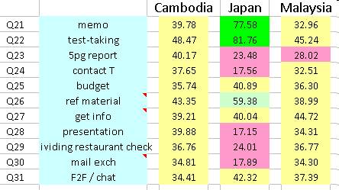
Results (4) Willingness to Use Technology (WUT)
Willingness to Use Technology
when faced with a task, the preference for using technology vs. a traditional medium (e.g., paper) when both are available
Cambodia: prefer tech
Japan: mixed (paper for tests, memos, ref material)
Malaysia: prefer tech

Slide 22
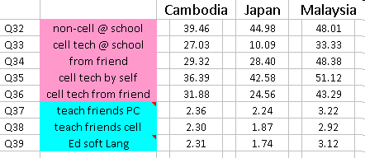
Results (5) Learned where?
At school, more PC skills (Q32) learned than mobile (Q33)
Not much peer learning
Ed software little used in Cambodia and Japan for language learning

Slide 23
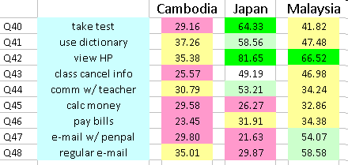
Results (6) Preference for PC vs. mobile
Cambodia: preference for mobile on all items
Japan: PC preference on 4 of upper 5 items
Malaysia: mobile for 6 items, PC for 3 items

Slide 24
The Larger Picture (1)
Tech preferred across the board in Cambodia ➔ fertile ground for implementing ICT
Trends in Japan similar to earlier study
Strikingly similar pattern re perceived usefulness
Limited ICT proficiency mediates (hinders?) effective implementation in educational settings ➔ limit to how much we can ask Ss to do
Limits on institutional support for ICT (e.g., funding)

Slide 25
The Larger Picture (2)
Speaking of a yellow wood…
“What is the question for which this is the solution?” (Sanders, 2007)
➔ Instead of cool bells and whistles, perhaps we need simpler solutions depending on the context
➔ THUS… mobile, wireless ed initiatives

Slide 26
The Larger Picture (2)
Obviously silly conclusion with absolutely no “bear”ing on reality…
George, where the salmon? Here, salmon, salmon, salmon…

Slide 27
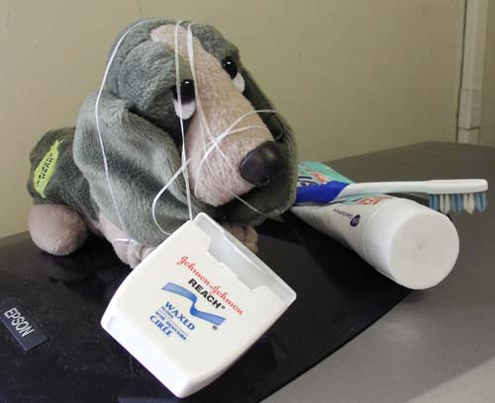
We’d be happy to entertain any questions at this time!
(sorry if we’ve tied you in knots)

Slide 28
Thank you for your kind attention.

