Slide 1

Bridge Types
[your name here]
Aoyama Gakuin University
English II - C
November 12, 2018

Slide 2
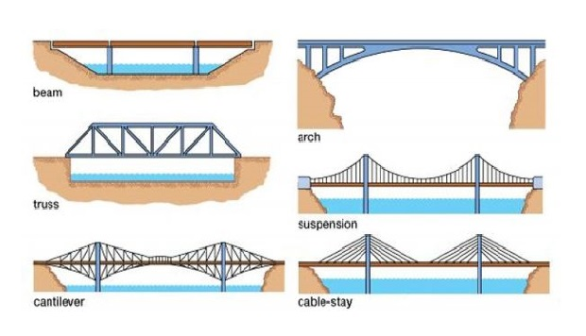
Today’s Talk
Parameters on Bridge Types
Six Bridge Types
Examples of Six Types
Q & A

Slide 3
Parameters
Intended Use (the Obstacle)
Length
Materials
Environmental Factors

Slide 4
Parameters: Type of Obstacle
River
Valley, gorge
Highway

Slide 5
Parameters: Size
Length
Height

Slide 6
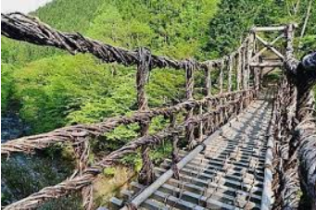
Parameters: Materials
Concrete
Steel
Wood
Masonry (stone, brick)
Other!

Slide 7
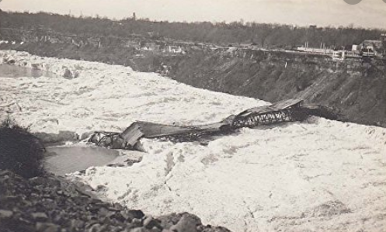
Parameters: Environment
Wind (Tacoma Narrows Bridge, Washington, USA)
Water current
Natural disasters (e.g., earthquakes, typhoons)
Ice (Niagara Falls Honeymoon Bridge – below)

Slide 8
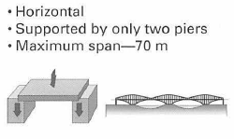

Beam Bridges

Slide 9
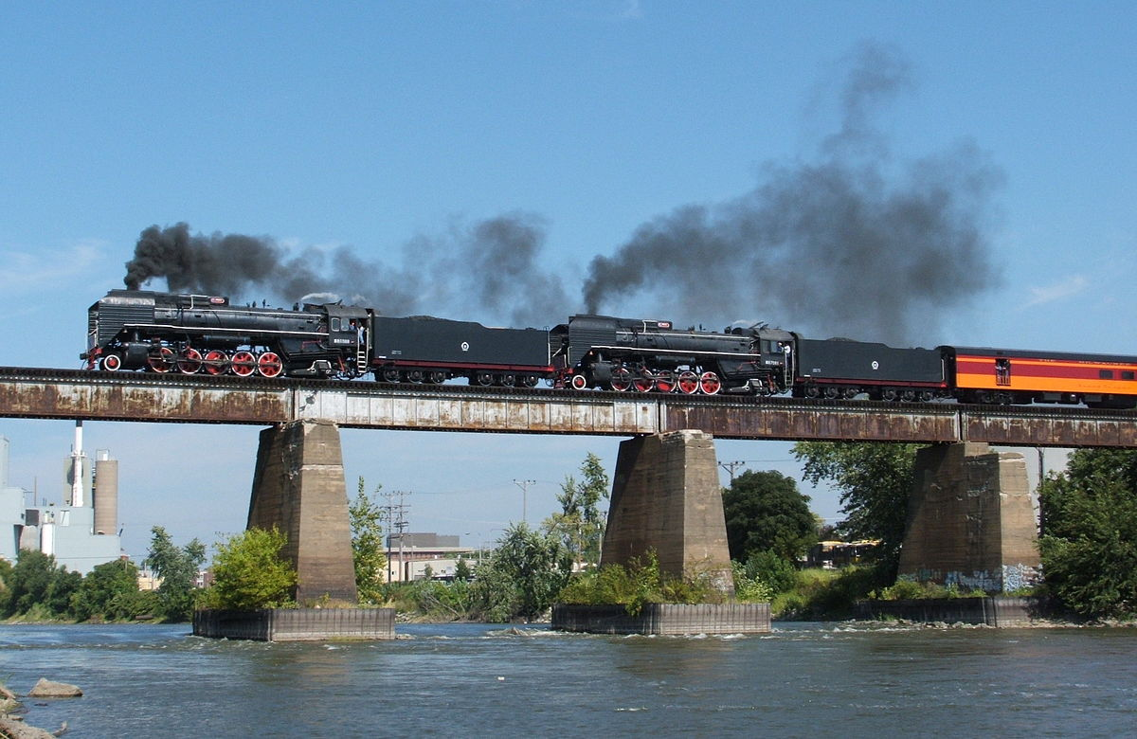
Beam Bridges

Slide 10

Truss Bridges
Horizontal
Support from triangles
Limited length
Common on railroads in Japan

Slide 11
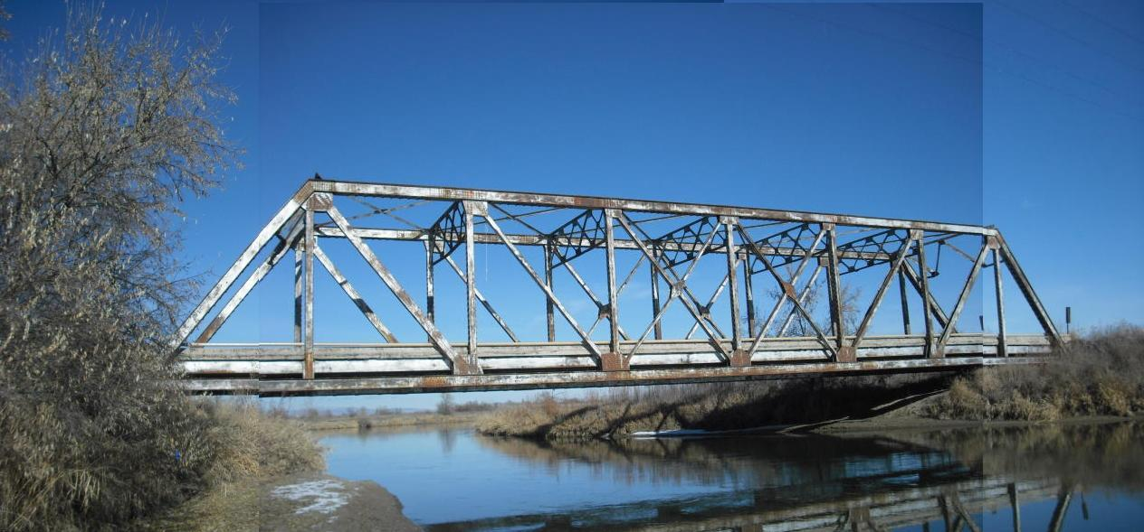
Truss Bridges

Slide 12
Cantilever Bridges
Horizontal
Support from complex series of triangles, both
above and below deck
Often quite long
Quite expensive to construct

Slide 13
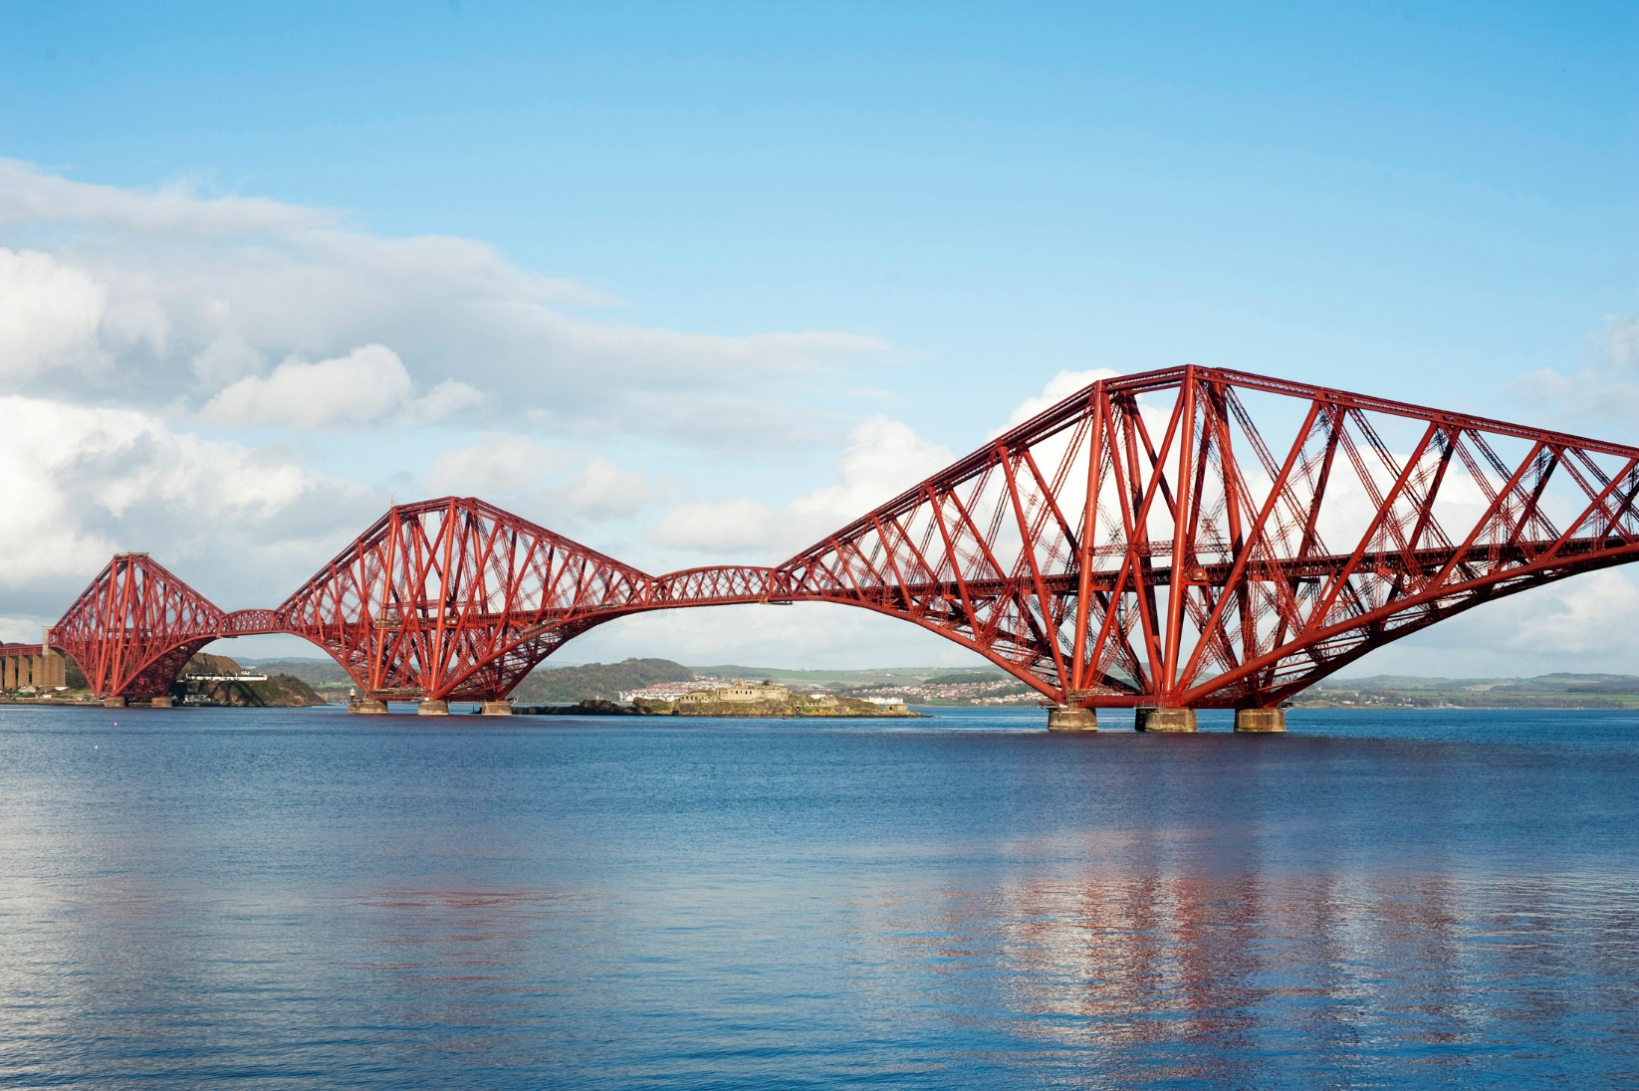
Cantilever Bridges

Slide 14

Cantilever Bridges

Slide 15
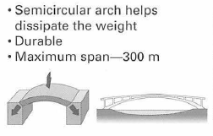
Arch Bridges

Slide 16
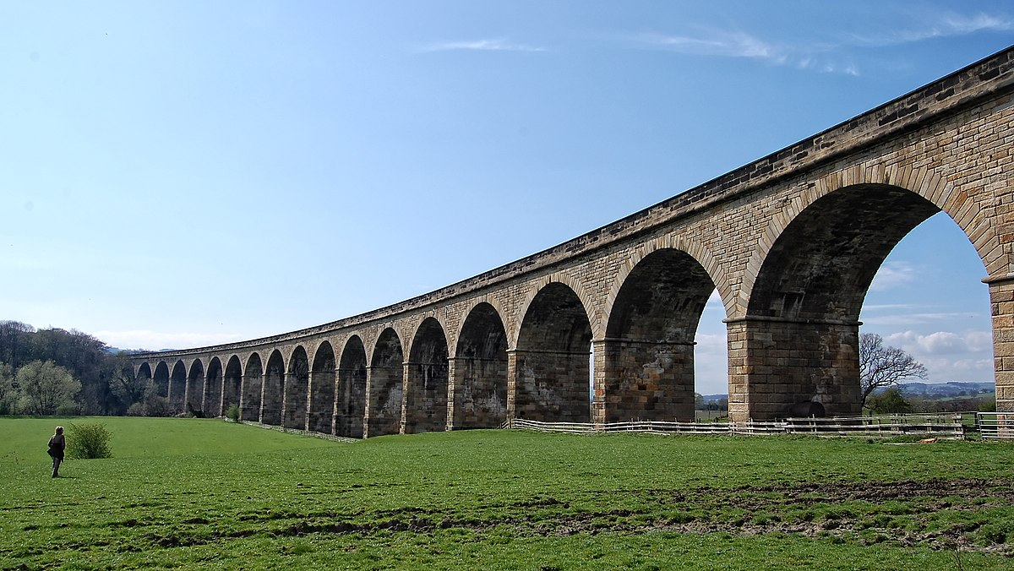
Arch Bridges: Viaducts
Arthington Viaduct in England

Slide 17
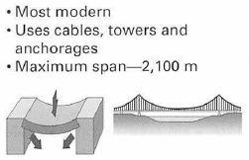
Suspension Bridges

Slide 18

Suspension Bridges

Slide 19
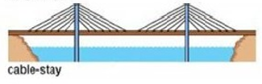
Cable-Stay Bridges
Horizontal deck
Tower(s)
Deck suspended via cables from tower(s)

Slide 20
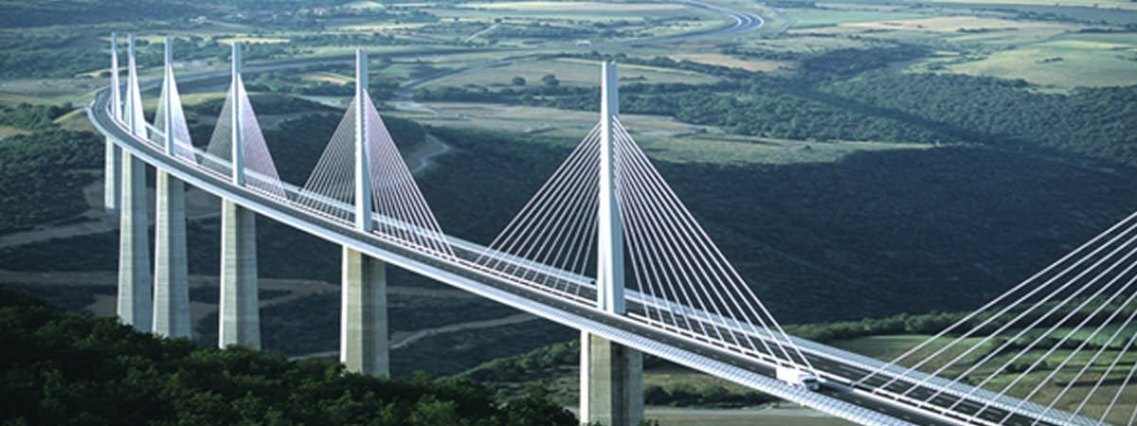
Combination Bridges

Slide 21
Q & A
Do you have any questions?

Slide 22
Thank you for
your kind attention

Slide 23
References
Ochsendorf, J. A., & Billington, D. P. (1999). Self-anchored suspension bridges. Journal of Bridge Engineering, 4(3). DOI: 10.1061/(ASCE)1084-0702(1999)4:3(151)
Truss bridges. (n.d.). Retrieved October 21, 2018, from https://ojhsbridges.weebly.com/truss-bridges.html
Types of bridges. (2019). Retrieved October 21, 2018, from http://www.historyofbridges.com/facts-about-bridges/types-of-bridges/

