Slide 1

The Nuts and Bolts of Willingness to Use Technology
James A. Elwood & George R. MacLean
Meiji University
JALT-CALL, Kyōto Sangyō University
May 30, 2010
Notes:
Room 10405, 10:20 to 11:00

Slide 2
Today’s Talk
What is WUT?
Study venues
Dimensionality
Invariance
Q & A

Slide 3
What is WUT?

Slide 4
What is WUT?
Willingness to Use Technology = “a person’s willingness to make use of technology when given the choice of a technological medium and a non-technological medium”
(MacLean & Elwood, 2009, p. 160)
Of course , this parallels WTC

Slide 5
What is WUT?
Imagine a writing student needing to hand in a paper… given equal access to each medium, would the student choose a technology medium (e.g., an e-mail attachment) or a non-tech medium (a printout)?
Notes:
Here add pics of USB, e-mail, and paper copy

Slide 6
What is WUT?
A recent example … last week I collected writing homework from 81 students. The homework could be
handwritten or done on a computer (class is in a computer classroom), and
handed in in any of four different ways…
Notes:
Here add pics of USB, e-mail, and paper copy

Slide 7
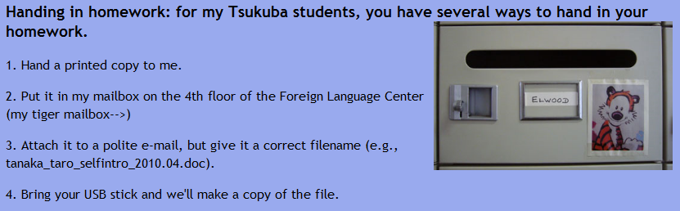
What is WUT?
The four options:
Notes:
Here add pics of USB, e-mail, and paper copy

Slide 8
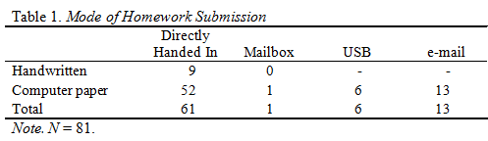
What is WUT?
What did my victims hand in?
Paper = 76.5%, tech = 23.5%
Notes:
Here add pics of USB, e-mail, and paper copy

Slide 9
What is WUT?
The WUT instrument is a series of questions asking about preference for using tech or using non-tech means for 11 tasks. Those 11 tasks are:
Notes:
Here add pics of USB, e-mail, and paper copy

Slide 10
What is WUT?
Writing a memo
Taking a test
Writing a 5-page report
Contacting one’s teacher
Doing a budget
Viewing reference material
Notes:
Here add pics of USB, e-mail, and paper copy

Slide 11
What is WUT?
Getting class info
Doing a presentation
Dividing a restaurant check
Exchanging mail
Chatting (F2F vs. Internet chat)
Notes:
Here add pics of USB, e-mail, and paper copy

Slide 12
What is WUT?
Finally, the scale used?
A percentage scale, on which respondents indicated the % of the time they would choose non-tech means
Notes:
Here add pics of USB, e-mail, and paper copy

Slide 13
Venues

Slide 14
The Respondents
Five groups of university students:
Cambodia, 2008 (n = 131)
Malaysia, 2008 (n = 170)
Japan, 2008 (n = 327)
Japan, 2009 (June, n = 530)*
Japan, 2010 (February, n = 405)*
Notes:
Here add pics of USB, e-mail, and paper copy

Slide 15
Our Purpose
Today we’ll look at four issues:
Dimensionality of the WUT in these contexts,
Performance of individual items,
Invariance of WUT over time, and
Invariance of WUT over groups.
Notes:
Here add pics of USB, e-mail, and paper copy

Slide 16
Analysis Tools
Exploratory factor analysis using SPSS
Rasch analysis using WINSTEPS
Structural equation modeling using EQS
Notes:
Here add pics of USB, e-mail, and paper copy

Slide 17
1. Factor Analysis
PASW 18 (nee SPSS)
Data screened for outliers, etc.
Orthogonal, then oblique rotation
Usual decision process about the # of components (Scree plot, eigenvalues)
Notes:
Here add pics of USB, e-mail, and paper copy

Slide 18
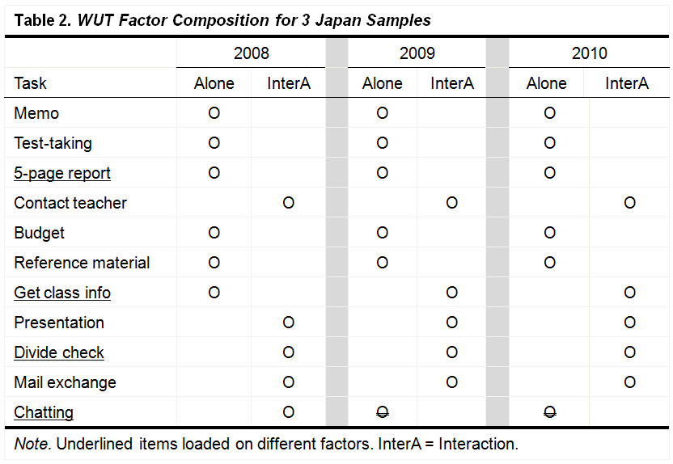
1. Factor Analysis
Notes:
Note overall similarity, comment on differences, focus on general pattern in spite of context differences

Slide 19
2. Rasch Analysis
WINSTEPS (Linacre, 2006)
Conversion to interval scale
1. Check disattenuated correlation
2. PCA of residuals, then check size & composition of “first construct”
3. Greater than certain size ➔ multiple dimensions
Notes:
Here add pics of USB, e-mail, and paper copy

Slide 20
2. Rasch Analysis
Dimensionality Results:
Cambodia—same as SPSS results
Malaysia—same as SPSS results
Japan, 2008—same as SPSS results
Japan, 2009—same as SPSS results
Japan, 2010—same as SPSS results
Notes:
Here add pics of USB, e-mail, and paper copy

Slide 21
2. Rasch Analysis
Item Behavior:
Cambodia—fit statistics adequate
Malaysia—fit statistics adequate
Japan, 2008—fit statistics adequate
Japan, 2009—10 items fine, “chatting” slightly misfitting
Japan, 2009—10 items fine, “chatting” slightly misfitting
Notes:
Here add pics of USB, e-mail, and paper copy

Slide 22
3. Structural Equation Modeling (SEM)
Conducted using EQS 6.1 (Bentler, 2007)
Two phases:
Confirmatory factor analysis to investigate dimensionality
Structural equation modeling to investigate invariance
Notes:
Here add pics of USB, e-mail, and paper copy

Slide 23
3. SEM
Usual list of data assumptions
Based on a priori hypothesis, thus CFA
In general, looking at fit of model to data
Standards for comparison are usually χ² and various fit indices
Notes:
Here spell out explanation of why chi-square should be non-significant

Slide 24
3. SEM
Confirmatory Factor Analysis
For example, the Japan-2009 analysis
Hypothesized configuration from SPSS results
Two components:
  “Alone / asynchronous”
  “Interactive / synchronous”
The hypothesized model looked like this…
Notes:
Here add pics of USB, e-mail, and paper copy

Slide 25
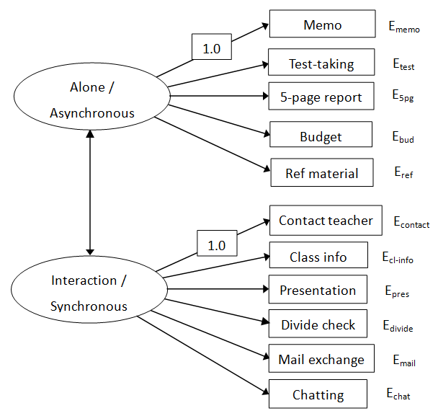
3. SEM
Confirmatory Factor Analysis
Notes:
Here add pics of USB, e-mail, and paper copy

Slide 26
3. SEM
Confirmatory Factor Analysis
Notice the error terms…
Mainly interested
in paths (arrows)
Notes:
Here add pics of USB, e-mail, and paper copy

Slide 27
3. SEM
Confirmatory Factor Analysis
The initial Japan-2009 model had poor fit
Model fit statistics
χ² = 165.002, p < .01
CFI = .758
IFI = .763
SRMR = .068
RMSEA = .072
Conf Int = .060-.084
Benchmarks
n.s. result good, but…
> .90 good, > .95 superior
> .90 good, > .95 superior
~< .05 good
< . 08 adequate, < .06 good
small ➔ good accuracy
Notes:
SRMR = standardized root mean residual, RMSEA = residual mean squared error of approximation

Slide 28
3. SEM
Confirmatory Factor Analysis
Japan-2009 initial results
Model had adequate fit
Possible modifications from Lagrange multiplier test…
Changes:
Added one error covariance (memo-test),
changed one path (“report” from “Interaction” to “Alone”)
deleted one non-significant path (chatting - interaction)…
Notes:
Here add pics of USB, e-mail, and paper copy

Slide 29
3. SEM
Confirmatory Factor Analysis
Notes:
Here add pics of USB, e-mail, and paper copy

Slide 30
3. SEM
Confirmatory Factor Analysis
Thus, revised Japan-2009 model had good fit
Initial
165.002
.758
.763
.068
.072
.060-
.084
Model fit statistics
χ² = 64.212, p < .01
CFI = .933
IFI = .934
SRMR = .047
RMSEA = .042
Conf Interval = .027-.058
Benchmarks
n.s. result good, but…
> .90 good, > .95 superior
> .90 good, > .95 superior
~< .05 good
< . 08 adequate, < .06 good
small ➔ good accuracy
Notes:
SRMR = standardized root mean residual, RMSEA = residual mean squared error of approximation

Slide 31
3. SEM
Confirmatory Factor Analysis
Cambodia
Added one error covariance
Moderate fit ☺
Malaysia
Added three error covariances
Moderate fit ☺
Notes:
Here add pics of USB, e-mail, and paper copy

Slide 32
3. SEM
Confirmatory Factor Analysis
Japan-2008
Added one error covariance
Rather poor fit ☹
Japan-2010
Added one error covariance, deleted “chatting” path
Adequate fit ☺
Notes:
Here add pics of USB, e-mail, and paper copy

Slide 33
Invariant across time?
Basically test-retest with Japan-2009 and Japan-2010 (same students)
Test two adequate models simultaneously with full structural equation modeling…
…so check for
1. overall model fit, then
2. paths that are NOT invariant (i.e., ARE variant)

Slide 34
3. SEM
Full Structural Equation Modeling
Results… very good fit, just one non-invariant path (Item 8, presentations … )
Thus…
WUT was nearly invariant over time although average weekly computer time had increased by nearly 3 hours (11.21 hours → 14.08 hours)
Notes:
Here add pics of USB, e-mail, and paper copy

Slide 35
Invariant over groups?
Japan-2008 and Japan-2009 (different students in very similar contexts)
Test two adequate models simultaneously with full structural equation modeling…
…so check for
1. overall model fit, then
2. paths that are NOT invariant (i.e., ARE variant)

Slide 36
3. SEM
Full Structural Equation Modeling
Results:
Somewhat poor fit, but not horrendous (recall Japan-2008 had poor fit)
Just one non-invariant path (Item 2, test-taking)
Thus…WUT was nearly invariant over (similar contexts) although fit was rather poor
Notes:
Here add pics of USB, e-mail, and paper copy

Slide 37
Conclusions
Today we’ll look at four issues:
Dimensionality of the WUT in these contexts?
Performance of individual items,
Invariance of WUT over time, and
Invariance of WUT over groups.
Notes:
Here add pics of USB, e-mail, and paper copy

Slide 38
Conclusions
Today we’ll look at four issues:
Dimensionality of the WUT in these contexts?
Performance of individual items,
Invariance of WUT over time, and
Invariance of WUT over groups.
Notes:
Here add pics of USB, e-mail, and paper copy

Slide 39
Conclusions
1. Dimensionality of the WUT in these contexts?
Two dimensions, similar but not identical
“Alone / asynchronous” vs. “Interactive / synchronous”
Notes:
Here add pics of USB, e-mail, and paper copy

Slide 40
Conclusions
2. Performance of individual items?
Item fit statistics adequate except for “Chatting” in two data sets
This difference appeared in the SPSS and EQS results
Notes:
Here add pics of USB, e-mail, and paper copy

Slide 41
Conclusions
3. Invariance of WUT over time, and
4. Invariance of WUT over groups
Mostly invariant over time
Also mostly invariant for groups from similar contexts
Notes:
Here add pics of USB, e-mail, and paper copy

Slide 42
Conclusions
Thus, convergent results from 3 types of analysis point to psychometric soundness of the WUT instrument.
Notes:
Here add pics of USB, e-mail, and paper copy

Slide 43
Questions?
Notes:
Here add pics of USB, e-mail, and paper copy

Slide 44
Thank you for your kind attention.
Notes:
Here add pics of USB, e-mail, and paper copy

Slide 45
References
Bentler, P. (2007). EQS [Computer software]. Encino, CA: Multivariate Software, Inc.
Linacre, M. (2007). Winsteps [Computer software].
Notes:
Here add pics of USB, e-mail, and paper copy

Slide 46
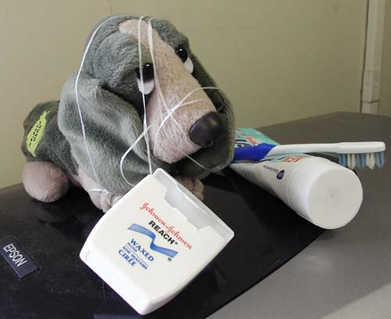
Questions?
(sorry if we’ve tied you in knots)
Notes:
Here add pics of USB, e-mail, and paper copy

