Slide 1
PAAL 2015 Conference
Korea University
Seoul, Korea
December 5, 2015
Social Learning
Leveraging
SNS
the Power of
Language Learning
in
Kiyomi Fujii, James Elwood, Yasuo Uotate,
Yuka Matsuhashi, Brent Wright, Barron Orr

Slide 2


3-year Project
To stimulate students beyond classroom learning to informal learning outside the classroom
Notes:
This research explores a language exchange activity between university EFL (English as a foreign language) students in Japan and JFL (Japanese as a foreign language) students in the U.S.. The project aims to stimulate students beyond active classroom learning to informal learning outside the classroom.
Let me ask you a question. How many of you studied a second language? How many times a week did your class meet?

Slide 3

1/week vs. 3-5/week
Notes:
Even 3-5 times a week in the classroom is not enough for language learning. Therefore, we would need additional activities.

Slide 4

Required vs. Elective
Study English!

Slide 5
Technology & Language Learning
Technology opens a new spectrum of possibilities in language learning (Fukai, Nazikian, & Sato, 2008; Jauregi & Canto, 2012)
Positive effects on the development of language skills (Fujii, Elwood, & Orr, 2010; Hirotani & Lyddon, 2013)

Slide 6




3-year Project
To stimulate students beyond classroom learning to informal learning outside the classroom.
Notes:
To this end, the authors developed an approach to encourage informal language learning through the use of online platforms that facilitate social networking, which creates learning community.

Slide 7





Slide 8

Post Project Reflection
Wanted to choose own topics
More posts (weekly)
Wanted to interact more
but format was constraining
  (Facebook or Skype)
Notes:
We analyzed data, data were collected through set of questionnaires and interviews for recruited students. The result didn’t show significant differences between pre and post project questionnaires. With this questionnaire we aimed to measure students’ motivation, cultural competence, willingness to communicate outside of activity. Also, Although we received positive comments, we also received comments such as Wanted to interact more but format was constraining
(Suggested Facebook or Skype)
− Wanted to choose own topics
− More posts (weekly)

Slide 9
Self-introduction
My university
School life
Post anything you like
Notes:
Japanese students created a video and posted in English on their facebook page and commented in Japanese to American students’ facebook.

Slide 10
Participants
Kanazawa Institute of Technology
79 English learners
(intermediate)
University of Florida
52 Japanese learners
(27 intermediate 25 advanced)
Notes:
Japanese students created a video and posted in English on their facebook page and commented in Japanese to American students’ facebook.

Slide 11
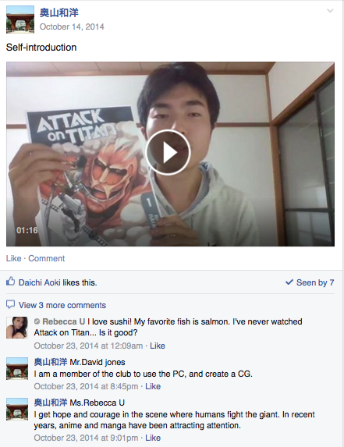
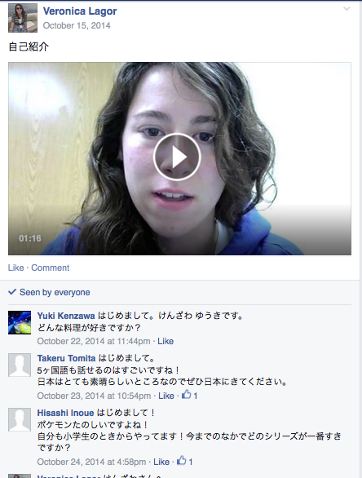
Two types of private pages
English page group 1
Japanese page group 1
Notes:
In the project, we prepared two types of private pages on Facebooks. a page where students spoke only in English and a page where they spoke only in Japanese.

Slide 12
  English page
    Group A
    Group B
    Group C
    Group D
  Japanese page
    Group A
    Group B
    Group C
    Group D
interaction
interaction
interaction
interaction
Notes:
The students at each institution were divided into four groups and there were four Japanese pages and four English pages in total.

Slide 13
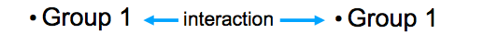
English page group 1
Japanese page group 1
Notes:
The students who were in Group 1 shared Japanese Group 1 page and English Group 1 page,, each group had two private pages: Japanese and English pages. The group members consisting of the two schools shared the pages and had interaction within a group.

Slide 14
Facebook Video

Slide 15
Timeline & Instruments
Pre-project phase
  Questionnaire 1 (October, 2014)
Project phase (October-December)
Post-project phase
  Questionnaire 2 (February, 2015)
  Reflection Log (February, 2015)
  Questionnaire 3 (April, 2015)
Notes:
The project was completed at the end of the semester and, while we are still analyzing the data listed on the previous slide, in this presentation, we will focus on the analysis of the pre and post-project questionnaire data, specifically on the statistical comparison between _______ and ______.
Each questionnaire consists of five sections, Motivation, International posture, Cultural competence, L2 willing to communicate, and Willingness to use technology

Slide 16
Questionnaire
1. disagree
5. agree
Section 1
Q12. After I graduate from college, I will continue to study English/Japanese and try to improve.
Motivation
Section 2
International posture
Q1. I want to make friends with international students studying in the US/Japan.

Slide 17
Section 3
Cultural Competence
Q1. I can name three things that an American/Japanese college student might do for fun.
1. disagree
5. agree

Slide 18
0%
100%
Section 4
L2 Willingness to communicate
Q 8. Talk in a small group of strangers.
Q19. Talk in a small group of friends.
Willingness to use technology
Q7. Looking at class materials (e.g., paper handouts vs. webpage)
Section 5

Slide 19
Ratio of Variables
with Positive Slope over Length of Study
(Facebook)
 | Motivation | I-Posture | WTC | WUT | Cultural C
Treatment | 11/12 | 18/26 | 20/24 | 4/11 | 22/26
Control | 1/12 | 5/26 | 3/24 | 2/11 | 5/26

Slide 20
Means of Scales at Three Data Collection Times
(Facebook, 2014-2015)
Treatment (n) | Willingness To Communicate | Willingness to use Technology
September (131) | 44.48 | 38.83
January (123) | 48.24 | 40.50
April (49) | 55.38 | 42.80
Control (n) | Willingness To Communicate | Willingness to use Technology
September (24) | 37.17 | 38.33
January (21) | 29.65 | 40.89
April (8) | 36.09 | 37.56

Slide 21
Means of Scales at Three Data Collection Time
(Facebook, 2014-2015)
Treatment (n) | Motivation | I-Posture | Cultural C
September (131) | 3.07 | 3.00 | 2.52
January (123) | 3.38 | 3.17 | 2.99
April (49) | 3.61 | 3.23 | 3.25
Control (n) | Motivation | I-Posture | Cultural C
September (24) | 2.40 | 2.74 | 1.77
January (21) | 2.72 | 2.89 | 2.22
April (8) | 2.52 | 2.77 | 2.06

Slide 22
Reflection Logs
(70 respondents)
How was it and why? Good points
Exchange / Learn about U.S. – 50 responses
I was able to learn a variety of things about American university students.
Opportunity to use English – 7
I made an effort to proactively speak English.
I could interact with people I wouldn’t normally be able to interact with.
Notes:
– アメリカの大学生の様々なことについて
知ることができた
自分から英語を話そうと努力した
普段会えない人と交流できた

Slide 23
Reflection Logs
(70 respondents)
How was it and why? Difficult points
Language related – 24 responses
I didn’t know how to write comments in English.
Video related – 23
Theme / Content – 6
Notes:
英語でどうコメントしたらいいかわからなかった。
同じ学年でグループを作成したらいいかと思う。
個人の親しい人としかFacebookを使わない
ようにしていたのでグループで引き合わされる
ことに大きなストレスを感じた。

Slide 24
Reflection Logs
(70 respondents)
How was it and why? Difficult points
Group work – 6
It would be better to have groups of students
in the same school year.
Facebook – 5
I only wanted to use Facebook with close friends
so it was a big stress to have to be in the same
(private) group.
Notes:
英語でどうコメントしたらいいかわからなかった。
同じ学年でグループを作成したらいいかと思う。
個人の親しい人としかFacebookを使わない
ようにしていたのでグループで引き合わされる
ことに大きなストレスを感じた。

Slide 25
Results
Statistically significant increase in
  Motivation
  Willingness to Communicate
  Cultural Competence

Slide 26
Conclusion
Challenges encountered
  Group formation: teacher chooses
  Differing education systems cause some difficulty in coordinating international projects

Slide 27
Conclusion
Further study
  Examination of how their communication skills actually improved (use Facebook data)
  Corpus analysis of student output in an SNS environment utilizing both spoken and written data

Slide 28
Thank you for your kind attention today!
Notes:
Japanese students created a video and posted in English on their facebook page and commented in Japanese to American students’ facebook.

Slide 29
Acknowledgement
This work was supported by JSPS KAKENHI Grant Number. 25370656

