Slide 1
IPA (International Phonetic Alphabet)

Slide 2
First, a review…
“phonetic” means … sound
The basic idea is one symbol = one sound
IPA symbols are in slashes / … /

Slide 3
Today, the Japanese vowels
ア = / ɑ /
イ = / i /
ウ = / u /
エ = / ε /
オ = / o /

Slide 4
The vowel map…
First, imagine a person’s head

Slide 5
The vowel map…
Now imagine inside the mouth…

Slide 6
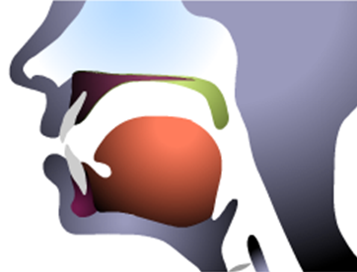
The vowel map…

Slide 7
The vowel map…
Now imagine a box…here…

Slide 8
The vowel map…

Slide 9
The vowel map…

Slide 10
The vowel map…
i
u
ε
o
ɑ

Slide 11
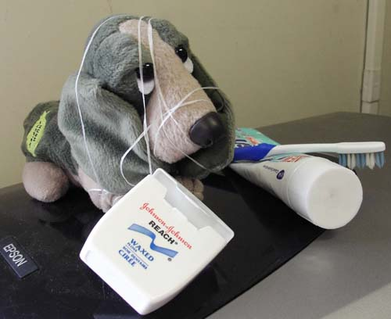
I’d be happy to entertain any questions at this time!
(sorry if I’ve tied you in knots)

