Slide 1
IPA (International Phonetic Alphabet)

Slide 2
First, an introduction…
“phonetic” means … sound
The basic idea is one symbol = one sound
IPA symbols are in slashes / … /

Slide 3
Places of Articulation
Articulation? How a word is said or pronounced …
First, imagine a person’s head…

Slide 4
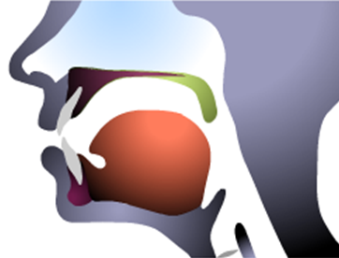
Your Mouth
Now imagine inside the mouth…

Slide 5
Place of Articulation Lips
lips → labi, labio

Slide 6
Place of Articulation Teeth
teeth → dental

Slide 7
Place of Articulation Alveolar Ridge
Alveolar ridge

Slide 8
Place of Articulation Velum (Soft Palate)
Velum

Slide 9
Today, the plosives (“stops”)
“explosive sounds”
short

Slide 10
Place of Articulation Lips
lips → labi, labio

Slide 11
Bilabial Plosives
voiceless bilabial stop
“bi” = 2 (bicycle, bilingual)
bilabial = two lips
voiced bilabial stop
p = / p / power, up, apple
Now add your voice …
b = / b / baseball, bag

Slide 12
Place of Articulation Alveolar Ridge
Alveolar ridge

Slide 13
Alveolar Plosives
voiceless alveolar plosive
alveolar ridge + tongue
t = / t / two, take
Now add your voice …
d = / d / dog, food
voiced alveolar plosive

Slide 14
Place of Articulation Velum (Soft Palate)
Velum

Slide 15
Velar Plosives
voiceless velar plosive
velum + tongue
k = / k / cake, cut, kangaroo
Now add your voice …
g = / g / golf, bag, gold, egg
voiced alveolar plosive

Slide 16
Thus, we have six plosives…
p = / p / power, up, apple
b = / b / baseball, bag
t = / t / two, take
d = / d / dog, food
k = / k / cake, cut, kangaroo
g = / g / good, go, golf

Slide 17
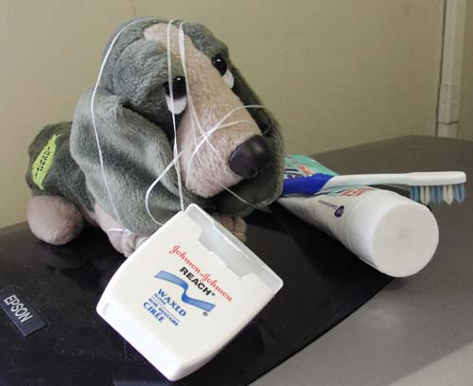
I’d be happy to entertain any questions at this time!
(sorry if I’ve tied you in knots)

