Slide 1
Water Pollution
Ayaka Ogawa Yuko Yamamoto ami Sugimoto
Toyo University
English Core II-C
January 7, 2019

Slide 2
Today’s talk
Cases and causes of water pollution
Harmful influences of water pollution
Measures against water pollution

Slide 3
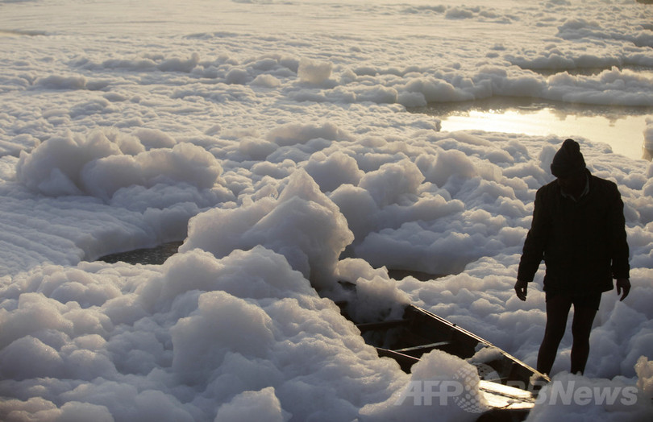
Case 1
Yamuna River (India)
Domestic wastewater
Industrial wastewater

Slide 4
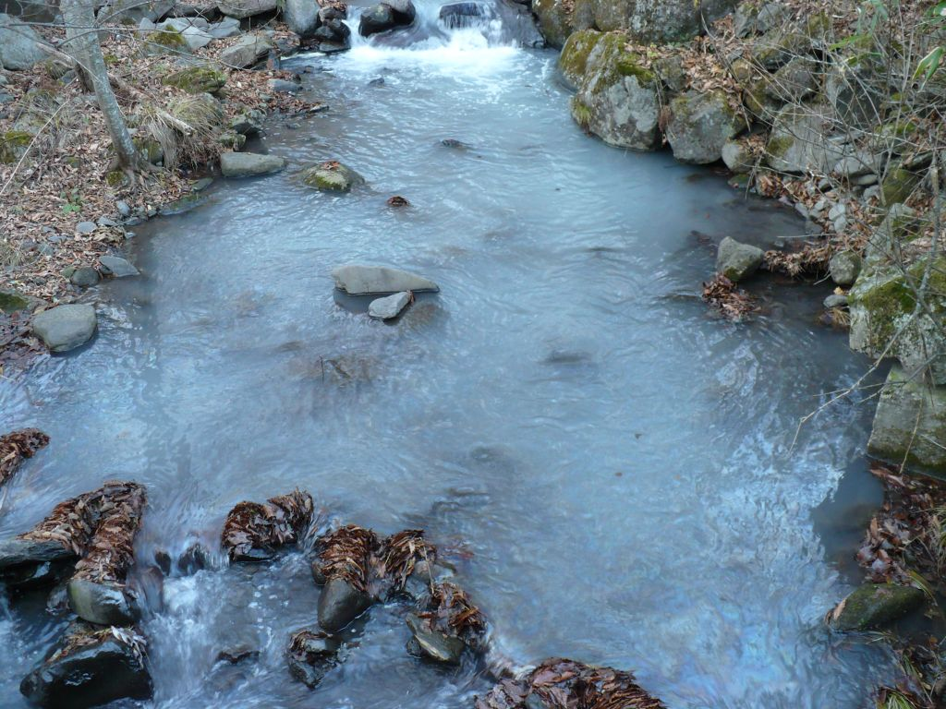
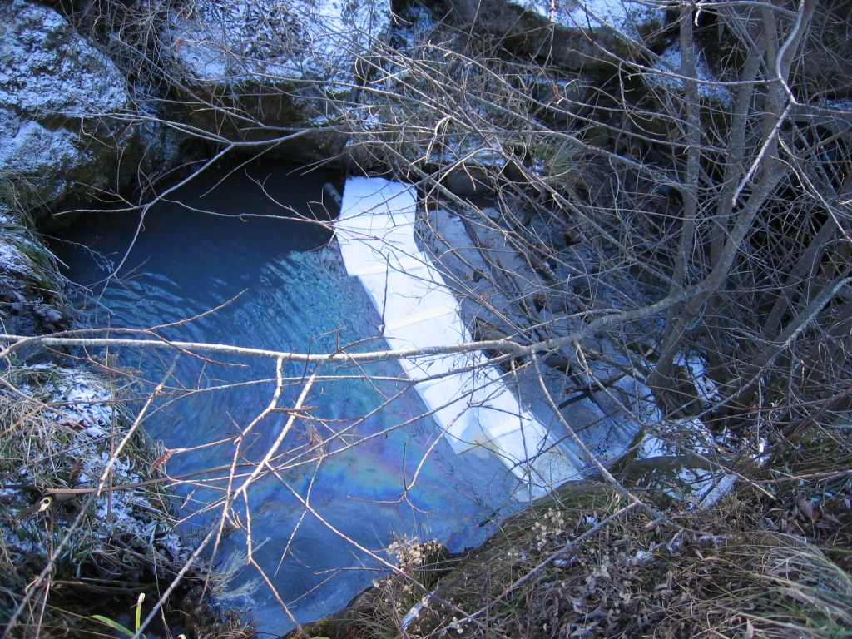
Case 2
Chikuma River (Japan)
Oil
Agricultural chemicals

Slide 5
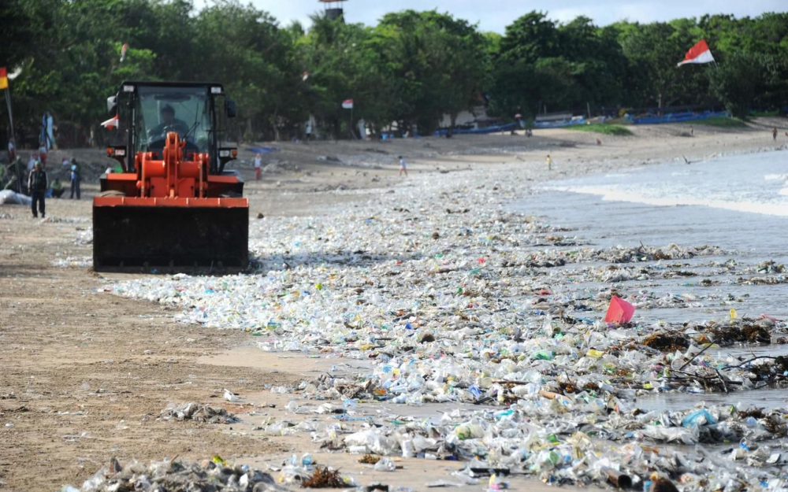
Case 3
Bali (Indonesia)
Washed up trash
Illegal dumping

Slide 6
Harmful influence
Pollution disease
Global warming
Offensive odor

Slide 7
Harmful influence
Itai-itai disease
Minamata disease
Pollution disease
Global warming
Offensive odor

Slide 8
Harmful influence
Pollution disease
Global warming
Offensive odor
Water pollution →
CO2

Slide 9
Harmful influence
Pollution disease
Global warming
Offensive odor

Slide 10
・measures

Slide 11
Sewerage treatment more thorough
Using by filtration and microorganism

Slide 12
Sewerage penetration
Japan is over 70%
Africa, southeast Asia, and south Asia are 50% or less
There are many cases where only the role of fulfillment or processing facilities is not performing

Slide 13
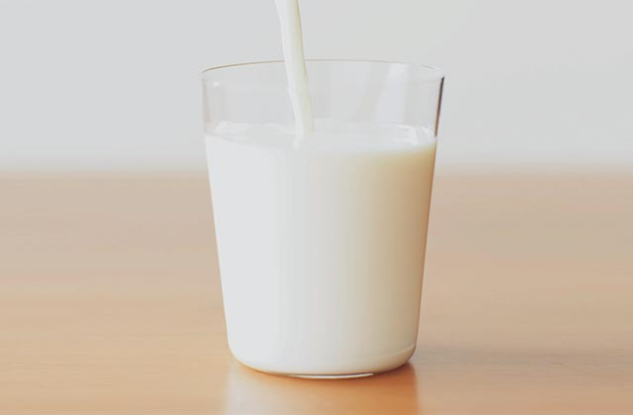
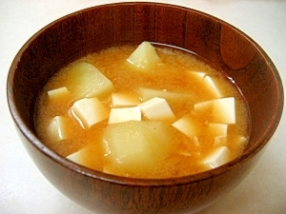
Tempura oil 20ml
Milk 200ml
Miso soup 180ml
20 cups
11 cups
4.7 cups

Slide 14
Not To leave food
To protect the necessary amount of things

Slide 15
Do you have any questions?

Slide 16
Thank you for listening

